Slide 1
2018 Survey Results

Slide 2
Sexual Harassment in the Legal Environment
The Association of Law Firm Administrators partnered with Mell Consulting, a law firm marketing and strategy consultant, to undertake this survey. The purpose of the survey is to collect data in order to evaluate whether sexual harassment is a widespread concern in our profession and, if so, how ALA can support members in addressing it and promoting a safe work environment for ALA members and their colleagues.
This survey was voluntary and anonymous. This is an opinion survey. This is not a scientific study, nor does it define or use technical or legal terms to define offenses. Some questions relate to the ALA member’s knowledge, while others relate to their own experience, sense of culture at their workplaces.
The survey was electronic and distributed by email. Respondents were asked to answer based on work environment/firm life prior to October 2017, when the story about Hollywood Producer Harvey Weinstein broke, even if their environment had changed in recent months in response to escalated public attention on this issue of harassment.

Slide 3
461 respondents participated in the survey. The survey was distributed to ALA members in the United States, who have identified their work place as a law firm. The survey was distributed in late February 2018 and open for 30 days.
Some points to keep in mind while reading this report:
  Respondents could skip any question they chose.
Comments following the multiple choice answers were not required.
Some participant comments have been deleted from this report.
Some comments in this report were edited for spelling, grammar or punctuation.
Comments that duplicated the multiple choice part of answer, e.g. “no” have been deleted from this report.
Comments that did not add substantive value, e.g. “Not at this firm,” or “See above” have been deleted from this report.
Highlight on chart = most popular answer to that question.

Slide 4
The Association of Law Firm Administrators serves 9,000 management professionals worldwide in law firms, legal departments, and other legal-related organizations. As the undisputed leader for the business of law, ALA is focused on the delivery of cutting-edge management and leadership products and services for the global legal community. We take pride in being a dynamic, member-driven organization. ALA is committed to an elevated standard of excellence as we serve individuals comprising the legal industry ― wherever that person works or whatever the role he or she holds.
For more about ALA Membership Demographics: Click Here
Mell Consulting is strategic management and marketing firm that serves a growing law firms and nonprofit legal service organizations. The Mell Consulting team has experience in law firms, legal departments, management consulting and other legal-related organizations. We have unique perspective on how professional services are bought, sold and delivered. We understand that smaller organizations often have limited means, and managing costs has never been a bigger priority.
For more about Mell Consulting, LLC: Click Here.
Organization Contacts
Association of Legal Administrators Teena Austin, Sr. Manager of Member Services 8700 W. Bryn Mawr Ave., Suite 110S Chicago, IL 60631 taustin@alanet.org 847.267.1382 | Mell Consulting, LLC Elizabeth L. Mell, Owner 1900 Market Street, 8th Fl. Philadelphia, PA 19103 elizabeth@mellconsulting.com 215.266.6501

Slide 5
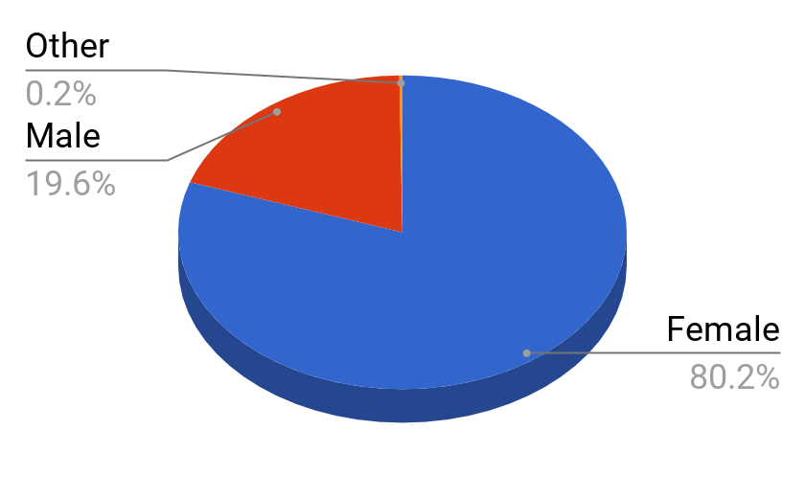
1. Gender Identification
Male | Female
19.6% | 80.2%

Slide 6
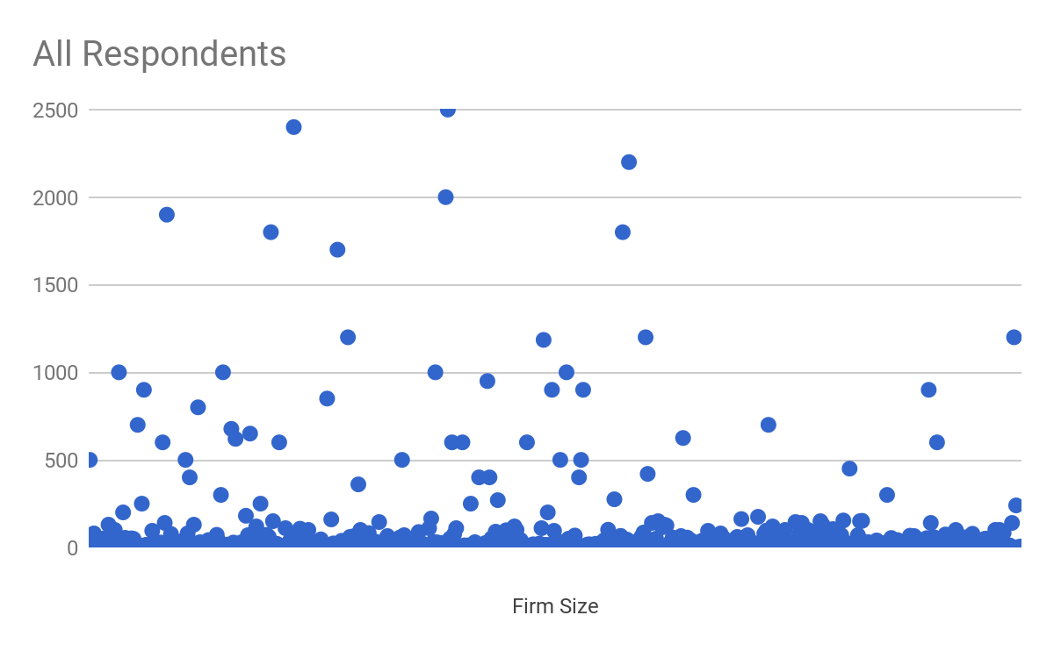
2. Number of lawyers at firm
Firm Size by # of Attorneys | Respondents
<10 | 12.82%
11-55 | 50.58%
56-100 | 15.15%
101-400 | 11.66%
>400 | 9.79%

Slide 7
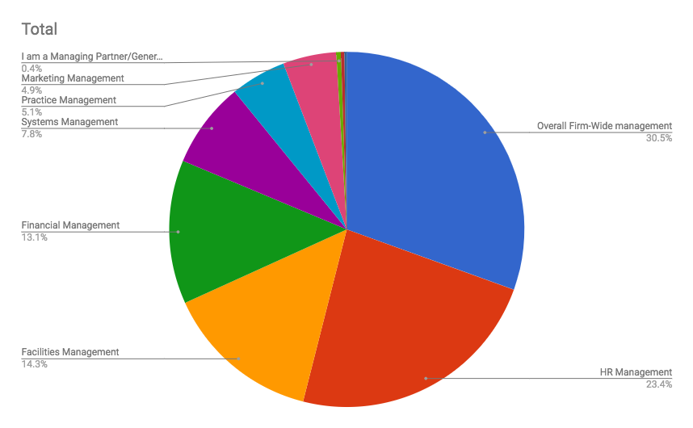
3. My responsibilities include: (Check all that apply.)
Responsibility | All Respondents | Male Respondents | Female Respondents
Overall Firm-Wide management | 30.52% | 35.26% | 29.33%
HR Management | 23.44% | 17.89% | 24.83%
Facilities Management | 14.26% | 12.63% | 14.66%
Financial Management | 13.09% | 14.74% | 12.68%
Systems Management | 7.81% | 7.89% | 7.79%
Practice Management | 5.07% | 4.21% | 5.28%
Marketing Management | 4.86% | 4.74% | 4.89%
Managing Partner/GC | 0.42% | 1.58% | 0.13%
Partner/Shareholder | 0.32% | 1.05% | 0.13%
Associate/Firm Attorney | 0.21% | 0.00% | 0.26%

Slide 8
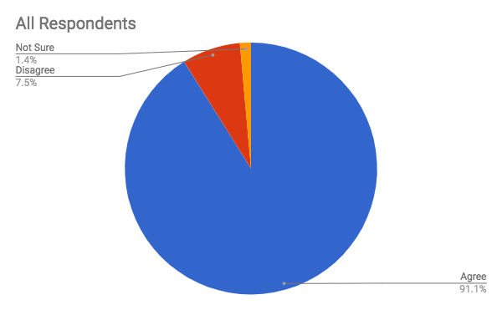
4. We have express written policies prohibiting sexual harassment.
Answer | All Respondents | Male Respondents | Female Respondents
Agree | 91.11% | 93.62% | 90.52%
Disagree | 7.47% | 4.26% | 8.23%
Not Sure | 1.41% | 2.13% | 1.25%

Slide 9
4. We have express written policies prohibiting sexual harassment.
Having a written policy is a legal requirement in Ontario
It is part of our Employee Handbook that all employees that must sign prior to starting work.
Nothing has been published during my time with firm, not sure if anything was published before I joined.
Policy prohibits unlawful harassment
We also conduct annual training sessions with everyone
We have a policy against harassment of any form, sexual or otherwise.
We plan to work on this in the future.

Slide 10
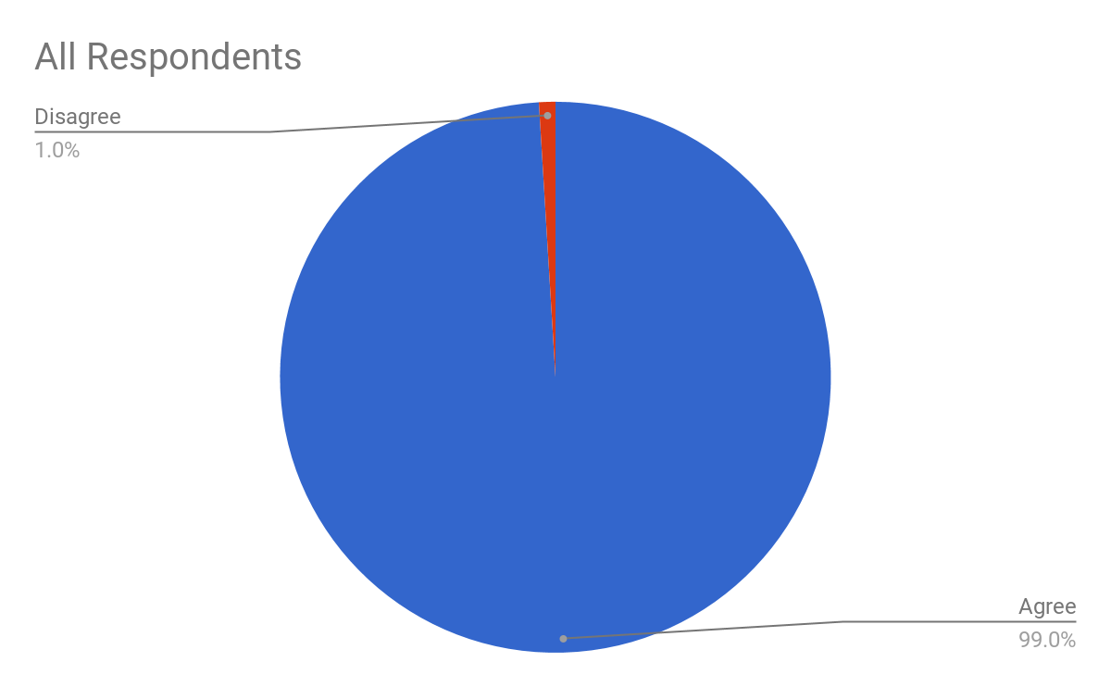
5. The policies apply across the board to lawyers, staff and all gender identities.
Answer | All Respondents | Male Respondents | Female Respondents
Agree | 99.04% | 97.65% | 99.40%
Disagree | 0.96% | 2.35% | 0.60%
Not Sure | 0.00% | 0.00% | 0.00%

Slide 11
5. The policies apply across the board to lawyers, staff and all gender identities.
And the infractions depend on who you are and who you are harassing
Lawyers and management obtain sexual harassment prevention training. Staff does not.

Slide 12
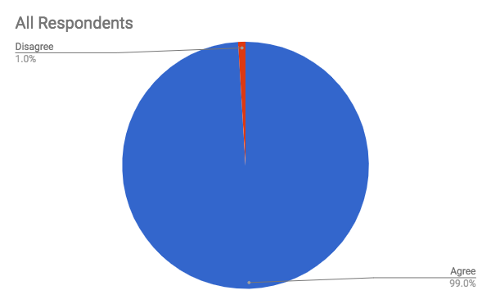
6. The term “harassment” is well defined in the policy.
Answer | All Respondents | Male Respondents | Female Respondents
Agree | 99.04% | 97.65% | 99.40%
Disagree | 0.96% | 2.35% | 0.60%
Not Sure | 0.00% | 0.00% | 0.00%

Slide 13
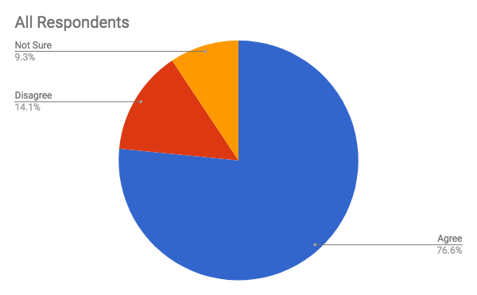
7. The policy is well communicated/explained.
Answer | All Respondents | Male Respondents | Female Respondents
Agree | 76.56% | 78.26% | 76.15%
Disagree | 14.11% | 8.70% | 15.38%
Not Sure | 9.34% | 13.04% | 8.46%

Slide 14
7. The policy is well communicated/explained.
Annual meetings for all firm members.
Annual training is required.
Currently working towards improving with more frequent training.
Employees sign off on it in the handbook, but it's not generally a discussion topic when onboarding or in any other capacity (unless we were to have the need to address it).
I need to do a meeting with everyone to go over the policy again. It has been a few years since that was done. I have only been here a year, so I think it's time.
I think we can do a better job, i.e. recirculating at least once a year and making it mandatory to read it.
I think we do a good job during orientation and onboarding, but we don't do annual reminders and probably should, for this and all policies. Some firms actually do an annual acknowledgment sign off for all policies - probably a good idea.
In the wake of the national attn. on this issue, I feel it needs to be re-communicated to ALL.
It is being reviewed again to be sure the policy is fully explained.
It is addressed upon review of the employee handbook.
It is beneficial to hold a "sex" talk annually for all supervisors. You can easily obtain CLE credit.
It is clearly stated; however, I feel like very few people go back and ever review their handbook and read policy.
It is communicated to new hires. We have never had a reminder of the policy.
It is given to new employees, but not re-addressed from time to time.
It is in the handbook; we have had one training session in the past 13 years.
It is in the manual, however do they read the manual....?
It is shown to new hires. There has not been regularly scheduled training.
It's part of EE handbook.

Slide 15
7. Continued -- The policy is well communicated/explained.
Nobody wants to talk about it.
Our policy is in our handbook which is lengthy and people probably don't really read. It really should be circulated separately and periodically.
Policy is communicated in the firm's policy manual
The handbook documents very well but we never do follow up and most employees have been here for a very very long time....decades…
The policies are given to everyone and communicated to each new employee. I believe everyone knows that we have a policy manual, but I doubt everyone understands every policy within even though they contain an appropriate level of information.
The policy is provided as a new hire, but rarely visited after that. If you are a long-tenured employee you probably haven't read the policy in years, and may not know if it exists.
The written policy is included in all new-hire materials; beyond that, it is not discussed unless a violation is reported.
Unless employees are newly hired, they don't hear about the Anti-Harassment Policy.
We are finally re-issuing our Personnel Manual where our policy is contained but prior to this, it had not been published since 2008.
we are holding training sessions over the next month firm wide.
We give a copy of the policy to every new employee. When the policy was originally created, we gave it to everyone.
We have not had training in a few years. Many new managers do not know their responsibilities.
We have yearly sexual harassment training.
We require everyone to sign forms stating they understand the firm's anti-harassment and anti-sexual harassment policies, but there isn't additional training.
Well explained in the employee handbook. All lawyers and staff acknowledge receipt and understanding of the policies. However, no annual or periodic follow up or training.
While it is addressed clearly in the employee handbook, it is not ever talked about or explained once the employee has the handbook until something happens.
While it is part of the employee handbook, no one has ever expressed it verbally to the employees.

Slide 16
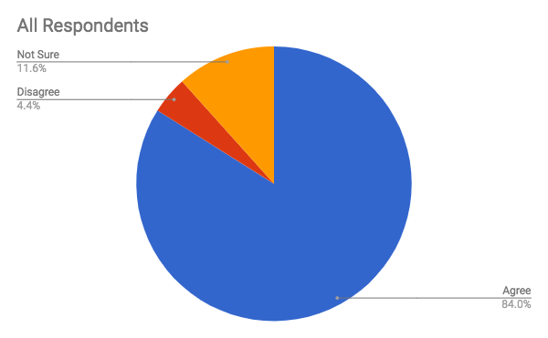
8. The policy is enforced.
Answer | All Respondents | Male Respondents | Female Respondents
Agree | 83.95% | 83.53% | 84.06%
Disagree | 4.42% | 2.35% | 4.93%
Not Sure | 11.63% | 14.12% | 11.01%

Slide 17
8. The policy is enforced.
Anything reported has been immediately dealt with.
At my current firm, we do not have any issues that I am aware. At previous firms, the policy was not properly enforced. It all depended on who was the offender and how much business did that person develop.
Except when the harasser is a VIP.
Fortunately, I have never been confronted with an issue to enforce.
Generally, yes, but I have had reports of comments being made by some attorneys which are not acceptable. We have so far been unable to change old habits. These comments were not direct and over the top, but they did have a sexual undertone that should not and cannot be tolerated.
Have not had the opportunity to see it in action.
Have only had one incident.
I assume that it is if instances arise but not aware of instances in other office locations.
I believe verbal harassment (non-sexual) is mildly enforced. Offenders are spoken to, but no harsh punishment in the last 5+ years.
I have had no first-hand experience with issues involving sexual harassment here.
I have never had a claim that required action. I would like to think it is enforced - that is the intent.
In all the years I have managed the firm (and in all the years prior as history has been related to me), there have been no incidents.
In my tenure at the firm, we have been fortunate not to have had any reason to enforce our policy.
It is enforced when management knows. I question how often it is reported.
It is enforced when we are aware of something happening. I'm sure things happen that don't get reported. These things scare me.

Slide 18
8. Continued -- The policy is enforced.
It would be enforced if we had an incident.
Never had an issue / complaint.
New here - have not had any issues and have not heard of any in the past.
Not involved in policy enforcement.
Our firm is six years old, no complaints have been filed but, if they were, the policies would be enforced.
Regarding sexual harassment, I agree the policies are enforced, regarding abusive and bullying behavior perhaps not as much.
The general concept of sexual harassment is frowned upon. However, there are some situations which could be considered inappropriate that are not addressed.
The policy is enforced vigorously unless the alleged harasser is an equity partner.
This specific type of harassment is considered a NO tolerance, even years ago.
We are working towards this.
We have been lucky that enforcing of policy has not been needed to be enforced. All employees follow the rules.
We have experienced 3-4 situations that have been brought to our attention over the last 9 years. In at least one instance, the employee, who was a member of the management team was terminated.
We have never had to enforce it, but we'd enforce the policy should the need arise.
We have not had an issue requiring investigation so to my knowledge the policy is working and enforced.
We've never had to enforce the policy b/c no one has ever reported an incident or made a complaint.

Slide 19
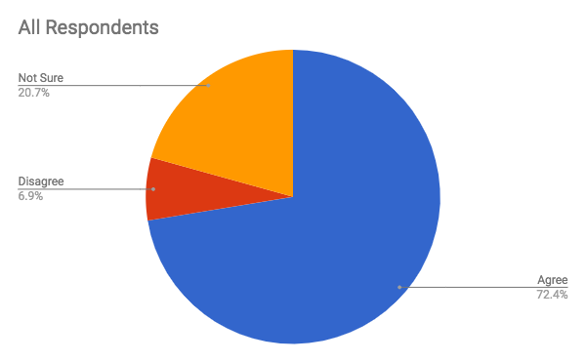
9. We resolve sexual harassment issues promptly and to everyone’s satisfaction.
Answer | All Respondents | Male Respondents | Female Respondents
Agree | 72.41% | 71.70% | 72.60%
Disagree | 6.90% | 3.77% | 7.69%
Not Sure | 20.69% | 24.53% | 19.71%

Slide 20
9. We resolve sexual harassment issues promptly and to everyone’s satisfaction.
I have not had any incidents in my specific location with the firm.
A few years ago two employees (ages 18 - 20) were harassed by the same attorney. One female employee left on her own volition. The other female employee continued to work at the firm because her mother also worked at the firm. A strong letter was written by the firm's outside attorney but the letter was never given to the attorney. Supposedly, the shareholders talked to him and one month later he left the firm but during that time he attempted to intimidate the mother and her daughter. The female employees were very upset that he was able to stay in the firm for another month. One of the shareholders still has lunch every month with this attorney. Non-sexual harassment continued after the attorney left. The firm has never had a female partner and the female attorneys who worked at the firm over the years left and became successful in other firms. The female attorney who was being harassed by the male shareholders was extremely intelligent and they considered her a "know it all." Basically, the clients started calling her and not the male attorneys for help resolving their issues. She would always cc the shareholder whose client she was working with but the client(s) would always respond to her without copying the shareholder. She continued to get admonished for everything she did and finally decided to leave and is a partner and successful with the firm she left to go to. Another issue was that one of her clients that she brought to the firm was the highest grossing client for the period of time she was here and that did not go over well (which we could not understand). This is just a snippet of what this woman endured. Note: this woman has over 30 years legal experience. When she left several long-term clients left with her! Of course, they blamed her for "unethically" taking the clients. Need I say more . . . .
Again, most complaints are quickly and effectively resolved. Those involving "rainmakers," while few in number, are not.
Agree except for the part that say's to everyone's satisfaction.
Am unaware as this is something HR would handle.
How would anyone outside the situation know?

Slide 21
9. Continued -- We resolve sexual harassment issues promptly
and to everyone’s satisfaction.
I am not aware of the details of every situation - only the ones that require my involvement. The remaining situations are dealt with confidentially by our HR director and the parties involved. No other employees are involved and nothing is communicated to those who do not have a "need to know" and those who have a "need to know" are not given the specifics.
I assume that they are if instances arise but not aware of instances in other office locations and there have been none at my regional office.
I take the issues to our CEO after the investigation and he takes it to our Executive Committee. Often times when I follow-up, all I get back is "It's been handled." with no other explanation. That scares me.
I've only been here a few months.
In my 18 years at the firm, we have only had one situation, and it was resolved quickly and with extreme care.
In my almost 20 years with the Firm, we've only had one incident and it was quickly resolved and the employee was terminated.
Not a formal incident, at any rate.
Not involved in policy resolution.
Not sure that everyone will be satisfied if the investigation does not favor them.
Since any harassment issues are resolved confidentially, I have no knowledge about whether all parties are satisfied.
Someone "at fault" would not consider it to be to his or her satisfaction.
The part I am not sure about is whether previous issues have been resolved to everyone's satisfaction. Plus we haven't had an issue like this anytime recently.
the sexual harassment issues I am aware of in the past were dealt with appropriately, using outside resources
We addressed a harassment case, but not a sexual harassment case.
We do resolve issues promptly but I doubt it is to everyone's satisfaction. In most instances these cases rarely have definitive evidence and is usually 2 conflicting versions.

Slide 22
9. Continued -- We resolve sexual harassment issues promptly
and to everyone’s satisfaction.
.
We had one issue brought up after an Employee Review regarding a subtenant, and inappropriate comments he has made over the years. She demanded that we not investigate it or speak with him about it because he had stopped making them sometime ago, so we documented everything and monitor the situation.
We have not had an incident in the 12 years that I have been here. I think we would deal with it in a prompt manner and to everyone's satisfaction.
We have one 74 year old attorney who just cannot help himself. This has been addressed over and over with him. It is a problem.
We have only had one incident we had to address.
We respond immediately to issues however, resolution is not always to the satisfaction of all involved.
We respond to issues as soon as they are reported. We have resolved the issues that have been brought forward, but it's difficult to know if we've resolved the issued to everyone's "satisfaction".

Slide 23
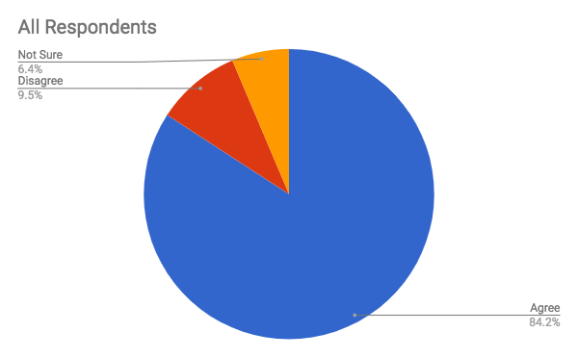
10. We have complaint procedures that are well defined and communicated.
Answer | All Respondents | Male Respondents | Female Respondents
Agree | 84.18% | 82.61% | 84.57%
Disagree | 9.45% | 8.70% | 9.64%
Not Sure | 6.37% | 8.70% | 5.79%

Slide 24
10. We have complaint procedures that are well defined and communicated.
Again, part of the employee handbook that is provided to new hires.
Again, reference to prior response. They are defined and specific, but do people know them.
Again, the policy is distributed in all new-hire materials; beyond that, it is not discussed.
Again, while it clearly states in the employee handbook what they procedure for communicating an incident is, it has never been expressed verbally.
Although again I think we should recirculate the policy at least once a year.
Communication consists of distributing policy to new hires. Policy is also in the employee handbook that is available to everyone.
Complaint procedures are defined, but not well communicated.
During orientation, the complaint procedures are communicated.
Formal policy, but I'm not sure any employee would really know what to do since it's something they simply sign off on in the personnel handbook.
Never had a complaint
Our firm uses an online tool and hotline reporting process and protocols.
The procedures are spelled out in the Policies and Procedures Manual, however, there hasn't been any formal training.
We have complaint procedures in our policy, but, the policy is not well communicated so therefore neither are the complaint procedures.
We have them, I don't consider them to be well communicated as they are only in the employee handbook and never addressed again until a situation arises.
Well defined, but not well communicated.

Slide 25
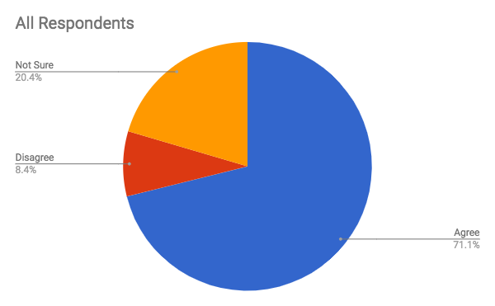
11. We have complaint procedures that are effectively utilized/enforced.
Answer | All Respondents | Male Respondents | Female Respondents
Agree | 71.11% | 71.11% | 71.11%
Disagree | 8.44% | 6.67% | 8.89%
Not Sure | 20.44% | 22.22% | 20.00%

Slide 26
11. We have complaint procedures that are effectively utilized/enforced.
Agree, but we have not had to use them.
From my perspective but I am senior management and cannot speak for everyone
Given that we've never had an incident reported, I cannot with confidence indicate that the complaint procedures are effectively utilized or enforced.
Have not been with this firm long enough to experience any complaints.
Have not had an issue to be reported.
Have to assume this is the case.
I usually hear about issues from a third party
In addition to an HR reporting chain, there is also an anonymous, third party-hosted line that employees can call.
Not all various types of complaints are effectively utilized/enforced.
Not yet tested
Nothing has come up in the 7 months I've been here.
Some attorneys get involved when they should be directing complaints to HR.
we have never had to enforce or utilize but procedures are in place
We have not had an incident since new P&P have been in place.
We haven't had any issues in the three years I have been here but I believe they would be very effective if necessary.
We receive very few complaints.
When I hear of a complaint, I take immediate actions.
When used, yes they are effective.

Slide 27
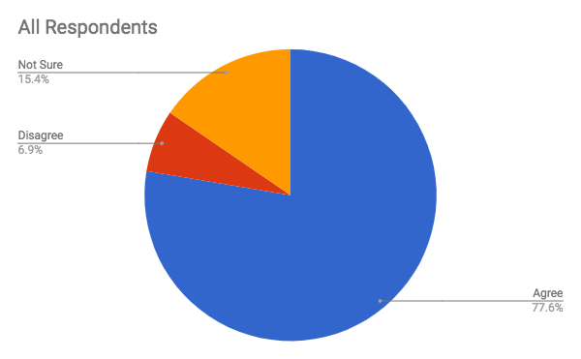
12. I believe our lawyers and staff feel comfortable approaching HR
(or the designated person) with a problem or complaint about sexual harassment.
Answer | All Respondents | Male Respondents | Female Respondents
Agree | 77.64% | 77.32% | 77.72%
Disagree | 6.91% | 7.22% | 6.84%
Not Sure | 15.45% | 15.46% | 15.44%

Slide 28
12. I believe our lawyers and staff feel comfortable approaching HR
(or the designated person) with a problem or complaint about sexual harassment.
As a small office, I fear the staff would not report.
I believe sometimes they feel more comfortable speaking to their mentor, manager, practice group leader before they come to HR but our door is open and they are relieved once they know HR is there for them.
I think HR is approachable, but if I had a complaint as a staff member against an attorney, not sure I would bring it up, depends on how severe it was and how long it had been going on. I need my job and I believe lawyers are almost always protected more than staff.
I'd like to think so, but with the attorneys having so much power, I know some people are nervous about whether the firm would really hold to its "no retaliation policy."
If someone is not comfortable going to HR, they can share their concern with any Shareholder who can help.
Lawyers yes, staff no or don't know about it.
Since we've never had a complaint, I'm not sure. I hope so.
The fact that some situations have been brought to our attention leads me to believe this is true but I cannot speak for everyone and there may be situations where someone is not comfortable speaking up.
We also invite them to report concerns to their supervisor or any partner so that they have a choice if they don't feel comfortable reporting to a certain person.
We do harassment training every two years as well to reinforce
We have a policy that allows for a complaint to be taken to certain identified individuals to allow for employees to choose a member of the management team that they feel comfortable with
We try to keep lines open, but having been in that type of situation personally, even I don't know if I would be comfortable discussing it with a superior.
We're pretty open with each other. I think if there were a problem it would be communicated. We are a small collegial firm.

Slide 29
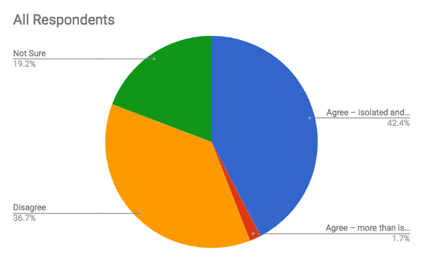
13. Sexual harassment occurs or has occurred within our firm.
Answer | All Respondents | Male Respondents | Female Respondents
Agree | 77.64% | 77.32% | 77.72%
Disagree | 6.91% | 7.22% | 6.84%
Not Sure | 15.45% | 15.46% | 15.44%

Slide 30
13. Sexual harassment occurs or has occurred within our firm.
Happened only once in 3 years I have been here.
I have never been made aware or experienced this issue at my firm.
I know of one occurrence many years ago.
I'm new, so not in this office, since I joined. I don't know of incidents in other offices, but I wouldn't. I'm confident in how they would have been handled.
It used to occur more often in the "old" days. No one wanted to talk to the offending partner(s) because of the revenue they brought to the firm.
None has been reported, and I'd like to believe this means there have been no incidents of any real significance. It's likely that an occasional inappropriate comment has been made, because I think we're at a point where virtually everything can be considered inappropriate by someone in some fashion.
None in the last 5 years or more that I'm aware of.
None that I am aware of, but I haven't done a lengthy investigation on what may have occurred.
Not at this firm, but I did work at a place that had sex harassment issues frequently.
on average less than once per 5 year period
One incident, but a claim of SH was not made and insisted there was none.
Only twice in my tenure and after investigation it was determined that one situation was not deemed sexual harassment.
To my knowledge there has only been one incident about 15+ years ago. Neither individual is currently with the firm.
We have had some concerns about unfair treatment based on gender, but we haven't really had what I think of as the traditional sexual harassment claim.
We've had two incidents this year already. More than before.
While not made aware, that doesn't mean it hasn't happened.

Slide 31
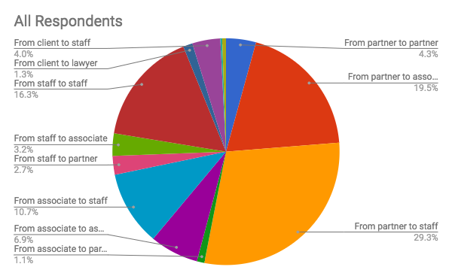
14. The harassment I am aware of occurs mostly: (Check all that apply.)
Answer | All Respondents | Male Respondents | Female Respondents
From partner to partner | 7.88% | 10.26% | 7.32%
From partner to associate | 35.96% | 30.77% | 37.20%
From partner to staff | 54.19% | 56.41% | 53.66%
From associate to partner | 1.97% | 2.56% | 1.83%
From associate to associate | 12.81% | 23.08% | 10.37%
From associate to staff | 19.70% | 17.95% | 20.12%
From staff to partner | 4.93% | 0.00% | 6.10%
From staff to associate | 5.91% | 7.69% | 5.49%
From staff to staff | 30.05% | 35.90% | 28.66%
From client to lawyer | 2.46% | 0.00% | 3.05%
From client to staff | 7.39% | 5.13% | 7.93%
From lawyer to client | 0.49% | 0.00% | 0.61%
From staff to client | 0.99% | 0.00% | 1.22%

Slide 32
14. The harassment I am aware of occurs mostly: (Check all that apply.)
A couple of inappropriate relationships that ended badly.
Actual harassment situations are unknown to me.
Can happen at levels within and outside the organization
DNA.
I can't speak to that in my location as it hasn't happened since I I started however I can't speak to prior or other office locations.
I do not think that we have had any recent issues or concerns about sexual behavior in physical terms, but have concerns that attitudes exist, inappropriate joking exists, and that the overall tone is not as balanced as we would like. Problematic behaviors are more in terms of bullying behavior rather than sexual behavior; there may be more issues with gender bias rather than actual sexual harassment issues.
Issues were resolved as soon as management was made aware
Most recent was from vendor to staff.

Slide 33
14. Continued -- The harassment I am aware of occurs mostly: (Check all that apply.)
Non-firm employee to an employee
Only harassment was staff to staff, and it was not of a sexual nature.
Outside Vendor to Employee
Outside vendor to staff
Previous employee but was never formally reported.
Some staff members confuse harassment with difficult attorneys.
The client is no longer with the firm and the attorney left. Currently there is no on-going harassment .
The offending party is no longer with the Firm.
The one incident concerned a partner and staff person.
The only occurrence was a partner to staff member, immediately handled.
There has been no harassment of any kind within our firm.
There have been no instances in the recent past that I am aware of. I feel generally that sexual harassment is a thing of the past in most law firms save for a few old geezers.
Upper Administration to mid-level management and staff maybe.
We have also had a situation where an expert was inappropriately propositioning a staff member
We have never had a formal claim; we have had a few situations that we have dealt with promptly and effectively
We've only had one complaint in the last few years and it was between associates

Slide 34
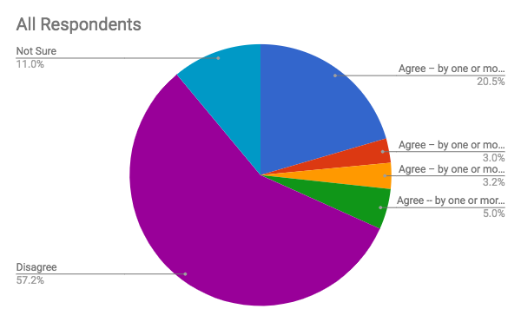
15. There is at least one person in the firm who behaves inappropriately, but most people put up with it. (Check all that apply.)
Answer | All Respondents | Male Respondents | Female Respondents
Agree – by one or more partners | 20.48% | 16.00% | 21.61%
Agree – by one or more associates | 3.01% | 6.00% | 2.26%
Agree – by one or more senior staff | 3.21% | 2.00% | 3.52%
Agree -- by one or more employees | 5.02% | 7.00% | 4.52%
Disagree | 57.23% | 55.00% | 57.79%
Not Sure | 11.04% | 14.00% | 10.30%

Slide 35
15. There is at least one person in the firm who behaves inappropriately, but most people put up with it. (Check all that apply.)
89 year old attorney who speaks inappropriately. Has to be told when he is inappropriate because he doesn't think he is. Can also be rude to his young secretary.
Anytime inappropriate comments are made, the HR Director will counsel the offending party. However, there may be partners in other offices who make inappropriate jokes. I have heard of this on occasion but never confirmed it.
By one senior partner, who is on senior status, but still comes in the office on a regular basis.
Elderly gentleman sometimes makes comments that could be interpreted as inappropriate, but people acknowledge his age/generation and know he is not being intentionally inappropriate - he is otherwise professional, kind and sensitive to all
He is more inappropriate in a hostile way.
I wouldn't say the situations I'm thinking of involve serial harassers, which I would say is not tolerated. They were instances of specific harassment that were not addressed the way other incidents were, because of the stature of the accused.
Inappropriately, yes, but not sexual harassment. One partner is challenging to work with.
Not any longer.
Not horrible, just inappropriate according to the definition of sexual harassment

Slide 36
15. There is at least one person in the firm who behaves inappropriately, but most people put up with it. (Check all that apply.)
One partner frequently tip toes to the line of appropriateness in an attempt to be funny at firm events. HR and I tend to be concerned what he says (fear of potential complaints) rather than the staff. Perhaps we are overly protective on the issue.
Prior to entering into his current relationship, it has been said that one male partner made inappropriate comments to subordinate females. This occurred prior to my tenure and I have not personally witnessed this behavior or heard of it first hand. The young woman who currently provides his administrative support is unaware of these prior allegations and describes him as an "awesome" boss.
Pushes the boundaries of the line for appropriate vs inappropriate.
Sometimes it is unconscious bias; the same person who may make a comment like "well they are a mother now" will say "we are not biased at all, look at all the female attorneys we have".
They continue to say unkind things about the attorney who left.
This answer relates to abusive (bullying) behavior.
We had one foul-mouthed employee; however, he is now part-time working from home. People put up with it and thought it was funny because he's older and has been here forever. That would not be acceptable from anyone else going forward
We have a partner who is harsh to staff.
We have been very strict about this over the last 20+ years. We have one partner who has been required to sign a "last chance" agreement. That usually solves things. Most of the time they are so insensitive they don't even realize they are being offensive.

Slide 37
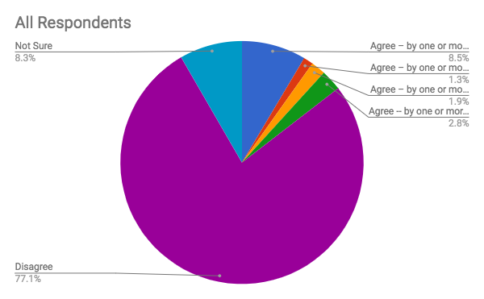
16. There is at least one person in the firm who behaves so inappropriately that most people avoid them. (Check all that apply.)
Answer | All Respondents | Male Respondents | Female Respondents
Agree – by one or more partners | 8.55% | 4.44% | 9.52%
Agree – by one or more associates | 1.28% | 3.33% | 0.79%
Agree – by one or more senior staff | 1.92% | 0.00% | 2.38%
Agree -- by one or more employees | 2.78% | 5.56% | 2.12%
Disagree | 77.14% | 78.89% | 76.72%
Not Sure | 8.33% | 7.78% | 8.47%

Slide 38
16. There is at least one person in the firm who behaves so inappropriately that most people avoid them. (Check all that apply.)
He is more inappropriate in a hostile way.
Not my current firm.
Our firm would not allow this under any circumstances.
same 89-year-old. Offends and insults people all the time.
Same person from Question 15 (the person is on a "last chance" agreement). We don't put up with this stuff.
We do a lot of labor work - people here know better
We have one partner that can make inappropriate comments at the worst times. People chalk it up to "that's just how he is."

Slide 39
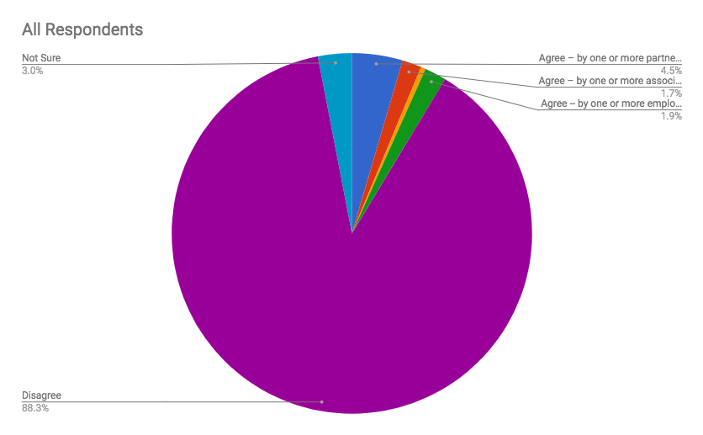
17. I am aware of specific come-ons or outright requests for sexual activity.
(Check all that apply.)
Answer | All Respondents | Male Respondents | Female Respondents
Agree – by one or more partners | 4.55% | 3.26% | 4.86%
Agree – by one or more associates | 1.73% | 3.26% | 1.35%
Agree – by one or more senior staff | 0.43% | 1.09% | 0.27%
Agree -- by one or more employees | 1.95% | 3.26% | 1.62%
Disagree | 88.31% | 86.96% | 88.65%
Not Sure | 3.03% | 2.17% | 3.24%

Slide 40
17. I am aware of specific come-ons or outright requests for sexual activity.
(Check all that apply.)
Employee denied the allegation of a cat whistle; no other witnesses but sufficient evidence to suggest it may have happened. He was placed on a warning.
I agree with this but with respect to non quid pro quo situations I also am conscious of the fact that as one comedian put it "It's only harassment if the other person isn't interested, otherwise it's called dating."
In the past only
Not at this firm but yes at prior companies
Not my current firm. Previous employer - definitely outright requests.
The comments are more of the nature about how attractive certain women are .
There was one incident and it was dealt with immediately, partner was asked to resign.
We had a situation where a relationship developed between a staff and a manager. After the relationship ended, the staff came forward with a complaint about the manager making inappropriate comments and actions. We investigated it and terminated the manager.

Slide 41
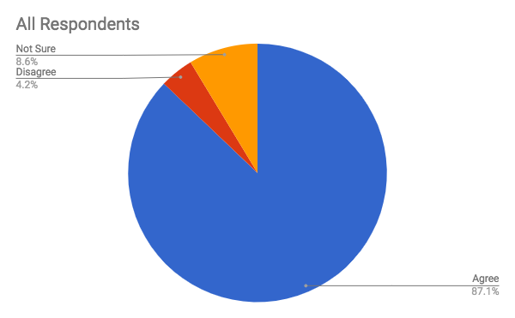
18. I feel that the firm supports the person in the HR role in addressing this issue.
Answer | All Respondents | Male Respondents | Female Respondents
Agree | 87.13% | 95.60% | 85.12%
Disagree | 4.22% | 2.20% | 4.70%
Not Sure | 8.65% | 2.20% | 10.18%

Slide 42
18. I feel that the firm supports the person in the HR role in addressing this issue.
... if there were an issue
For the most part, yes, with some unknown if it was a partner.
Fully supported should an issue be presented.
HR is supported in addressing the issue to the fullest extent HR can. When its a partner/owner, the HR person has limits.
I would like to believe that to be true, however we have never had a complaint while I have been here.
If needed, the partners would.
In some cases yes, in most no. They don't want to make billers uncomfortable or risk losing someone.
Inappropriate behavior has not been addressed.
Just generally, the HR role is not very supported.
Somewhat, but softpedals it
We are a small firm and the final decisions are made by the shareholders.

Slide 43
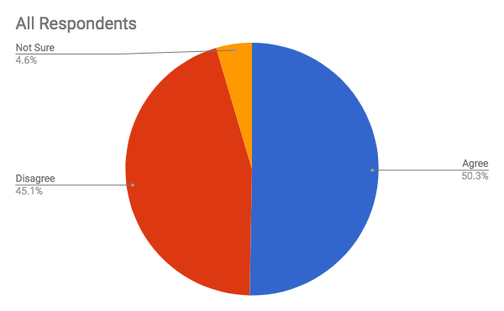
19. I feel that there is too much fear and/or lack of support to confront these issues.
Answer | All Respondents | Male Respondents | Female Respondents
Agree | 50.30% | 48.47% | 50.75%
Disagree | 45.13% | 44.79% | 45.21%
Not Sure | 4.57% | 6.75% | 4.04%

Slide 44
19. I feel that there is too much fear and/or lack of support to confront these issues.
But I still believe we haven't had instances of it.
I currently have a wonderful firm environment, but you're kidding yourselves if you think that the vast majority of staff who may be being harassed by a partner will raise the issue. The rainmaker/partner is NEVER going to be admonished/suspended/terminated. While there might be some informal reprimand and request/instruction to "stay away from" any staff alleging harassment, the staffer would ultimately being the one who'd suffer from speaking out even if that only meant a promising career turns dead-end at that firm. I'm truly grateful that our firm environment is such that a predatory personality would not be knowingly welcomed, but know well enough that they are out their.
I believe people will always be afraid to step forward to address such an uncomfortable situation. We do everything we can to let them know they have a safe resource but human nature often times wins.
I will clarify this response as being based upon the reporter--some personalities may struggle internally within themselves and worry about the outcome if they do report something.
In general, I think people are afraid to bring up issues, but I know of none in this firm.
Naive response among the top execs. Did not understand what could happen and possible volatile outcomes.
Perpetrators are not aware their conduct rises to problematic levels and victims worry about blowback from reporting.
Personally, I believe we appropriately address situations that are brought to our attention. I do not know though if someone is fearful of coming forward so they remain silent.
Sometimes is seems to depend on the day or the person/biller involved.
While I don't think there is fear, and should an obvious sexual harassment issue arise the situation would be dealt with appropriately, the Firm has a prevailing history letting things happen without proper recourse, or addressing the problem for any type of issue that comes up (behavioral, performance, etc.) so I do wonder if there are small issues that have gone unreported because people think nothing will happen. As one employee recently said to me, they practically let you get away with murder here.

Slide 45
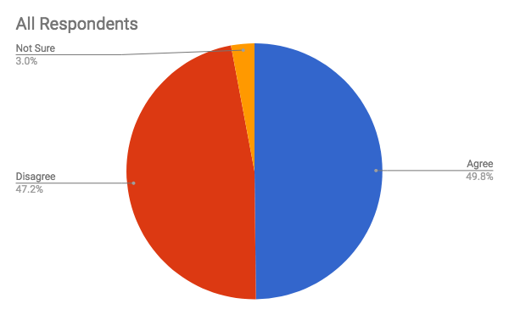
20. Our lack of ability to address the problem has made it worse and/or encouraged the actors to increase their behavior.
Answer | All Respondents | Male Respondents | Female Respondents
Agree | 49.82% | 50.00% | 49.78%
Disagree | 47.23% | 48.26% | 46.96%
Not Sure | 2.95% | 1.74% | 3.26%

Slide 46
20. Our lack of ability to address the problem has made it worse and/or
encouraged the actors to increase their behavior.
Continues at same pace
It hasn't gotten worse, but it hasn't gone away either.
It made the problem worse when the attorney was still employed at the firm.
Not at all. I don't think newer attorneys would even think to act inappropriately in the workplace even before #metoo.
Not worse, but not improved.
One potential incident and it was resolved quickly.

Slide 47
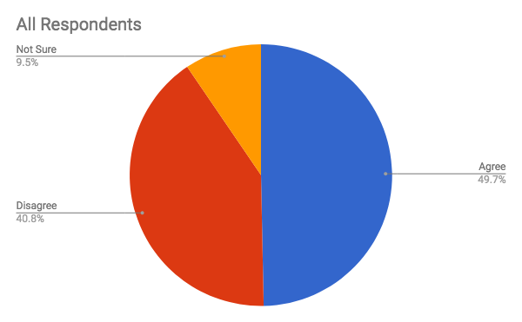
21. Our firm would benefit from better training and policies,
but I don’t know how to broach the subject.
Answer | All Respondents | Male Respondents | Female Respondents
Agree | 49.67% | 50.00% | 49.59%
Disagree | 40.81% | 42.21% | 40.46%
Not Sure | 9.52% | 7.79% | 9.95%

Slide 48
Additional training is always a good thing. We remind partners annually about our policies and more specifically about harassment but if someone was to provide more training, that is always a good thing.
Agree that my firm would benefit, but not hesitant to broach the subject.
All firms can use better training and I am not afraid to broach the subject at all. It is my job to make sure everyone is educated and has a safe environment.
ALL firms would benefit from better training and policies, and I do know how to broach the subject.
All firms would benefit from better training and policies, however broaching the subject isn't the issue.
Although again, I beleive that we should be recirculating policies.
Always room for improvement and to review/dust off existing policies.
Better training and policies are always a plus
Better training would be great, but the issue is openly discussed here and a harassment free workplace is a clear priority of senior management.
Can't ever have enough training in this area.
Everyone in today's environment would benefit from more training and knowledge.
Firm can always improve training
I agree that anyone can benefit from more training in this subject, but disagree that the subject cannot be broached.
I am not aware there have ever been harassment issues, and I think that's because all of us share a common attitude about it. We have freely discussed past experiences at other places of employment, and my impression is that everyone here recognizes what harassment is and would universally oppose it and take any action necessary to eliminate it and the perpetrator.
I believe the attorneys have been informed but the staff is missing training and guidance.
I do believe we would benefit from better training as this is not a topic or situation that you can ever be complacent with.
21. Our firm would benefit from better training and policies,
but I don’t know how to broach the subject.
Additional training is always a good thing. We remind partners annually about our policies and more specifically about harassment but if someone was to provide more training, that is always a good thing.
Agree that my firm would benefit, but not hesitant to broach the subject.
All firms can use better training and I am not afraid to broach the subject at all. It is my job to make sure everyone is educated and has a safe environment.
ALL firms would benefit from better training and policies, and I do know how to broach the subject.
All firms would benefit from better training and policies, however broaching the subject isn't the issue.
Although again, I believe that we should be recirculating policies.
Always room for improvement and to review/dust off existing policies.
Better training and policies are always a plus.
Better training would be great, but the issue is openly discussed here and a harassment free workplace is a clear priority of senior management.
Can't ever have enough training in this area.
Everyone in today's environment would benefit from more training and knowledge.
Firm can always improve training.
I agree that anyone can benefit from more training in this subject, but disagree that the subject cannot be broached.
I am not aware there have ever been harassment issues, and I think that's because all of us share a common attitude about it. We have freely discussed past experiences at other places of employment, and my impression is that everyone here recognizes what harassment is and would universally oppose it and take any action necessary to eliminate it and the perpetrator.
I believe the attorneys have been informed but the staff is missing training and guidance.
I do believe we would benefit from better training as this is not a topic or situation that you can ever be complacent with.
I have been trying to implement training for 18 months but other priorities have taken over. We are growing so fast, too much to do and can't hire quickly enough.
I have broached the subject, but management has declined as "too expensive."
I have made a request for training, and due to a change in management, that training is in development and will occur in the next few months.
I just have to put a training program together seeing as I am new. I have the materials, I just have not had the time.
I think all firms benefit from continued and improved training.
I think our training is good, and our policy is good, but it is the enforcing it and holding EVERYONE accountable.

Slide 49
21. Continued -- Our firm would benefit from better training and policies,
but I don’t know how to broach the subject.
Our firm would benefit from more/better training, but I do know how to approach the subject (and I will).
Our firm, and any firm for that matter, would benefit from better training and policies.
Our training, likely like most, could be improved somewhat. Our polices are excellent and inclusive.
Poorly worded. Everyone would benefit from better training.
The firm doesn't invest in providing training to staff members other than what is taught when the person is first hired.
There is no way they would allow this because they do not believe harassment has occurred or will occur.
Updated training and information is always helpful.
We already have a good training program in place.
We are currently looking at a different type of training program than the one we have been using for the past 5 years.
We do annual anti-harassment training, but I don't think it's taken seriously by the partners.
We have a large labor and employment department and I am proud of the mandatory training we have established within the firm.
we have discussed a renewal training but have not found the right source for that
We have discussed the topic and are planning a formal training.
We have good training and a good policy.
We have policies and training for all.
We offered training last year for the Firm and it was very well received.
We would benefit, but I know how to broach the subject. The challenge is having the time to address the subject in an ever-growing list of things to do.
We would certainly benefit from better training and policies not just about sexual harassment, but also about gender and other biases and improving attitudes and behaviors. We have broached the subject, have been discussing ways to address it, and will be setting up some mandatory programming this year to help address this.
While we would benefit from better training and policies, we are also addressing it.
Yes the first half of the comment, no to the second.
Yes! everyone benefits from better training

Slide 50
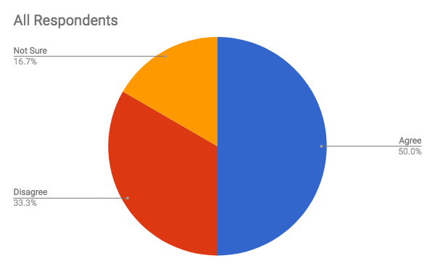
22. Our firm has a problem and leadership won’t address it.
(Choose all that you believe apply.)
Answer | All Respondents | Male Respondents | Female Respondents
Agree | 50.00% | 50.00% | 50.00%
Disagree | 33.33% | 50.00% | 0.00%
Not Sure | 16.67% | 0.00% | 50.00%

Slide 51
22. Our firm has a problem and leadership won’t address it.
(Choose all that you believe apply.)
Again abusive (bullying) behavior not sexual harassment.
Firm leadership is strongly behind supporting a culture free of harassment
I disagree in that our firm does not have a problem and in the rare occasion that an issue does arise, it is dealt with swiftly. We also proactively provide harassment training seminars annually administered by an outside vendor.
I don't think we have an institutional problem, only isolated incidents; leadership is swift to address in a systematic and consistent way.
Issue is addressed immediately through our employee relations department.
Leadership is constantly saying how important it is to report this and would take action immediately.
Other: They don't pretend it doesn't exist exactly - they addressed it, but more that they think it's not as serious an issue and don't see the potential for what could happen; they don't consider worst-case scenario.
Our firm management addresses issues appropriately, both when brought forth by an employee reporting an issue and by having an open chain of communication that allows employees to fee their concerns would be properly addressed
Our partners are willing to confront and address issues, but sometimes it takes some prompting.
Sexual harassment is not perceived as a pervasive problem, and leadership is addressing it in the context of other related training as described above.
This is not a problem we have.
This is not an issue in our firm which is also predominantly women.
We do address anything that comes up.
We do not have a problem with sexual harassment, but if anything did happen, I am sure someone would say something and we would put an end to it.
We do not have a problem. Everything brought to our attention is investigated.
We take it seriously and head on

Slide 52
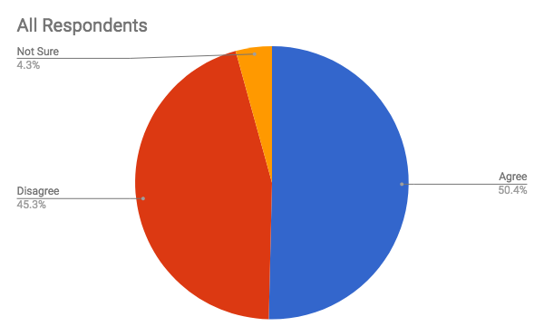
23. Our leadership is aware of problems, but I don’t believe the will exists to address it.
Answer | All Respondents | Male Respondents | Female Respondents
Agree | 50.38% | 48.78% | 50.80%
Disagree | 45.33% | 47.56% | 44.75%
Not Sure | 4.29% | 3.66% | 4.46%

Slide 53
23. Our leadership is aware of problems, but I don’t believe the will exists to address it.
I think it is mostly our COO that does not want to bring it to our Executive Committee.
Leadership helps resolve issues.
Not true as to sexual harassment issues but yes as to dealing with some other HR issues unrelated to harassment, discrimination or other illegal behavior.
Not with regards to sexual harassment, the one issue, when we finally came to be aware of it, was immediately addressed and would have been addressed further had the employee specifically said not to speak with the subtenant she claimed spoke inappropriately.
There are no current problems that I know of. Leadership addressed problems when they occur.
There was a time though...
Unlikely that leadership would lack the will to address any problem of which they have awareness.
We are addressing it but the individual is a rain maker and there is a lot at stack i.e. 1.5 million in billings...

Slide 54
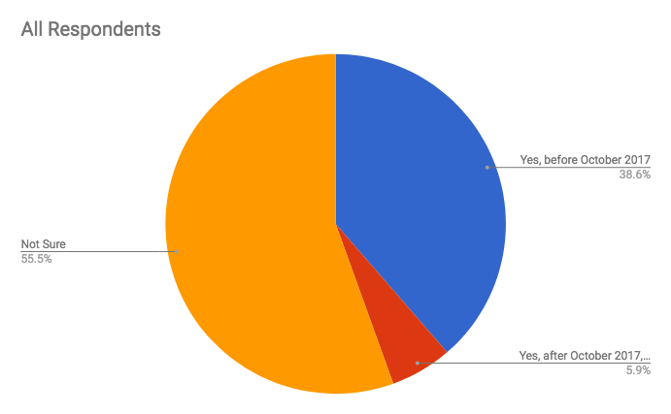
24. The partners at our firm have discussed the financial risk of harassment claims.
Answer | All Respondents | Male Respondents | Female Respondents
Yes, before October 2017 | 38.64% | 49.43% | 35.88%
Yes, after October 2017, as a result of media attention | 5.85% | 5.75% | 5.88%
Not Sure | 55.50% | 44.83% | 58.24%

Slide 55
24. The partners at our firm have discussed the financial risk of harassment claims.
Actually, we have not addressed the financial risk of harassment claims, but I did add "H/R-Harassment" to our office insurance policy.
Annually we remind partners of significant HR policies that they need to make sure they paying attention to and following them.
Before and after Oct 2017
Discussed prior to 10/2017 in combination with all potential employer liability issues, need for insurance coverage; discussed again post 10/2017 due to media attention.
in general yes- post oct 17 - but nothing that has risen to critical concern
In training every two years.
It has been discussed. We have no issue.
Only during the required harassment training that happens every other year.
We are in Calif where there is mandatory training required for those in supervisory positions. Although we are not large enough to have to provide training, we are going to do so for both attorneys and staff.
We educate all employees annually.
We have long had a priority, but we did discuss it and communicate at the firm broadly about it after the incidents of October 2017.

Slide 56
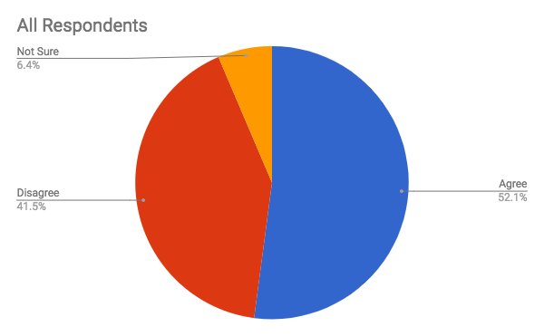
25. Some of the offending behavior is exhibited by very powerful partners.
Answer | All Respondents | Male Respondents | Female Respondents
Agree | 52.09% | 51.03% | 52.36%
Disagree | 41.50% | 42.76% | 41.19%
Not Sure | 6.41% | 6.21% | 6.46%

Slide 57
25. Some of the offending behavior is exhibited by very powerful partners.
One isolated incident was swiftly addressed by mgmt.
Again, there are issues with powerful partners and certain types of behavior, but not generally issues with sexual harassment.
HR discussed directly with partner. Offending behavior stopped immediately.
Not lately but was by those in top command at other employers.
Not behavior that crosses the line, but dangerously close in my opinion
Staffer
While not a current issue, this sort of "offending" behavior is typically exhibited by only the very powerful.

Slide 58
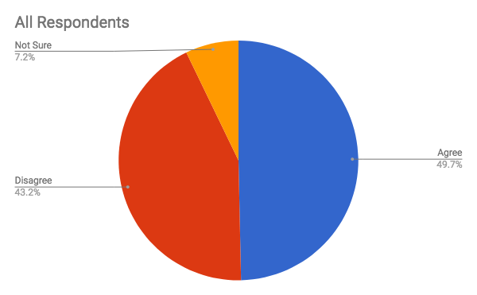
26. Some of the offending behavior is exhibited by a person who is perceived to
have the ear of very powerful partner(s).
Answer | All Respondents | Male Respondents | Female Respondents
Agree | 49.66% | 48.67% | 49.92%
Disagree | 43.17% | 44.00% | 42.95%
Not Sure | 7.17% | 7.33% | 7.13%

Slide 59
26. Some of the offending behavior is exhibited by a person who is perceived to
have the ear of very powerful partner(s).
Does not apply to our organization
In the past

Slide 60
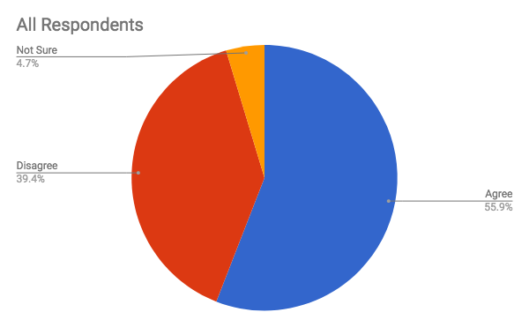
27. There seems to be less attention on this issue than on other
basic workplace conditions.
Answer | Respondents | Male Respondents | Female Respondents
Agree | 55.91% | 55.10% | 56.11%
Disagree | 39.42% | 40.82% | 39.07%
Not Sure | 4.67% | 4.08% | 4.82%

Slide 61
27. There seems to be less attention on this issue than on other
basic workplace conditions.
Agree because we really have had a single issue and most people were never aware of it.
But only because there are no issues, not due to lack of importance
Given that I am not aware of a problem in this regard, I am not sure that more attention needs to be paid.
Less attention to this topic because I/we periodically remind everyone about our policy (not a lot, but enough).
This issue is treated equally in comparison with other workplace conditions

Slide 62
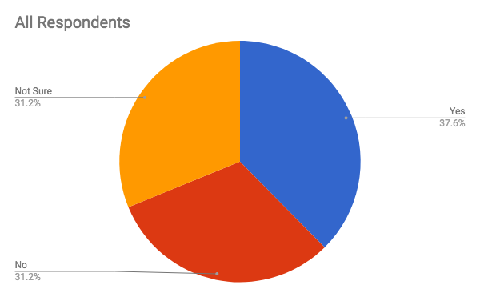
28. Our firm has conducted internal investigations using lawyer(s) at the firm.
Answer | All Respondents | Male Respondents | Female Respondents
Yes | 37.62% | 48.39% | 34.94%
No | 31.19% | 25.81% | 32.53%
Not Sure | 31.19% | 25.81% | 32.53%

Slide 63
28. Our firm has conducted internal investigations using lawyer(s) at the firm.
At a previous firm, we did use a lawyer for all investigations.
But not specifically for this issue.
For other serious issues, we have brought outside counsel. Not sure what we'd do if there was a harassment allegation.
Nearly a decade ago, we had 1 informal claim by a staffer against an associated.
It was addressed and resolved, the associate was terminated. The situation was handled professionally, swiftly and according to policy.
Our HR and general counsel conduct investigations internally.
The level of offense did not rise to hiring outside counsel to investigate.
There are no issues related to sexual harassment at our firm.
Use outside counsel when needed.
Usually HR conducts, but under the guidance of internal counsel.
We had one internal investigation a long time ago. It was first handled by another attorney, but then we brought in an outside person.
We have conducted them but we do not have internal lawyers handle the investigations, except in a rare instance.
Our labor lawyers provide guidance, but they typically don't do the investigations.
We have not had any complaints about sexual harassment that have needed to be investigated. When there are other complaints (bullying, nasty behavior, gender bias) they are investigated internally.

Slide 64
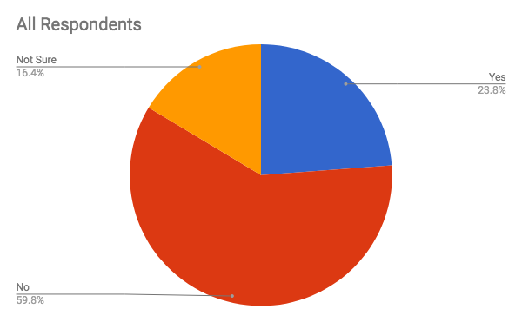
29. Our firm has conducted internal investigations using staff at the firm.
Answer | All Respondents | Male Respondents | Female Respondents
Yes | 23.81% | 34.31% | 21.28%
No | 59.81% | 51.96% | 61.70%
Not Sure | 16.38% | 13.73% | 17.02%

Slide 65
29. Our firm has conducted internal investigations using staff at the firm.
By staff I mean leaders of HR along with executive level partners.
HR direct and COO.
HR director was used.
HR Manager.
HR/Administrative Management.
Our HR Director performs any such investigations.
Same incident both area supervising partner and Office Manager were involved in investigation and resolution.
Staff meaning Firm Administrator.
When investigations are needed they are usually conducted by our Chief Human Resources Officer with support from our employment lawyer and/or general counsel.

Slide 66
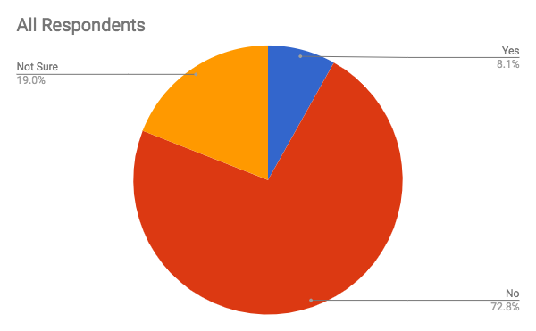
30. Our firm has conducted internal investigations using an outside law firm.
Answer | All Respondents | Male Respondents | Female Respondents
Yes | 8.13% | 10.58% | 7.55%
No | 72.83% | 73.08% | 72.77%
Not Sure | 19.04% | 16.35% | 19.68%

Slide 67
30. Our firm has conducted internal investigations using an outside law firm.
For advice on process only.
Never allowed it to get to that point.
We use our General Counsel legal services before going outside. But will if necessary.

Slide 68
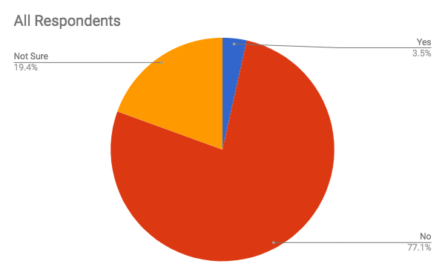
31. Our firm has conducted internal investigations using a third-party investigator.
Answer | All Respondents | Male Respondents | Female Respondents
Yes | 3.49% | 1.90% | 3.86%
No | 77.06% | 81.90% | 75.91%
Not Sure | 19.45% | 16.19% | 20.23%

Slide 69
31. Our firm has conducted internal investigations using a third-party investigator.
Before my time with the firm
I did at my last firm - only here 3 years and "no" during that time

Slide 70

32. Our firm has fired partners for harassment.
Answer | All Respondents | Male Respondents | Female Respondents
Yes | 5.31% | 4.72% | 5.45%
No | 75.64% | 79.25% | 74.77%
Not Sure | 19.05% | 16.04% | 19.77%

Slide 71
32. Our firm has fired partners for harassment.
There has not been an issue involving a partner since I have been here. There was one involving a senior person, of counsel, and we terminated him.
We were told the attorney was asked to leave but the females do not believe it.

Slide 72
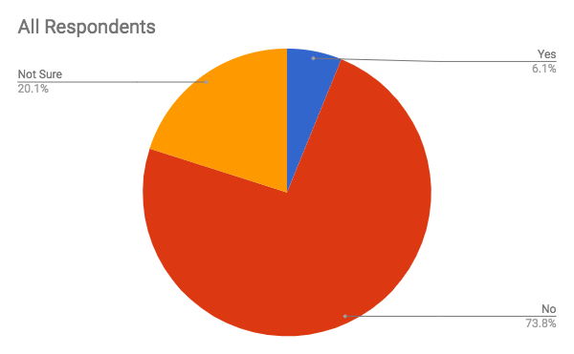
33. Our firm has fired associates for harassment.
Answer | All Respondents | Male Respondents | Female Respondents
Yes | 6.15% | 8.33% | 5.62%
No | 73.78% | 74.07% | 73.71%
Not Sure | 20.07% | 17.59% | 20.67%

Slide 73
33. Our firm has fired associates for harassment.
Harassment was only one issue leading to termination
Over 20+ years ago. One incident.
The associate was in a relationship with the Shareholder.
There may have been an associate terminated several years back due to inappropriate behavior
Unofficially - No formal cause of "harassment" was stated.

Slide 74

34. Our firm has fired staff for harassment.
Choice | All Respondents | Male Respondents | Female Respondents
Yes | 6.31% | 12.15% | 4.91%
No | 73.69% | 71.03% | 74.33%
Not Sure | 20.00% | 16.82% | 20.76%

Slide 75
34. Our firm has fired staff for harassment.
At past employers, we have fired a vendor for harassment.
It is amazing that older men do not believe certain things are harassment. Also, I have been witness to females doing the intimidation but at a larger firm.
We have paid off the staff involved if a release is obtained. Small amounts considering the offenses. That there way of solving the problem.

Slide 76
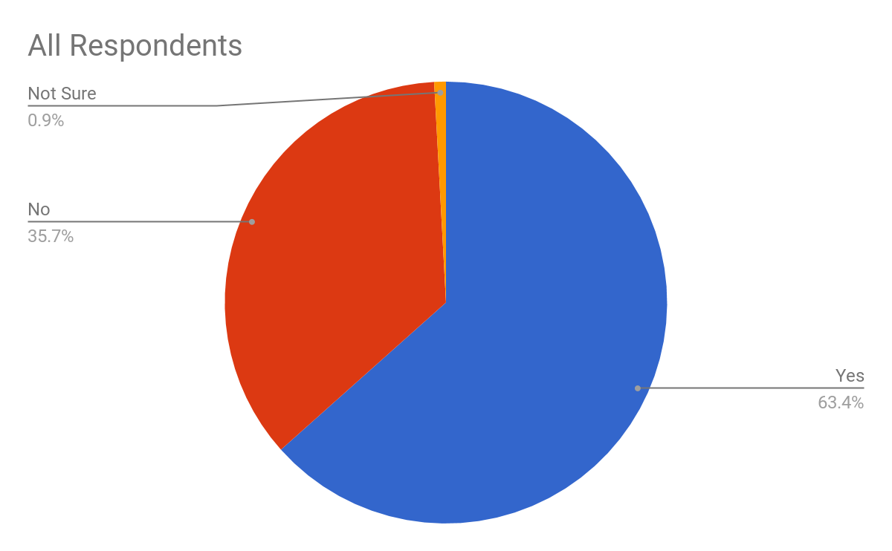
35. At some point in my career I have been subjected to harassment,
but I did not report it.
Answer | All Respondents | Male Respondents | Female Respondents
Yes | 63.40% | 52.38% | 66.85%
No | 35.74% | 47.02% | 32.22%
Not Sure | 0.85% | 0.60% | 0.93%

Slide 77
35. At some point in my career I have been subjected to harassment,
but I did not report it.
A long, long time ago (1993-1994) not at this firm.
Also from a professor in college .
But not at a law firm.
I addressed it with the person when it happened.
I did not report it because I made the person aware that was uncomfortable with being touched the first time he tried to touch me and he he never tried again.
I did report it. It was a long time ago, and not at my current firm.
I handled it myself.
I handled it on my own at a prior firm
I have been in the workforce for 40 years and during this time there have been many levels of accepted behavior, much of which in today's workplace is no long tolerated. I have not experienced harassment in the last 10 years, so I do feel that positive strides are being made and hope that will continue.
I have been subjected to harassment and did report it but is was not at my law firm.
I have overheard borderline inappropriate comments, but have never felt I worked in a hostile environment or been in a situation I would characterize as harassment.
I reported it and it was effectively dealt with immediately by a senior partner at the firm.
I reported it it but nobody thought it was important (in my previous job at a big Law Firm)
I reported once but not in a official way
I think every woman has been subjected to harassment at some point in her career. Until fairly recently, reporting it was not necessarily going to resolve it.
I was 23. My own mother told me I would never work again if I reported him.
I was harassed at my prior firm, and reported it
I was subject to harassment and did report it.

Slide 78
35. At some point in my career I have been subjected to harassment,
but I did not report it.
I was subjected to harassment, reported it and it was handled appropriately - prior to joining my current firm.
I was young and didn't know better. This happened in my first job out of college.
I wasn't working at a law firm at the time.
I'm 53 years old and worked on Wall Street in my early 20's. The stories I could tell.
I'm old. Harassment was "the norm" back in the 60s and 70s
In a prior career in a CPA firm
It was done to me by a non-employee who sublet space from us. I declined and it never happened again. I didn't feel the need to take further action as I was the one that would normally address those complaints.
It was very early in my career and the environment was such that encouraged and tolerated harassment. I was too young to know better.
Many years ago and not at my current employer.
Not at my present firm.
Not at this law firm
Not while at current employer.
Reported it, nothing done.
Sometimes our COO uses belittling language. It's embarrassing for him and it demeans the staff. The Executive Committee never hears the COO speak to the staff in this way, COO doesn't do it in front of them.
This happened well over 20 years ago at a previous firm.
This response is over a 32 year career, not necessarily covering the last decade where I have become much more assertive as a person, and the overall behavior has changed to be more appropriate due to society's attention to this topic.
This was at my very first job out of school, not my current firm.
Very early in my career a partner made comments about my appearance.
very early in my working career as a teenager but nothing really bad as a professional.
Years ago (NOT in the legal industry) I was harassed and reported it and nothing was done.
Yes, at every other job I've had over the past 30 years.

Slide 79
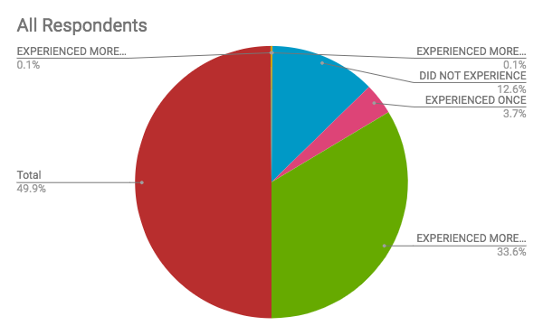
36A. Indicate how often you have personally experienced the following behavior:
Sexist remarks / jokes at the workplace.
Answer | All Respondents | Male Respondents | Female Respondents
DID NOT EXPERIENCE | 25.17% | 35.96% | 22.44%
EXPERIENCED ONCE | 7.48% | 8.99% | 7.10%
EXPERIENCED MORE THAN ONCE | 67.35% | 55.06% | 70.45%

Slide 80
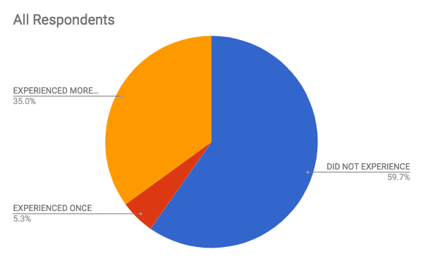
36B. Indicate how often you have personally experienced the following behavior: Obscene gestures / sounds or stares.
Answer | All Respondents | Male Respondents | Female Respondents
DID NOT EXPERIENCE | 59.18% | 62.92% | 58.24%
EXPERIENCED ONCE | 5.22% | 3.37% | 5.68%
EXPERIENCED MORE THAN ONCE | 34.69% | 33.71% | 34.94%

Slide 81
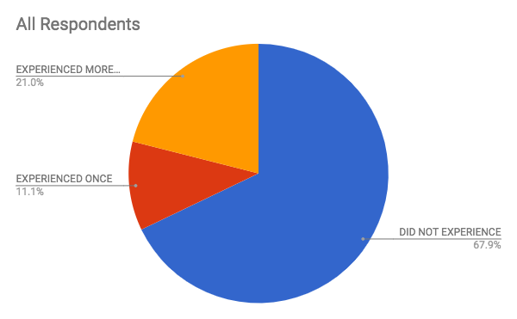
36C. Indicate how often you have personally experienced the following behavior: Unwanted physical contact.
Answer | All Respondents | Male Respondents | Female Respondents
DID NOT EXPERIENCE | 68.03% | 69.66% | 67.61%
EXPERIENCED ONCE | 11.11% | 8.99% | 11.65%
EXPERIENCED MORE THAN ONCE | 21.09% | 20.22% | 21.31%

Slide 82
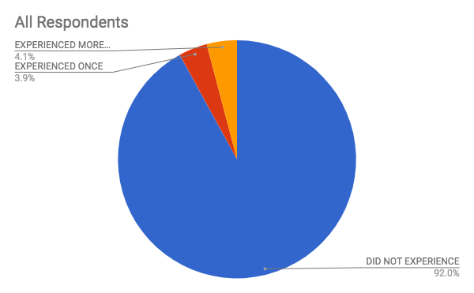
36D. Indicate how often you have personally experienced the following behavior: Unwanted digital sexist messages and or photos (sexting).
Answer | All Respondents | Male Respondents | Female Respondents
DID NOT EXPERIENCE | 91.61% | 89.89% | 92.05%
EXPERIENCED ONCE | 3.85% | 3.37% | 3.98%
EXPERIENCED MORE THAN ONCE | 4.08% | 6.74% | 3.41%

Slide 83
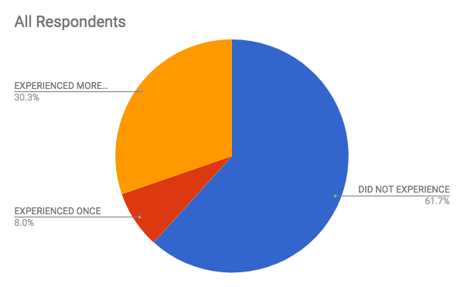
36E. Indicate how often you have personally experienced the following behavior:
Having someone make unwelcome sexual comments, jokes or gestures to or about you.
Answer | All Respondents | Male Respondents | Female Respondents
DID NOT EXPERIENCE | 61.45% | 60.67% | 61.65%
EXPERIENCED ONCE | 7.94% | 11.24% | 7.10%
EXPERIENCED MORE THAN ONCE | 30.16% | 28.09% | 30.68%

Slide 84
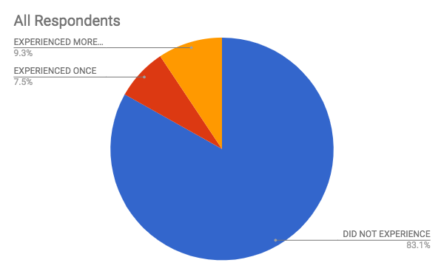
36F. Indicate how often you have personally experienced the following behavior:
Being shown pictures or videos that you did not want to see.
Answer | All Respondents | Male Respondents | Female Respondents
DID NOT EXPERIENCE | 82.77% | 85.39% | 82.10%
EXPERIENCED ONCE | 7.48% | 11.24% | 6.53%
EXPERIENCED MORE THAN ONCE | 9.30% | 3.37% | 10.80%

Slide 85
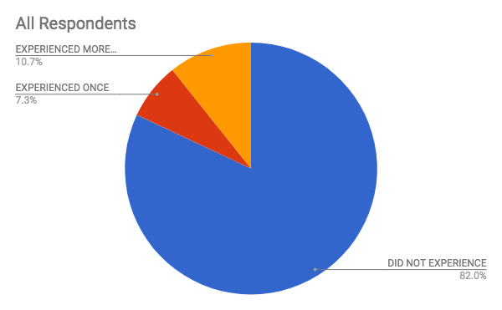
36G. Indicate how often you have personally experienced the following behavior:
Being touched in an unwelcome sexual way.
Answer | All Respondents | Male Respondents | Female Respondents
DID NOT EXPERIENCE | 81.63% | 83.15% | 81.25%
EXPERIENCED ONCE | 7.26% | 5.62% | 7.67%
EXPERIENCED MORE THAN ONCE | 10.66% | 11.24% | 10.51%

Slide 86
36. Overall Comments
A long time ago at another place of employment. I was young and didn't want to cause trouble.
Again, after 40 years in the workforce with many of the early years being much more tolerant about harassing behavior, I have experienced many forms of harassment. Many of these would be reason for firing today, but we have to put the actions into context with the times and accepted social norms.
All above behavior experienced prior to 1993; nothing since joining present firm.
All the incidents checked above were experienced before I was employed in the legal industry. I have fortunately not experienced any of these during my career in the legal industry at this firm.
Answered based on my career, not just this job
At some point I probably experienced some of these, however nothing stands out in my memory.
Did not occur in this industry or this law firm.
Experienced many years ago (late 1980s and early 1990s) at a different law firm
I am an 60+ year old male and probably unlikely to be a target of sexual harassment.
I answered only for my current firm, not for any previous firms
I have heard inappropriate joking in the workplace, and have usually commented to the participants that the nature of the content was inappropriate. The jokes were usually generic, not directed at a particular individual, but none-the-less weren't appropriate.
Jokes at a previous employer
My #METOO experiences were at another firm - not here, where I've been for almost 30 years. I was once fired from a job after refusing sexual contact with a supervisor, after being named employee of the month the month prior.
My experiences were before Anita Hill - Not recent

Slide 87
36. Overall Comments
None of this activity occurred at my current employer. It happened in a retail establishment that I worked in (X1) and on Capitol Hill by a former boss.
Not at my current firm but during my career
Not in the last ten years or so.
Not since being employed with a law firm.
Not while at current employer.
observed, not necessarily experienced
One problem that I saw at my old firm was attorneys viewing porn on their work computers and a staff member walking in and out quickly and unnoticed... then would not report the incident.
Some of the jokes and videos were unwelcome for reasons other than being sexual
The experiences I indicate above were all at past places of employment.
The only one experienced in the office ever was the first one. The rest experienced in the world in general (sometimes at biz events outside office).
The time frame was in the 70s - 90s primarily.
These experiences are over the length of my career and predate the time at my current firm. I have not experienced any of the above over the last four years (my tenure to date at this firm).

Slide 88
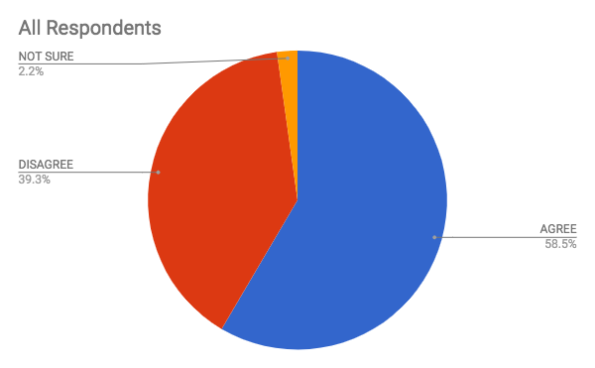
37A. Indicate your reaction to the following statement:
I have personally been a target of sexual harassment.
Answer | All Respondents | Male Respondents | Female Respondents
AGREE | 58.46% | 60.43% | 57.99%
DISAGREE | 39.34% | 35.97% | 40.14%
NOT SURE | 2.20% | 3.60% | 1.87%

Slide 89

37B. Indicate your reaction to the following statement:
I have personally witnessed sexual harassment of another person.
Answer | All Respondents | Male Respondents | Female Respondents
AGREE | 56.54% | 58.22% | 56.14%
DISAGREE | 39.50% | 36.99% | 40.10%
NOT SURE | 3.96% | 4.79% | 3.76%

Slide 90
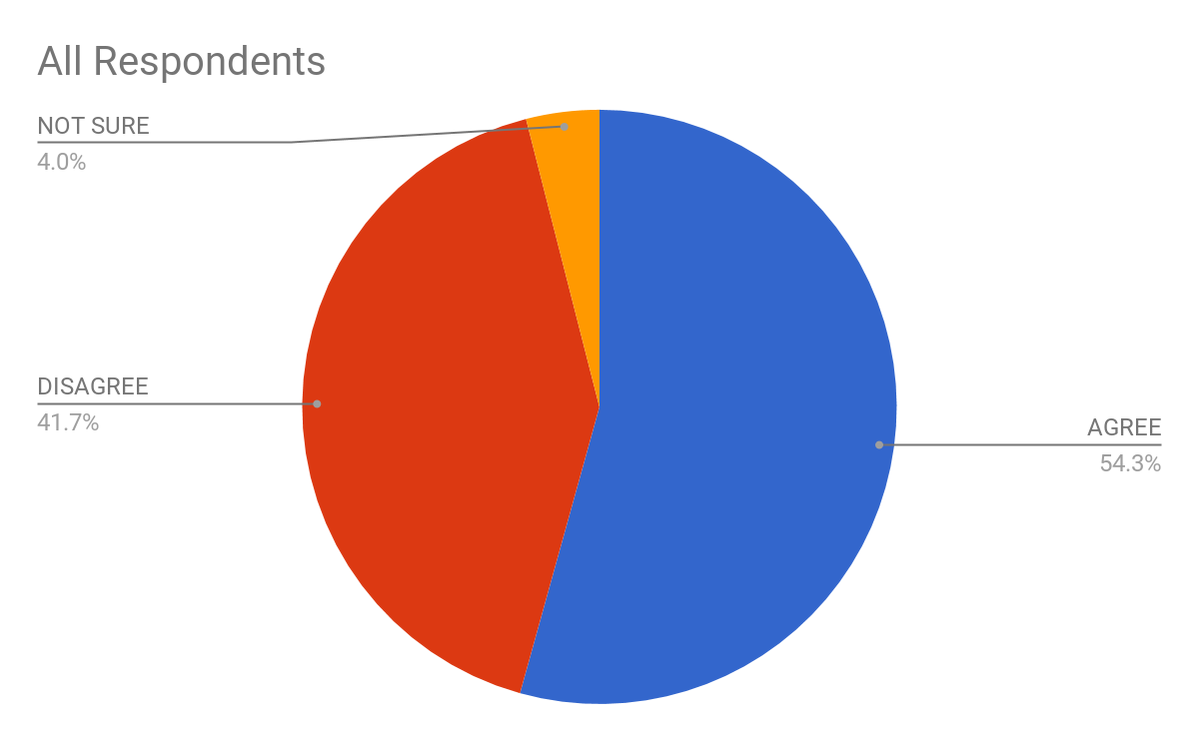
37C. Indicate your reaction to the following statement:
If I bring this up, I will be thought of as a troublemaker or no longer trusted by leadership to have conversations in the inner circle.
Choice | Response | Male Respondents | Female Respondents
AGREE | 54.30% | 51.57% | 55.03%
DISAGREE | 41.72% | 44.03% | 41.11%
NOT SURE | 3.97% | 4.40% | 3.86%

Slide 91
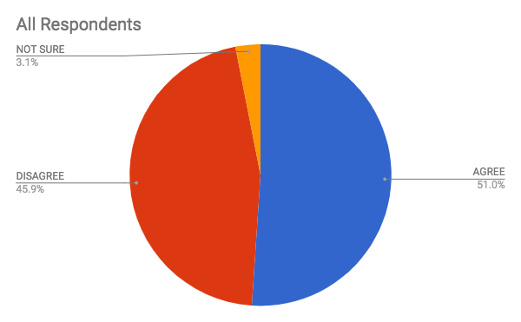
37D. Indicate your reaction to the following statement:
If I bring this up, I feel my job may be jeopardized.
Answer | All Respondents | Male Respondents | Female Respondents
AGREE | 51.05% | 51.55% | 50.92%
DISAGREE | 45.88% | 44.72% | 46.17%
NOT SURE | 3.08% | 3.73% | 2.91%

Slide 92
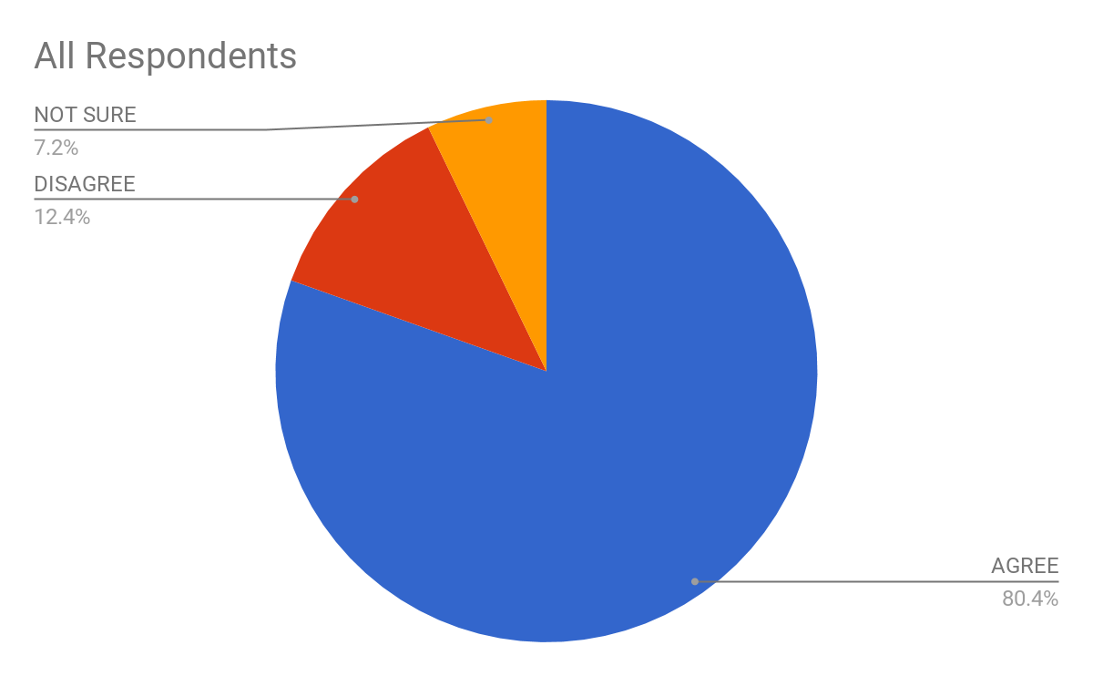
37E. Indicate your reaction to the following statement:
I believe that staff has the power to do something about sexual harassment.
Answer | All Respondents | Male Respondents | Female Respondents
AGREE | 80.44% | 78.57% | 80.89%
DISAGREE | 12.38% | 11.22% | 12.66%
NOT SURE | 7.19% | 10.20% | 6.45%

Slide 93
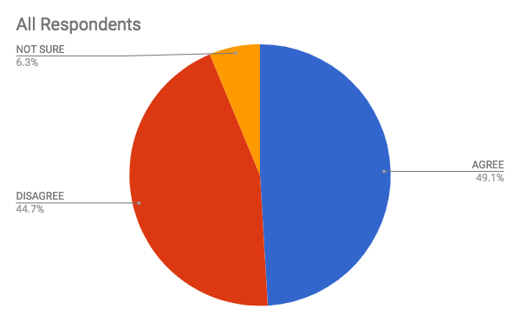
37F. Indicate your reaction to the following statement:
I feel that “harassment” is a harsh term. Some shenanigans go on, but it’s no big deal.
Answer | All Respondents | Male Respondents | Female Respondents
AGREE | 49.06% | 47.20% | 49.53%
DISAGREE | 44.67% | 44.72% | 44.65%
NOT SURE | 6.27% | 8.07% | 5.82%

Slide 94
37G. Indicate your reaction to the following statement:
I feel that individuals naturally behave in a “friendly” way, but it’s harmless.
Answer | All Respondents | Male Respondents | Female Respondents
AGREE | 47.85% | 45.74% | 48.37%
DISAGREE | 33.23% | 32.56% | 33.40%
NOT SURE | 18.92% | 21.71% | 18.23%

Slide 95
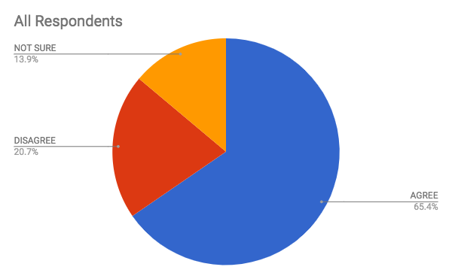
37H. Indicate your reaction to the following statement:
I feel that individuals are aware when they behave inappropriately.
Answer | All Respondents | Male Respondents | Female Respondents
AGREE | 65.41% | 62.07% | 66.29%
DISAGREE | 20.72% | 23.28% | 20.05%
NOT SURE | 13.87% | 14.66% | 13.67%

Slide 96
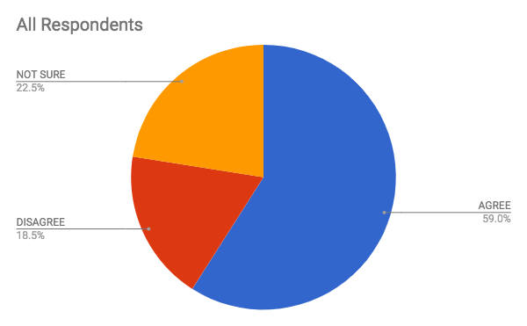
37I. Indicate your reaction to the following statements:
I believe more women in leadership ranks would help address this problem going forward.
Choice | Response | Male Respondents | Female Respondents
AGREE | 59.04% | 55.77% | 59.82%
DISAGREE | 18.45% | 14.42% | 19.41%
NOT SURE | 22.51% | 29.81% | 20.78%

Slide 97
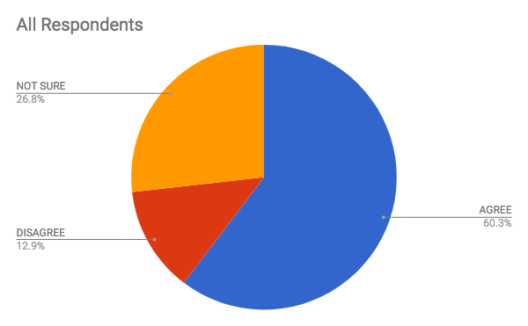
37J. Indicate your reaction to the following statement:
I believe that ALA engaging in this issue will help me in my role.
Answer | All Respondents | Male Respondents | Female Respondents
AGREE | 60.32% | 63.00% | 59.65%
DISAGREE | 12.90% | 13.00% | 12.87%
NOT SURE | 26.79% | 24.00% | 27.48%

Slide 98
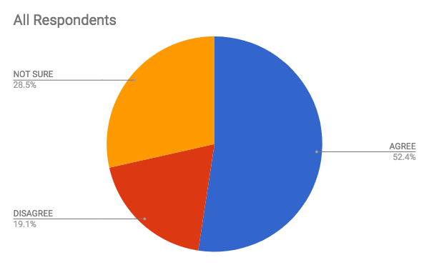
37K. Indicate your reaction to the following statement:
I would like more ALA support on this issue.
Answer | All Respondents | Male Respondents | Female Respondents
AGREE | 52.41% | 52.34% | 52.42%
DISAGREE | 19.07% | 17.76% | 19.40%
NOT SURE | 28.52% | 29.91% | 28.18%

Slide 99
37. Overall Comments
"I feel that individuals naturally behave in a "friendly" way, but it's harmless" seems to be situation specific without providing enough context to confirm whether or not harassment is present.
#1 I do feel the term "harassment" is over-used, especially in one-time situations that do not rise to the level of harassment. A male staffer telling a female staffer that she looked "hot" may be unwelcome. However, she told him so and he didn't do it again. I don't think that was harassment. Unwanted? Yes. Unwise? Probably. Harassment? I don't think so. #2 Some people seem clueless on their behavior - probably because they got away with it for so long. Training helps make them aware and empowers people to say they are offended. Most of the incidents I have had to address were first time "offenses.”
All of the harassment I experienced took place before the year 2000. The awareness of "hostile work environment" has helped immensely and the incidents have been taken much more seriously, and increasingly so, in the last 20 years.

Slide 100
37. Continued -- Overall Comments
I believe ALA support would be helpful across the board, but I personally am in a very good place.
I believe staff are not powerless. They do have power, but they also have the option of using that power to involve others to help them. Only with them coming forward to make HR leadership aware of issues can change happen. I also believe that the majority of individuals behave in a friendly way with no ill-intent meant. It's never as black and white as a yes/no answer tries to make it. I also believe those with ill intent are aware of their behavior and that the behavior is inappropriate. There are those that can do/say something completely inappropriate without intent and without being appropriately aware of how wrong/offensive it is. Once could be forgiven. Repeat behavior, no.
I believe the atmosphere is changing but it appears to be a warning to mgmt about the costs and not the bad behave
I feel that SOME individuals are aware when they behave inappropriately; some do not realize it is inappropriate and need better training
I feel there is a big difference between sexual harassment and sexual abuse. Both should be reported; however, in some cases of sexual harassment, if the harasser is the boss, it's best to just move on.
I have not personally experienced traumatic situations in this manner. However, if many of my colleagues have, then I would most certainly agree that more engagement and support on this issue would be appropriate and needed from the International level.

Slide 101
37. Continued -- Overall Comments
My situation occurred well over 20 years ago when this issue was not typically made public, or worse, simply overlooked.
Our firm requires annual harassment and diversity at all levels. Individuals in a supervisory role (all attorneys and management) training is extensive, relative to staff training.
Our managing partner is a woman and I don't think the attorney who we fired would have been fired if the managing partner was a man! The men in the firm, who caught wind of the issue, thought we were being too harsh.
I think education vs more women is the answer, because I have seen it where the woman is the aggressor - it's not always the man.
I would like to reiterate that my experiences were NOT at my current firm nor did I experience any issues after I left my first job where this was experienced. It was also 34 years ago.
In general, it is imperative that other people have the harassment-free environment I am personally blessed to be working in for the past 13 years! Having been exposed to it in the past, it really makes a HUGE difference in your ability to enjoy and be productive and happy at your workplace!
More needs to be done to assist women

Slide 102
37. Continued -- Overall Comments
Several in office "affairs" have gone on over the years. The effect is not only on the person having the affair (when it goes south), but also on those who work with that person as that person gets special favors and inappropriate "leave time" and other benefits which affect the volume of work for the others. The firm denies the "affairs" when there is not direct evidence and when there is, they say it is between the parties involved, even when it affects others in the office and ultimately the involved party when the relationship goes south and they are terminated for some made up reason (usually involving the problems resulting from the affair).
The harassment that I personally experienced and of which I was personally aware that occurred to others all took place in offices prior to my current employer. The harassment that I experienced personally occurred long ago. And even in those supposedly unenlightened times, I reported the behaviors to Human Resources, who investigated and took appropriate action against the other party. My job was not jeopardized, I was not ostracized, and in fact I continued to receive job advancement for years after I lodged the complaint. Too bad not everyone has had the same experience.
While I've certainly had my share of lewd comments and obscene gestures earlier in my career, I personally never felt harassed or threatened by them. Not to excuse inexcusable behavior, but it was a different time.
With respect to "friendly behavior", I do believe that behavior that may have been considered friendly in the past can be problematic now. People have very different levels of comfort, and one must be very cautious not to make another person feel uncomfortable

Slide 103
** General Survey Comments **
Although I have not experienced any harassment at my current firm, I was at a few different big law firms for about 15 years and left in part harassing behavior of various kinds was pervasive and ignored by firm leadership. Once when I spoke to a partner about being aware of an inappropriate comment made by another partner, he threatened to stop talking to me which would have made it hard to fulfill the needs of the position. I think the problem is far worse in big law firms than anyone acknowledges.
Continued discussion on the topic, and 3rd party companies handling training, is a great option for law firms where in-house attorney are often the trainers, which puts them in a difficult position if/when an incident occurs.
Education is key. EPLI carriers question what a firm does about training for all employees, partners and business part
I am fortunate to work at a Firm that simply will not tolerate inappropriate behavior of any kind.
As a result of recent media attention, our firm has revised its harassment policy.
I am not aware of sexual harassment in my current firm. I believe the firm would address the issue, but I would not want to bring it up for fear of recriminations. I also believe, however, that people are too sensitive and "politically" correct. You can no longer tell someone they look nice, or you like their outfit because it may be misconstrued.
I believe in Ontario we are in better shape due to employment legislation, including the occupational health and safety act.
I consider our environment very reactive to any incidents of harassment and that overall the issue is not present. All conduct themselves professionally and have done so for the last many years. I believe the firm may have been very different in the past but as emphasis was put on the issue and management supported the efforts, the problems have dissipated. A single incident several years ago was dealt with immediately and fairly and put the supervising members on notice and installed confidence that violations would be investigated in a manner fair to all.

Slide 104
*** Continued -- General Survey Comments ***
I do believe it's a rare woman who has not experienced harassment at some point in her career, but I do believe that there are current office environments where it truly has not occurred.
I feel that the issue of sexual harassment has been taken to a place in today's environment in which everyone wants to say "me too" just because someone made a pass at them. When you spend most of your waking hours at work, the people you interact with are at work. Relationships develop naturally when people are together. This does not mean that I don't believe there are true instances of sexual harassment because I do.It just means this situation has taken a life of its own and I feel that it is somehow blown out of proportion.
I found some of these questions very challenging to answer. The questions could have been more effectively worded.
I have not witnessed or been subjected to sexual harassment. It would not be tolerated at my firm. I believe there are many legitimate instances of it occurring in various businesses or industries. That said, I believe much is being blown out of proportion or exaggerated now. I witness - not at this firm but in life - as many women making sexual jokes or advances on men as vice versa. When it is legitimate harassment, it should absolutely be addressed because it is not acceptable. We need to find the balance though of addressing real situations versus a witch hunt or double standards. I am not making light of real and terrible instances of abuse. I also do not believe it is a rampant problem in every business or industry as is being portrayed right now by the media.
I think the size and culture of a firm will dictate whether EEs are comfortable reporting concerns, investigations are followed through with and, when appropriate, offenders, especially when they are in powerful, ownership, or leadership rolls, will be disciplined in accordance with policy. I also believe that younger generations are less tolerant and, in many cases too thin skinned, and more likely to report incidents than older generations. Growing up in a "good ole boy" and/or "man's world" type workplace, not only required thicker skinned ladies/staffers, but actually favored the behavior of those powerful/bullies many of whom will never realize the extent to which their behavior was inappropriate
I would have to say that over the past 35 years in the legal industry, I was subjected more to cruelty and disrespect than sexual harassment. By definition, I am not sure which is worse.
I would like to see ALA focus on harassment of all kinds.

Slide 105
*** Continued -- General Survey Comments ***
If a person is both professional and moral, they won't have a problem with this. If they are unprofessional or immoral, then they shouldn't be working for the firm.
It is difficult to segregate out sexual harassment from general bad behavior, because it is generally a more extreme result of tolerating other gender biased behavior which isn't acceptable. Gender bias, racial biases, homophobic biases, bullying in all facets, can all lead to an environment where it is seen as acceptable, or at least tolerated, to essentially do what you want without regard for how it impacts and affects others. This can lead to sexual harassment, but I doubt that such harassment would exist in an environment when no form of such inappropriate behavior is tolerated.
Many of these questions presupposes that harassment happens in all workplaces and seem somewhat biased.
Men can be harassed. SH is not a female exclusive club in the workplace.
My firms have been safe over my career, it's the world outside, both the professional world and the social world.
Need to make distinction between sexual harassment and general sexism (which I believe is rampant in law firms)
our firm is currently looking to engage a powerful speaker on this topic
Our firm recently conducted firm-wide mandatory sexual harassment training.
Over the years, I've tolerated light sexual misconduct, but nothing that I couldn't handle on my own. Most of my friends have experienced uncomfortable advances by male co-workers. I feel the situation has improved over the years. Most law firms have policies in place now, and consequences of abuse are well known.
Sex is a very powerful weapon and some men and women use it to their advantage - the answer? Just say no.

Slide 106
*** Continued -- General Survey Comments ***
Sitting thru mgmt training we still hear chuckles and jokes so I'm not sure the big picture information is being communicated!
We have to do more. My current firm has strong stance of awareness and training for this and I hope all firms take it as seriously.
Can we address Ageism next?
When I reported consistent harassment that everyone joked about, the partner was told to stay away from me and out of my office for some undetermined period of time.
There has NEVER been any type of sexual harassment issues at our firm since I have been here - over 20 years. The partners just would not stand for it. They are - and always have been - extremely conscious of the way everyone conducts themselves in the office. If anyone would ever do anything, I have every confidence that they person would be immediately dealt with. The previous sexual harassment I personally experienced happened a long time ago and I was young and naive - I know I should have spoken up, but I felt I could handle myself - and I did - by removing myself from the situation as soon as I could.
This has been going on for many many years. Surprised it has taken this long for something to be done.
This has been the trending issue for the past year or so, and I strongly believe people should be aware of it and understand what inappropriate conduct is. Sometime it seems to me, though, this issue has been turned into a witch hunt, as I believe it can also be utilized to destroy reputations. With education, and time, boundaries will become clearer to everyone, and people will feel more at easy reporting and bringing to light unjustified behaviors.
We had some issues in the early 2000's - which I addressed privately with the offender, who later resigned for a new opportunity. Last year we heard some rumblings among female associates that there was gender bias here. I had an outside attorney hire an investigator, who interviewed all of the female employees. No sexual harassment was reported. I don't believe it exists here.
We have had a couple of office romance situations but have not had any claims.

Slide 107
*** Continued -- General Survey Comments ***
We promote a work environment of mutual respect and have very few complaints. If an issue arises, our management is very supportive of prompt attention and resolution.
When I was a young secretary, it was fun to flirt and I dated lawyers in the firm. Now that I am married and in a management role, I find it inappropriate when employees form relationships with co-workers. The Christmas party flirting between employees is always an issue and I can only hope that one of the parties is not offended (or regret their actions the next day).
While our 40-lawyer firm has not experienced any example of harassment, we want to be proactive always and therefore very interested in ALA's advice and recommendations on the topic. Thank you.
A partner who had been spoken to about harassment in the past was promoted to managing partner.
Lawyers and management obtain sexual harassment prevention training. Staff does not.

Slide 108
End of Report

