Slide 1
ALA Chapters Insurance: What You Need to Know
Regan E. Katz, Managing Director / Sales Leader
Marsh USA, Inc.
July 7, 2021

Slide 2
Review of Coverage Provided by ALA
General Liability
Errors & Omissions
Education at Chapter level
Programs/educational programs
Promoting information regarding administration and management issues

Slide 3
Optional Coverage Available for Purchase
Crime Coverage
Directors & Officers Coverage (at Chapter level)
Cyber/Privacy Liability
**Possible discount if two (2) or more lines purchased (Crime, D&O, Cyber)

Slide 4
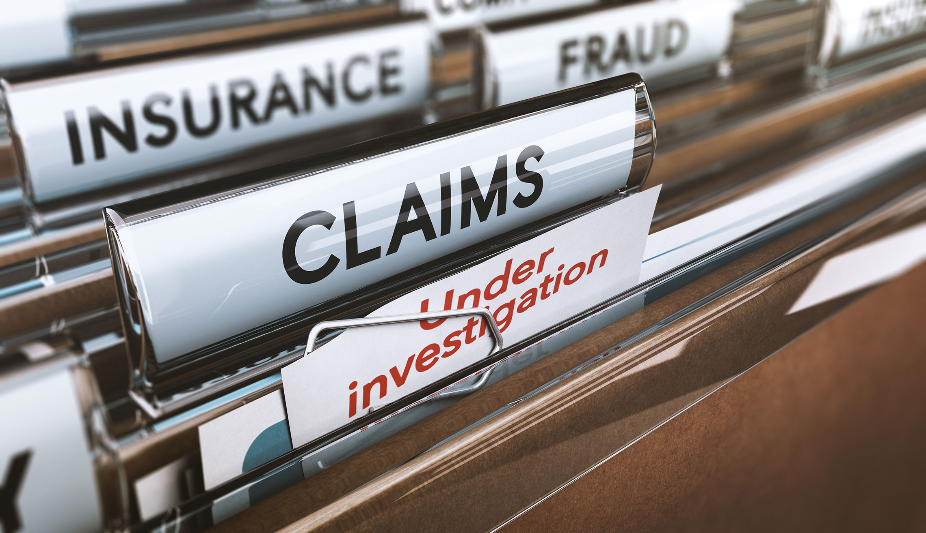
Crime
Provides coverage for the Chapter for theft by volunteer or employee of individual Chapter
Optional coverage for Third Party Theft

Slide 5
Crime Coverage Definitions
Generic Claims Examples
Insuring Agreement | Definition | Claim Scenario
Fidelity | Includes coverage for employee theft, ERISA fidelity and employee theft of client property for direct loss of, or direct loss from damage to money, securities and other property. | An employee leveraged her role as executive director to procure payment to fraudulent vendors and to procure gift cards and other goods for personal benefit resulting in loss of $789,000.
Forgery or Alteration | Includes coverage for loss sustained through forgery or alteration of outgoing negotiable instruments made or drawn by you, or drawn on your account(s), or made or drawn by one acting as your agent. | A signature was forged on a check and cashed at the insured’s bank resulting in loss of $6,343. An affidavit of forgery was executed claiming that the person’s signature that appears on the check was not placed on the check by that person.
On Premises | Includes coverage for direct loss from damage, money or securities located inside the premises directly caused by theft, robbery or safe burglary. | Rent checks from eight different residents were stolen from inside the insured’s premises. Loss was discovered after notices were sent out to residents advising that payments were overdue and one of the residents advised that his check had already been cashed.
In Transit | Includes coverage for direct loss of money or securities directly caused by theft, disappearance, damage or destruction while in transit outside the insured’s premises and in the care and custody of a messenger or armored vehicle company. | A company lost $2,500 when money was stolen from its messenger’s truck while in transit.
Definitions from Travelers Wrap+ Specimen Policy Form

Slide 6
Crime Coverage Definitions
Insuring Agreement | Definition | Claim Scenario
Money Orders and Counterfeit Money | Includes coverage for direct loss caused by the insured’s good faith acceptance of worthless money orders or counterfeit money. | A company received a counterfeit cashier’s check for payment of delivered equipment. Loss exceeded $30,000.
Computer Crime | Includes coverage for direct loss of, or direct loss from damage to, money, securities and other property caused by computer fraud as well as restoration expenses, or replacement of damaged or destroyed computer programs or electronic data caused by computer violation. | An employee of a vendor fraudulently gained access to the insured’s computer and changed the bank routing number from the vendor to the employee’s bank routing number, causing a large sum of money to be transferred directly to the employee instead of to the vendor.
Funds Transfer Fraud | Includes coverage for direct loss of money and securities contained in the insured’s transfer account caused by fund transfer fraud. | An unknown party impersonated the insured’s bank, contacted the insured’s funds transfer administrator and convinced them to activate a computer link back to a phony bank. This allowed the impersonator to contact the insured’s real bank, pretend to be the insured, and have wire transfers issued that ultimately ended up with a foreign bank resulting in loss of $30,000.
Personal Accounts Protection | Includes coverage for personal accounts forgery or alteration and identity fraud expense reimbursement. | A company executive entrusted her secretary with her personal credit card and account information to arrange for travel arrangements. The secretary used that personal information for personal gain.
Claim Expense | Includes coverage for reasonable claim expenses incurred and paid by the insured to establish the existence, amount and preparation of the insured’s proof of loss in support of a covered claim. | In addition to an employee dishonesty claim, a company incurred claim related expenses by retaining outside accountants and consultants in order to establish the existence, amount and preparation of its proof of the employee dishonesty claim.
Definitions from Travelers Wrap+ Specimen Policy Form

Slide 7
Crime Renewal Quotes- Basic Coverage
2020-2021 Policy Period
$50,000 Employee Theft
$50,000 ERISA *
$50,000 Forgery/Alteration
$50,000 Personal Accounts Protection
$1,000 Deductible
$125 Annual Premium
2021-2022 Policy Period
$50,000 Employee Theft
$50,000 ERISA *
$50,000 Forgery/Alteration
$50,000 Personal Accounts Protection
$1,000 Deductible
$125 Quoted Annual Premium
Note: $5,000 Claims Expense also included, with $0 deductible
ERISA coverage is subject to a $0 deductible
**Premiums will have some variation based on location.

Slide 8
Crime Renewal Quotes- Premium Coverage
2020-2021 Policy Period
$50,000 Employee Theft
$50,000 ERISA
$50,000 Forgery/Alteration
$50,000 On Premises
$50,000 In Transit
$50,000 Money Orders & Counterfeit Currency
$50,000 Computer Crime
$50,000 Funds Transfer Fraud
$50,000 Personal Accounts Protection
$50,000 Social Engineering Fraud
$1,000 Deductible
$248 Annual Premium
2021-2022 Policy Period
$50,000 Employee Theft
$50,000 ERISA
$50,000 Forgery/Alteration
$50,000 On Premises
$50,000 In Transit
$50,000 Money Orders & Counterfeit Currency
$50,000 Computer Crime
$50,000 Funds Transfer Fraud
$50,000 Personal Accounts Protection
$50,000 Social Engineering Fraud
$1,000 Deductible
$184-321 Estimated Annual Premium
Note: $5,000 Claims Expense also included, with $0 deductible
ERISA coverage is subject to a $0 deductible
**Premiums will have some variation based on location.
Higher Limits shown on next slide

Slide 9
Crime: Higher Limits
$100,000 Limit Option
$100,000 Employee Theft
$100,000 ERISA*
$100,000 Forgery/Alteration
$100,000 On Premises
$100,000 In Transit
$100,000 Money Orders & Counterfeit Currency
$100,000 Computer Crime
$100,000 Funds Transfer Fraud
$100,000 Personal Accounts Protection
$100,000 Social Engineering Fraud
$2,500 Deductible
$340-500 Quoted Annual Premium
$150,000 Limit Option
$150,000 Employee Theft
$150,000 ERISA*
$150,000 Forgery/Alteration
$150,000 On Premises
$150,000 In Transit
$150,000 Money Orders & Counterfeit Currency
$150,000 Computer Crime
$150,000 Funds Transfer Fraud
$150,000 Personal Accounts Protection
$150,000 Social Engineering Fraud
$3,000 Deductible
$568-700 Quoted Annual Premium
Note: $5,000 Claims Expense also included, with $0 deductible
ERISA coverage is subject to a $0 deductible
**Premiums will have some variation based on location.

Slide 10
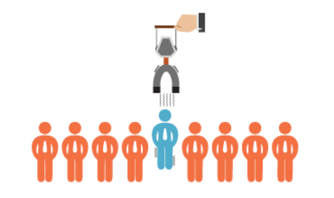
Add On: Social Engineering Coverage
This coverage was offered upon renewal in 2018.
Coverage is still available upon 2021 renewal.

Slide 11
Directors & Officers Liability
Over 63% of nonprofit organizations experienced a Directors & Officers Liability claim in the past 10 years, which is higher than the percentage for both private and public companies
Top 10 Current Business and Legal Trends Affecting Management Liability for Private and Not-For-Profit (NFP) Companies Winter 2020 Update
Employment Practices and Private Companies
Merger and Acquisition Liability
Securities Actions Against Private Companies
Anti-Trust Litigation
Risks Associated with Foundations
Risks Associated with Not For Profit Higher Education
Private Companies in Financial Distress
Cyber
Excessive Fee Litigation (Fiduciary)
Increased Focus On Healthcare

Slide 12
Reasons to consider D&O
Protection of Personal Assets (as individual director, volunteer… if there is no or there is not enough indemnification available, this policy responds)
If small ALA Chapter, assets may not cover defense
If large ALA Chapter, multiple defendants share limits
Exposure to Third Parties
Vendors
Other competing organizations
Misappropriation of funds
Nuisance Lawsuits

Slide 13
D&O Claims Examples
Breach of Fiduciary Duty
Failure to Fulfill the Organization’s NFP Mission
Misuse of Funds
Improper Conduct of Volunteers (or Employees)
“But we are protected by the Volunteer Protection Act”
This act does not provide defense costs, gross negligence or reckless misconduct

Slide 14
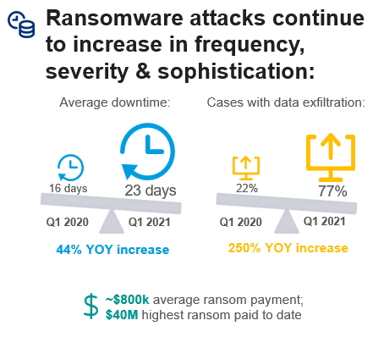
Cyber/Privacy Exposure
Data on membership (PII)
Credit cards – large chapters a/o PayPal type relations
Chapter Cyber extorted

Slide 15
Cyber Insurance Market Snapshot
Pricing & Terms |  | Claims |  | Underwriting
Rates | Limits / Coverage | Frequency | Severity | Information Needs | Carrier Flexibility
Average premium increase in: Oct 2020: 11% Nov 2020: 17% Dec 2020: 26% Jan 2021: 29% Feb 2021: 32% Mar 2021: 39% April 2021: 40% | Many carriers are reducing capacity exposed. Some carriers are scaling back ransomware-related coverages (or not offering coverage at all) for clients that don’t have adequate controls. | Ransomware is more accessible for bad actors. Short tail nature of losses is changing insurer profitability weekly. | Ransom payments in the millions. Business interruption and data recovery loss. Solar Winds & MS Exchange attacks have increased carrier uncertainty around systemic nature of cyber risk. | Full application & responses to ransomware Q’s. Underwriters will inquire about usage of Solar Winds services and Microsoft Exchange servers. | Ransomware responses required prior to quoting. Third party scans may lead to remediation requests. Minimum controls are required to obtain a quote.
Future Expectations
Anticipate increases to accelerate, likely 50% or greater in Q2 and beyond; terms dependent on risk profile & controls.
Future Expectations
Ransomware attacks will continue to increase in sophistication; systemic risks concerns; privacy risk concerns.
Future Expectations
Underwriters will demand additional information to assess risk and may require certain cyber controls to quote.
Favors Buyer Neutral Favors Insurers

Slide 16
Cyber Liability Insurance
 | DESCRIPTION | COVERED COSTS | CLAIMS EXAMPLES
First Party Cover 1st Party Insurance coverage: direct loss and out of pocket expense incurred by insured. Triggered upon discovery of an event.
Business Income/ Extra Expense | Interruption or suspension of computer systems due to a network security breach. Coverage may be added to include system failure and can extend to contingent businesses. | Loss of Income Costs in excess of normal operating expenses required to restore systems Forensic expenses Dependent business interruption | Malware gets into the computerized factory controllers causing the line to cease operating. IT forensics must be performed to restore system operations. During routine network patching duties, an IT employee accidentally crashes the critical IT infrastructure causing operational disruption when the IT systems are inaccessible. A supplier you depend for delivery of your end service to customers suffers a cyber event that prevents them from delivering critical parts/services to you. You sustain a business income loss.
Data Asset Protection | Costs to restore, recreate, or replace electronic data and other digital / intangible assets that are corrupted or destroyed. | Restoration of corrupted data Vendor costs to recreate lost data | After a cyber event that impairs your IT (or OT) network, costs are incurred to hire an IT forensics firm to determine whether the information can be restored. The data is recreated and restored.
Event Management / Breach Response | Costs incurred responding to a network security or privacy breach. | Forensics Notification Credit Monitoring Call Center Public Relations | You suffer a data breach and incur costs ranging from IT forensic analysis, legal advice, costs to notify affected parties, credit monitoring for affected parties, and public relations assistance to help restore public trust in your firm.
Cyber Extortion | Costs associated with a ransomware event, regardless of whether or not a ransom demand is paid. | Negotiation & ransom payments Forensics Investigation | Your employee unwittingly clicks a link in a phishing email resulting in ransomware locking out your ability to utilize business critical technology until a ransom demand is paid (or you’re able to restore your network from back-ups).

Slide 17
Cyber Liability Insurance
 | DESCRIPTION | COVERED COSTS | CLAIMS EXAMPLES
Third Party Cover 3rd Party insurance coverage: defense and liability costs due to alleged harm caused to others by the insured. Triggered by a demand/lawsuit.
Privacy / Network Security Liability | Failure to prevent unauthorized access / disclosure of personally identifiable or confidential information; Failure of system security to prevent or mitigate a computer attack | Liability and defense Bank lawsuits Consumer lawsuits | A breach of your computer network leads to loss of sensitive customer information. Customers file suit against you for the failure to protect their private data. Your network security fails to prevent a self-propagating malware from being transmitted from your network to a third party. You are sued for financial damages incurred by 3rd parties, like banks that incurred costs to re-issue bank cards to impacted individuals.
Privacy Regulatory Defense Costs & PCI Fines & Penalties | Investigations and related fines or penalties assessed by Regulators or for violation of PCI data security standards | Liability and defense PCI / PHI / regulatory fines and penalties Prep costs to testify before regulators | A data breach leads to an investigation by a regulator such as the Office Of Civil Rights (OCR) for a breach of sensitive healthcare information leading to a HIPAA violation A EU data protection authority investigates a potential GDPR violation.
Media Liability | Including but not limited to: libel, slander, product disparagement, misappropriation of name or likeness, plagiarism, copyright infringement, etc. | Liability and defense | You are sued by a competitor when your CEO posts disparaging comments about the competitor on a social media site.
Tech E&O | Acts, errors or omissions in the performance of technology services to others for a fee; or the failure of technology products to perform as intended – resulting in a financial loss. | Liability and defense | There is an error in the code that runs your hardware product which prevents it from operating properly. Because your customer cannot use the product, they sue you for breach of contract and other financial damages.

Slide 18
Cyber Liability Pricing
Third Party Liability Insuring Agreements | Limit | Retention | Continuity Date | Prior & Pending Proceeding Date
A. Network and Information Security | $1,000,000 for each Claim | $1,000 for each Claim | Inception | Inception
B. Communication and Media Liability | $1,000,000 for each Claim | $1,000 for each Claim
C. Regulatory Defense Expenses | $1,000,000 for each Regulatory Claim | $1,000 for each Regulatory Claim
First Party Insuring Agreements | Limit of Insurance | Retention
D. Crisis Management Event Expenses | $1,000,000 for each Single First Party Insured Event | $1,000 for each Single First Party Insured Event
E. Security Breach Remediation and Notification Expenses | $1,000,000 for each Single First Party Insured Event | $1,000 for each Single First Party Insured Event
F. Computer Program and Electronic Data Restoration Expenses | $1,000,000 for each Single First Party Insured Event | $1,000 for each Single First Party Insured Event
G. Computer Fraud | $1,000,000 for each Single First Party Insured Event | $1,000 for each Single First Party Insured Event
H. Funds Transfer Fraud | $1,000,000 for each Single First Party Insured Event | $1,000 for each Single First Party Insured Event
I. E-Commerce Extortion | $1,000,000 for each Single First Party Insured Event | $1,000 for each Single First Party Insured Event
J. Business Interruption and Additional Expenses | $1,000,000 for each Single First Party Insured Event
Due to current hard market conditions, all quoting will require a completed Cyber application and Multi-Factor Authentication (MFA) in place.

Slide 19
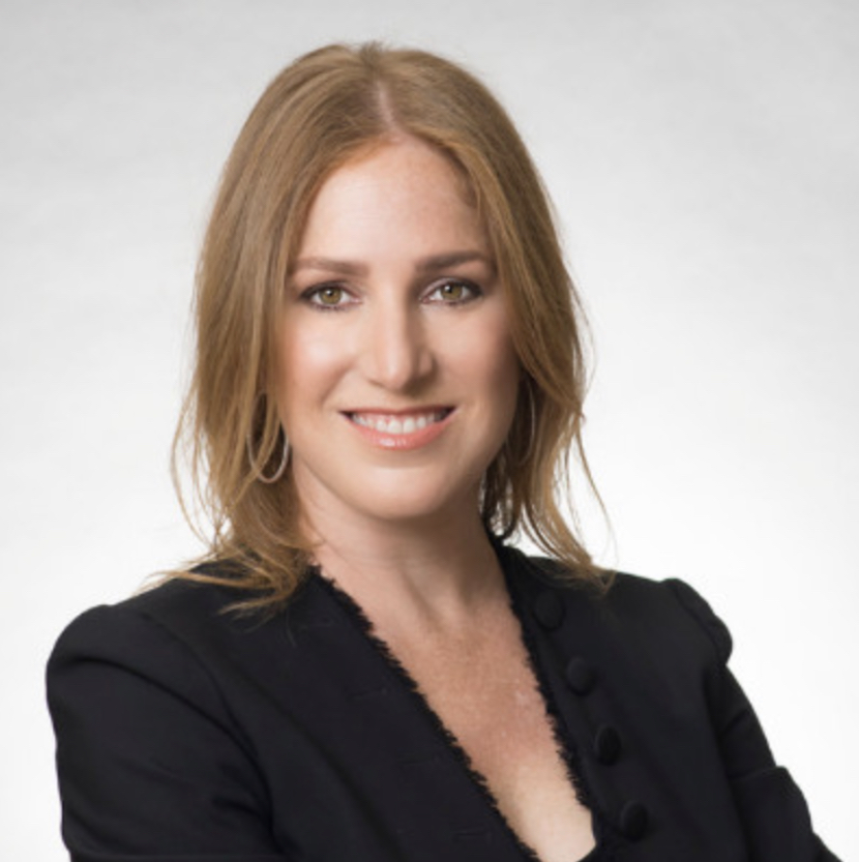
Questions?
Regan Katz
Marsh USA, Inc.
713-346-1081 Direct
Regan.Katz@Marsh.com
Regan Katz, Managing Director and Sales Leader, joined Marsh in 2012 and was elected Managing Director in 2014. Prior to joining Marsh, Regan worked in public accounting and at a national insurance brokerage firm. She has specific experience with professional service firms, cyber/technology risks, law firms, non-profit, and retail/hospitality clients. Her education includes a BBA from Texas A&M University and she is a Registered Professional Liability Underwriter, Certified Risk Manager, and Licensed Risk Management Professional. Regan is active in the Claims & Litigation Management Alliance where she has served as Texas State Chair and President of the Houston Chapter. She currently serves on the Board of Directors for the Houston Livestock Show and Rodeo.

