Slide 1
Any Volunteers?
Jody Gressett
DeAnna Lopez
Stacey Ransleben
ALA Chapter Resource Team

Slide 2
Today’s Nuggets Include:
1. The Benefits of Volunteering
2. Growing your Volunteer Base at your Chapter
3. Nurturing your Volunteers

Slide 3
ALA is a volunteer organization…

Slide 4
What are the benefits of volunteering?
Volunteering connects you to others
Volunteering is good for your mind and body
Volunteering can advance your career
Volunteering brings fun and fulfillment to your life

Slide 5
How to find volunteers
Just Ask…
People like being asked to volunteer!
Announce why and when your Chapter needs volunteer help, but invite your best leads personally. Flyers and sign-up sheets can be helpful as well.

Slide 6
And Don’t forget to Tell them about all the cool trophies they can accumulate over the years…

Slide 7
Team work
Work with your Board to create a list of members you believe would work best with your team and then ask them to volunteer.
Ask them what they enjoy doing.

Slide 8
Create lifetime volunteers
Create a relationship with new and old volunteers that will make them want to come back.
Treat them like employees of ALA.
Manage with respect, provide feedback and empower them to have a rewarding experience.

Slide 9
No is Not Never
Recruit as early as possible;
If they say no, don’t take that as rejection;
Continue contact and raise awareness; and remember…
Everyone’s schedule and life circumstances are subject to change at any time.

Slide 10
Leave Seats Empty
Make sure you have the right fit.
Sometimes an “empty” spot is better than just “filling” a spot…

Slide 11
POSITION TITLES ROCK!
Volunteers look at their titles in an organization like they do at work (e.g., legal secretary titles over the past few years).
Provide as much detail as possible – no surprises.
Consider volunteer sources “outside the box” – retirees, lifetime members and/or business partners.

Slide 12
Tried & True Ideas from the Houston chapter… to help demystify the “clique” urban legend
Consider one-on-one small “welcome” lunches with new members and your Membership Committee Chair to talk about involvement opportunities (get members excited about your Chapter);
During a monthly Chapter meeting, our Chapter President draws the name of one Business Partner and one member to take to lunch together each month for quality networking time together;
As a Board, demonstrate that being on the Board is fun and a worthy experience through your conversations with others. Invite members to attend your Board meetings to experience what it is like to be a Chapter leader first-hand; and
Houston hosts an annual HCLI following CLI that includes all Committee Chairs and Board members.

Slide 13
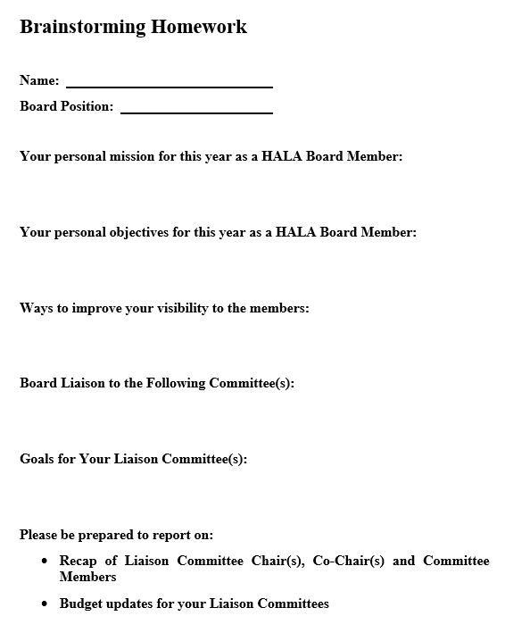
Presidents - Preparing for Your First Board Meeting Involvement from the Beginning

Slide 14
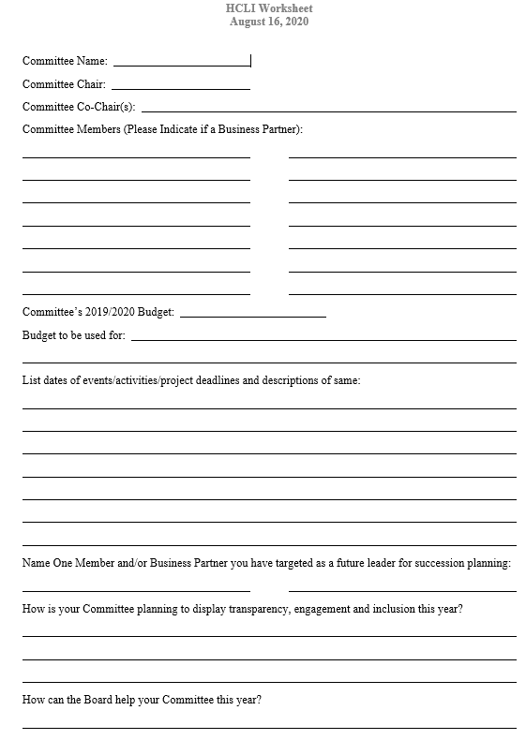
Preparing for Your Own Chapter Leadership Institute

Slide 17
Don’t ever run out of leaders… a/k/a SUCCESSION PLANNING
The hills are alive with the sound of leaders…
Keep it in the conversation;
Have Co-Chairs for each committee;
Identify the Co-Chair as early as possible for training purposes;
Invest in potential leadership through inclusion in committee planning & budgeting;
Consider scholarships for CLI opportunities with the ALA before a member is on the Board;
Discuss their “Chapter Career Path” – committee member, co-chair, chair, possible Board position; and
Talk about your Chapter’s leadership needs with members and especially at Chapter meetings.

Slide 18
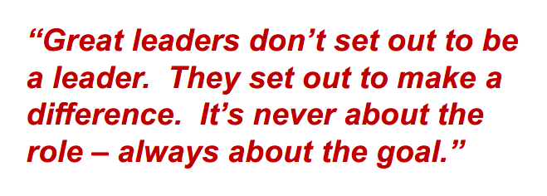
QuotesBlog.net

Slide 19
Why am I a volunteer?

Slide 20
In ala – Start out as a volunteer… grow into a leader

Slide 21
Thank you for sharing your time with US!

