Slide 1
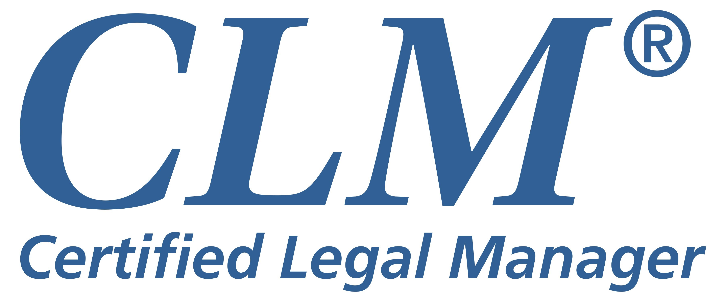
Path to Certification
2023

Slide 2
The Benefits of Certification
Regardless of the stage in your career, certification adds a valuable dimension to your professional development.
ALA’s Certified Legal Manager (CLM)® program provides the opportunity to demonstrate you have mastered the knowledge, skills and abilities to operate at a high level of expertise in the field of legal management.

Slide 3
Benefits Include
Real World Relevance
Increases on the job knowledge and preparedness
Return on Investment
Factors into employer decisions about compensation, hiring and advancement
CLMs can get significant discounts for their firm on products
Personal Satisfaction and Validation
Enhances confidence, peer respect and recognition

Slide 4
What Your Peers Say
“Preparing for the exam helped me to learn many new things while adding clarity to the things I already knew. My specialty was finance, but I ended up taking a position that utilizes my new CLM skills. I’m thankful that the CLM properly prepared me for it.”
– David Glicksman, CLM, CPA, Director of Finance at Lester Schwab
Katz & Dwyer, LLP, in New York, New York

Slide 5
What Managing Partners Say
“This certification exam covers very important principles necessary to the effective and proficient administration of a law firm.”
“Attorneys notice and appreciate the CLM’s expertise in managing the business of law at their firms.”
“Lawyers are status conscious, and the CLM provides professional status that they can relate to.”
“The CLM designation is an indication of professional excellence.”

Slide 6
What Is Certification?
Certification is defined as a credentialing process by which a profession grants recognition to an individual who meets predetermined qualifications specified by that profession.
What Is the CLM Program?
The voluntary CLM certification program allows a qualified legal management professional to demonstrate, through an examination process, a mastery of core areas of knowledge identified as essential to the effective performance of a principal administrator.

Slide 7
Certification Is Based on Competency
ALA has conducted several competency-based education job and needs analyses. Through these extensive research projects, we investigated the job of a legal management professional and identified the body of knowledge needed to perform the job successfully.
ALA’s Practice Analysis identifies the knowledge, skills and abilities (KSAs) needed to be an effective legal management professional and helps define the tasks associated with your job.
The most recent practice analysis completed in 2021 looked for similarities and gaps between KSAs and the Uniform Process Based Management System Codes (UPBMS), and identified more than 50 competencies in a legal administrator job.
Develop KSAs in All
Areas of Legal Management
Certification
Improve KSAs in Specialized Areas of Legal Management

Slide 8
When to seek a credential?
Anytime
Seasoned legal manager
Valuable educational and career development tool
Demonstrate knowledge learned over the years
Continue to identify your accomplishment in retirement as CLM(Ret.)
Demonstrate your competence in a new occupation
Transferring into the legal management profession or to another specialty

Slide 9
Why Certification?
ALA’s voluntary CLM program was developed in order to provide legal management professionals an opportunity to demonstrate a command of the core areas of knowledge identified as essential to the effective performance of a principal administrator.
CLMs are recognized as legal management professionals who have:
Met the work experience requirement
Displayed a commitment to continuing education
Passed a comprehensive examination

Slide 10
Why Seek a Credential?
For the Professional:
For the Employer:
Demonstrates competency ― knowledge in all areas of legal management
Increases professional credibility and value to your firm, a seat at the table
Increases your marketability and ability to compete in the job market; differentiates you from others
Personal satisfaction
Preparing for exam enhances skill set and broadens knowledge base
Recertification helps you stay current
Employers can efficiently identify qualified applicants
Employers can promote that firm is run by certified professional
Encourages and improves job performance
“You owe it to yourself. If you’re going to have a career, why not make it the best you can? The journey is incredible, the benefits you reap at a personal level are even more incredible.” — survey of CLMs

Slide 11
What Does It Mean to be a Certified Legal Manager?
CLM outwardly demonstrates your personal achievement and professional commitment to your career and the legal management profession.
Demonstrates that you have mastered the knowledge, skills and abilities to operate at a high level of expertise in the field of legal management
Shows the legal and “civilian” world that you have an elevated level of knowledge in areas identified as essential to be a legal manager

Slide 12
Test Blueprint
Comprehensive exam: 100 graded questions
Table 1. Current Test Blueprint
I. Financial Management |  | 31%
 | A. General Accounting (01) | 14
 | B. Financial Inforation and Analysis (02) | 17
II. Human Resources Management |  | 33%
 | A. Employee Selection and Promotion (03) | 9
 | B. Performance Management and Compensation (04) | 19
 | C. Organizational Development (05) | 5
III. Legal Industry/Business Management |  | 19%
 | A. Legal Industry (06) | 11
 | B. Business Management (07) | 8
IV. Operations Management |  | 17%
 | A. Technology (08) | 5
 | B. Operations (09) | 12
4 main areas of content
9 subject- matter areas
1 correct answer (only)
3 distinct distractors

Slide 13
Applying for the Exam
To Become Certified, You Must:
Meet the eligibility requirements in four areas:
Experience
Employment
Education
Ethics
Pay the
related fees
Pass the certification examination

Slide 14
What Are the Eligibility Requirements?
Experience | Employment | Education | Ethics
Principal administrators need to have three years of experience as an exempt-level principal administrator or a branch office manager of a law firm or law office. Functional specialists need to have three years of experience in a supervisory position. | You must, as of the date of application or within the immediately preceding 24 months, be employed full time by a: Private law firm Legal clinic Governmental agency Corporate legal department Court system | All candidates must have completed at least 120 minutes of course work in each of five required management categories within 24 months prior to application. Course work may include: College or university classes Workshops Webinars Conference programs offered by ALA, law-related associations and other professional associations | Participants will be required to affirm in writing that they endorse the ALA Code of Professional Responsibility.

Slide 15
Requirements for Becoming Certified
Principal Administrator
Functional Specialist
Experience
3 years full-time as a principal or
branch office manager
3 years full-time in a supervisory position
Full-time employment managing a legal organization within 24 months of the date of application
Education
2 hours in each of the 5 “soft skill” management categories
An additional 15 hours in content
areas outside their specialty
All coursework must be completed within 24 months of the date of application.

Slide 16
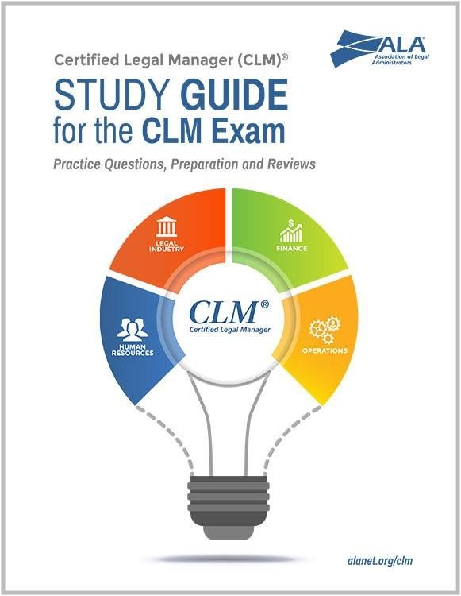
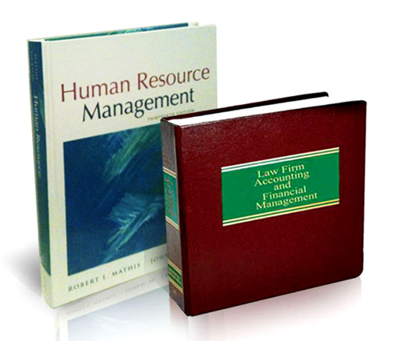
Recommended Reading
To help you enhance your preparation for the Certified Legal Manager exam, ALA created the Study Guide for the CLM Exam and a two-book bundle containing CLM recommended resources for test applicants. Together, financial management and human resources management account for over half of the body of knowledge emphasized on the exam. Deepen your knowledge of these areas with the “CLM® A Good Start” bundle.
“CLM® A Good Start” Bundle:
Law Firm Accounting and Financial Management, Fifth Edition and Human Resource Management, 16th Edition

Slide 17
Resources
Operations Management
Financial Management Any introductory college level accounting textbooks, plus industry-specific resources such as:
Law Technology News (magazine).
General Conditions of the Contract for Construction, A/A Document A201. American Institute of Architects.
Office Buildings: Standard Methods of Measurement (ANSI/BOMA Z65.1-2010). BOMA International.
Rhodes, J. & Polley, V. The ABA Cybersecurity Handbook: A Resource for Attorneys, Law Firms and Business Professionals. American Bar Association.
Williams, M. The Principles of Project Management.
Site Point.
ABA Standing Committee on Ethics and Professional Responsibility (Billing for Professional Fees, Disbursements and Other Expenses). American Bar Association.
Accounting and Financial Planning for Law Firms (newsletters). Law Journal Newsletters, a Division of ALM Media.
Annotated Model Rules of Professional Conduct, 7th Edition. ABA Publishing. Also available free online.
Cotterman. J. Compensation Plans for Law Firms, 5th Edition. ABA Publishing: Law Practice Division.
Iezzi, John B. Results-Oriented Financial Management: A Step-by-Step Guide to Law Firm Profitability; 2nd Edition. ABA Publishing: Law Practice Division.
Quinn, J .P, Bailey, J. A., Gaulin, D. E. & Kolodziejczak, S. Law Firm Accounting and Financial Management (including current annual supplement). Law Journal Press.
Robertson, M. Alternative Fees for Business Lawyers and Their Clients. ABA Publishing: Law Practice Division.
Legal Industry/Business Management
General textbooks such as:
Maister, D. H. Managing the Professional Service Firm. Free Press.
Maister, D. H. True Professionalism. Free Press.
Robbins, S. P, De Cenzo, D. A., & Coulter, M. Fundamentals of Management: Essential Concepts and Applications, 9th Edition. Frentice Hall.
General Resources
Study Guide for the CLM Exam. Association of Legal Administrators (ALA) (alanet.org)
Legal Management (magazine). Association of Legal Administrators (ALA) (legalmanagement.org and alanet.org)
Law Practice (magazine). ABA Law Practice Division (americanbar.org)

Slide 18
Websites containing information on the above, along with related information including:
Resources
Human Resources and Organizational Development
General textbooks such as:
Reference materials on current federal laws and government publications such as:
Brown, D. R. An Experiential Approach to Organizational Development, 8th Edition. Pearson Prentice Hall.
Fisher, R., & Ury, W. Getting to Yes: Negotiating Agreement Without Giving In. Penguin Books.
Mathis, R. L., & Jackson, J. H. Human Resource Management, 15th Edition. Cengage Learning.
1-9. Employment Eligibility Verification. U.S. Form 1-9, 0MB No. 1115-0136. U.S. Citizenship and Immigration Services.
Americans With Disabilities Act (ADA). U.S. Department of Labor.
Consolidated Omnibus Budget Reconciliation Act (COBRA). U.S. Department of Labor.
Employee Retirement Income Security Act (ERISA). U.S. Department of Labor.
Fair Labor Standards Act (FLSA). U.S. Department of Labor.
Family and Medical Leave Act (FMLA). U.S. Department of Labor.
Health Information Technology for Economic and Clinical Health Act (HITECH). U.S. Department of Health & Human Services.
Health Insurance Portability and Accountability Act (HIPAA). U.S. Department of Health & Human Services.
Patient Protection and Affordable Care Act (PPACA).
U.S. Department of Labor. Title VII of the Civil Rights Act. U.S. Equal Employment Opportunity Commission.
Uniformed Services Employment & Reemployment Rights Act (USERRA). U.S. Department of Labor.
Occupational Safety and Health Administration (osha.gov)
U.S. Citizenship and Immigration Services (uscis.gov)
U.S. Department of Health & Human Services (hhs.gov)
U.S. Department of Justice (justice.gov)
U.S. Department of Labor (dol.gov)
U.S. Equal Employment Opportunity Commission (eeoc.gov)

Slide 19
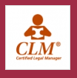
ALA Online Community
Share articles and other study materials
Sample curriculum outlines from chapter study groups are posted here
Study Groups
To help you prepare and study for the exam, some chapters have begun forming study groups. Check with your local chapter to find a study group near you.

Slide 20
Exam Dates – Spring and Fall
Exam Dates Application Deadline Registration Begins
May 16–22, 2023 March 17, 2023 Open as of January 1, 2023
November 14–20, 2023 September 15, 2023 Open as of January 1, 2023
May 6–31, 2024 March 7, 2024 Open as of January 1, 2024
November 4–30, 2024 September 5, 2024 Open as of January 1, 2024
ALA’s CLM exam is offered online at Pearson VUE’s many testing sites throughout the United States.
All approved CLM applicants will receive a unique URL and password to register at one of Pearson’s testing locations approximately one month prior to the exam. It is highly recommended that you make your reservation early, as space is limited at testing sites.

Slide 21
Where do I take my exam?
Beginning in May 2021, ALA offers live, online proctored testing for the Certified Legal Manager (CLM)® candidates through Pearson VUE’s online delivery system, OnVUE. This offering is in addition to test-center delivery. When you register, you’ll select the option to take the exam “from home or work.”
For more information or to find a test center near you, visit www.pearsonvue.com/ala.
Testing Center:
Computer-based exam
Cubicle environment with other examinees
Cannot take anything into the exam
Calculator on computer
For notes, provided a piece of paper and pencil
For sound, provided noise-cancelling headphones
Can mark items to go back to answer
Strikethrough feature to narrow answers
Security:
May have an electric wand
May have to empty pockets, raise pant legs to knees, and sleeves to elbows
Locker available outside exam area to hold drink, ID, etc.
Breaks allowed, but go through entire security process to get back in
Bring photo ID and testing center confirmation
Dress comfortably
Allow 20 minutes for entrance security & setup

Slide 22
What Are the Costs to Take the Exam?
Exam Fee | Retake Fee | Reschedule Fee | CLM Retired Status
Member: $529 | Member: $259 | Member: $159 | 1x Fee of $99
Nonmember: $629 | Nonmember: $259 | Nonmember: $159
Note: Costs as of January 1, 2021
What Happens If I Don’t Pass?
If you do not pass the examination, you will be allowed to retake it. You may retake the examination two times within a four-year period from the date of your initial application.

Slide 23
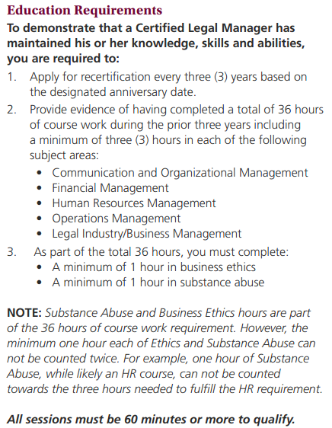
Recertification
Every 3 years: June 30 or Nov 30
Education
Requirements
36 hours of coursework
3 hours in each of 5 subject areas, CM, FM, HR, LI, OM
1 hour in business ethics
1 hour in substance abuse
Application and Code of
Professional Responsibility
Years 1 and 2: Annual maintenance fee of $59 due June 1
Year 3: Recertification fee of $189
Note: Costs as of January 1, 2023

Slide 24
Questions
Specific Questions About CLM Program, Testing Center, Study Groups?
alanet.org/education/certification
Contact ALA Headquarters:
certification@alanet.org

