Slide 1
ALA Strategic Direction and Member Benefits 2024

Slide 2
ALA Vision Statement
Creating excellence. Driving innovation. Empowering leaders in law.

Slide 3
ALA Mission
ALA is the catalyst for growth by providing:
Diverse educational experiences.
Engaged peer communities.
Strategic solutions.
Dynamic resources.
Trusted networks.

Slide 4
Strategic Direction 2024–2026
Board of Directors established the 2024–2026 Strategic Direction
Focuses on five focus areas:
Member Experience
Education and Professional Development
Impact
Diversity, Equity, Inclusion & Accessibility
Innovation
Details success indicators that identify what needs to be achieved to determine success
Drives how specific tactics will be developed in each area

Slide 5
Strategic Direction 2024–2026
What’s Next?
Programs, services and budget are continuously reviewed for alignment with strategic direction
Ongoing conversations with members and stakeholders on how to achieve goals together

Slide 6
Membership
2024 Membership Stats as of October 2023
737 organizations enrolled in Organizational Pricing (compared to 722 in 2023)
9,355 total members
9% vs. 2022

Slide 7
Online Communities
ONLINE COMMUNITY ACTIVITY 2023
YEAR | POST COUNT | COMMENT COUNT | LIKE COUNT
2023 | 3,269 | 8,164 | 5,222
15 All-Member Access General and Special Interest Community Groups
1,772 active users year to date
Most active: General Topics, HR and Small Law Firm
Notes:
ALA’s Online Communities are a place for members to have discussions and network with one another on daily business questions. The conversations grow organically and often include samples and checklists that other members provide.
Find the online community page on the ALA website under Networking tab on the website "Meet Your Online Community"
Helpful resources are available for users to reference including FAQs, video how-tos, links to community knowledge base and a Code of Conduct.

Slide 8
ALA Virtual Meetings
ALA Hangouts and Meetups
Member-to-member exchange of ideas and solutions
Monthly informal chats about timely topics of interest
Each session’s agenda is fueled by member sharing and interaction
Recordings posted in the Online Communities
Volunteer opportunities to moderate one of these open discussion sessions
More information and registration: ALA Member Virtual Meetups and Networking (alanet.org)
Notes:
ALA Hangouts are held on the second Tuesday of each month from 1 p.m. to 2 p.m. Central. Audio recordings are posted in the Resources section of the General Topics Online Community Group.
You can volunteer to moderate one or more ALA Hangouts. Get more information here, or email membership@alanet.org for details.
The Small Law Firm Group launched its virtual own Mental Health and Wellness Discussion on the third Wednesday of each month at 2 pm central time.
Small Firm Meetups are held on the first Wednesday of each month at 2 pm central time and focus on topics of special interest to small firm legal management professionals. Audio recordings and chat transcripts are posted in the Small Firm Online Community Group.
Video recordings for Hangouts May 2022 and beyond are available in the Events section of the General Topics Online Community Group — you must click "past" to view. Member login is required to access the recordings.
Video recordings for each Meetup May 2022 and beyond are available in the Events section of the Small Law Firm Online Community Group — you must click "past" to view. Member login is required to access the recordings.
For more information and to register, check out the Virtual Meetups and Networking page under the Networking tab on the ALA website.

Slide 9
ALA Virtual Meetings
Make Connections and Gain Insights
Opportunities for legal management professionals to interact, commiserate and share solutions to common problems virtually.
ALA Roundtables
Virtual, member-centered discussions providing a forum for members to share knowledge and best practices
Focus on topics of current interest, predetermined and driven by member need and supported by facilitator input
Sessions have an interactive component and allow for discussion and Q&A
Notes:
ALA Roundtables occur monthly and are a virtual opportunity for members to ask questions, share knowledge and best practices. Topics are driven by current issues and member needs. The sessions are intended to be interactive to allow for discussion and Q&A. Please send any questions or future topic suggestions to eLearning@alanet.org.

Slide 10
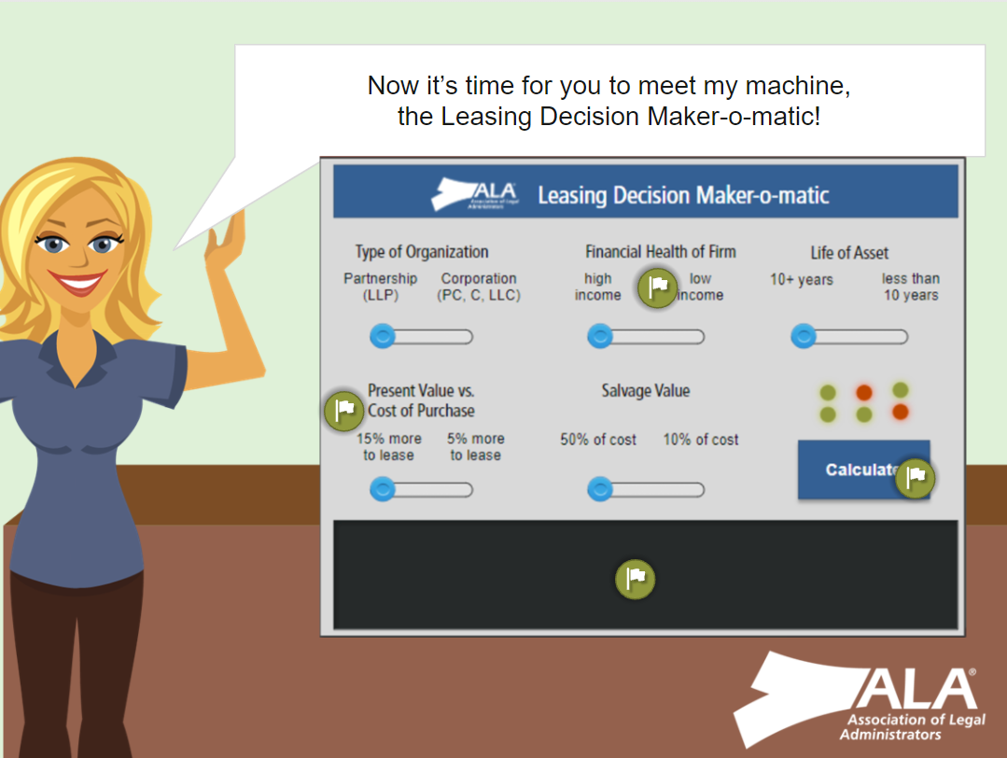
CLM® Program
2024 Application Deadlines
March 7 (Test Dates: May 6–31)
September 5 (Test Dates: November 4–30)
Find more information at alanet.org/clm.
Resources for Study
Webinar Bundle
CLM Study Guide
Chapter Study Groups
Notes:
Exam registration is open for the spring and fall exams, and application deadlines will close two months prior to each test date.
We recently overhauled the certification webpages to improve appearance and efficacy. Take a look if you haven't yet!
The CLM webinar bundle offered by ALA is an excellent resource that will satisfy all five of the Management Skill Categories and is still relevant to the exam today
We recommend utilizing the CLM Study Guide which will provide you with the following resources:
A focus on real-world issues faced by legal managers
The CLM Content Outline of the Body of Knowledge (also known as the test blueprint)
Review questions and answers for each subject area
A practice exam that follows the test blueprint
A comprehensive list of terms and definitions
Tips for creating a personalized study plan
Tips for preparing for an online exam
And finally, many chapters have formed study groups to assist members, and in some cases non-members, in preparing for the exam. Reach out to your local chapter or ALA headquarters to find the study group nearest you.

Slide 11
CLM® Program
The CLM credential demonstrates to your firm that you’ve mastered the knowledge, skills and abilities to operate at a high level of expertise in the field of legal management.
Earning the CLM can also be away to brush up on core competencies in an ever-changing field. It is one way to show your command of law firm administration and demonstrates that you can relieve the burden of administrative tasks to help attorneys realign their practices toward improving client service.

Slide 12
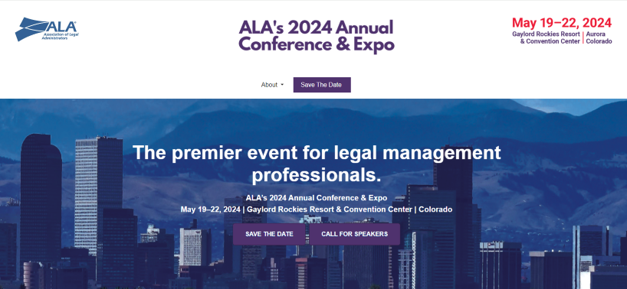
2024 Annual Conference & Expo
Find all the details at ALAannualconf.org.
#ALAConf24

Slide 13
Online Education
Mental Health First Aid Certification Program:
Fridays: April 12, April 19, April 26, May 3, May 10
Notes:
ALA’s Mental Health First Aid Certification Program is an interactive training course comprised of 2 hours of self-paced content (to be completed online independently prior to the live session) and one 6.5-hour instructor-led session over Zoom. The one-day training program is being offered on four consecutive Fridays. Due to the interactive nature of this course, there is a maximum of 30 participants per offering. Registration will be opening in the spring.
https://www.alanet.org/events/save-the-date

Slide 14
Online Education
Web-Based Courses
Six-week instructor-led online courses
Completing HR 1 and HR 2 or FM 1 and FM 2 provides the option to earn a Legal Management Specialist Certificate.
Visit alanet.org/education/online-learning/web-based-courses for more information and session dates!
Notes:
Web-Based Courses
Six-week instructor-led online courses for each (HR 1 and HR 2 OR FM 1 and FM 2) HR1 and HR2 are offered twice a year while FM1 and FM2 are only offered once.
These courses have been hugely popular lately!
Completing both 1 and 2, you have the opportunity to earn a Legal Management Specialist Certificate in the respective area.

Slide 15
Webinars: Live and On-Demand
ALA webinars:
Receive CLM/CE credits toward education
Access to more than 60 webinars on-demand
Best value in online education
Sessions on functional specialties, topics for every legal management professional
Content set 2-3 months out; stays relevant to today
60 minutes
Notes:
For the best value in online education, look no further than ALA's webinars with sessions spanning functional specialties and topics for every legal management professional. You can view them live or at your leisure.
Each webinar is one-hour long, listeners can receive CLM/CE credits toward education, and there is access to more than 80 webinars on-demand.
We book presentations no more than two or three months out, so the content stays relevant to what’s going on in your world now.

Slide 16
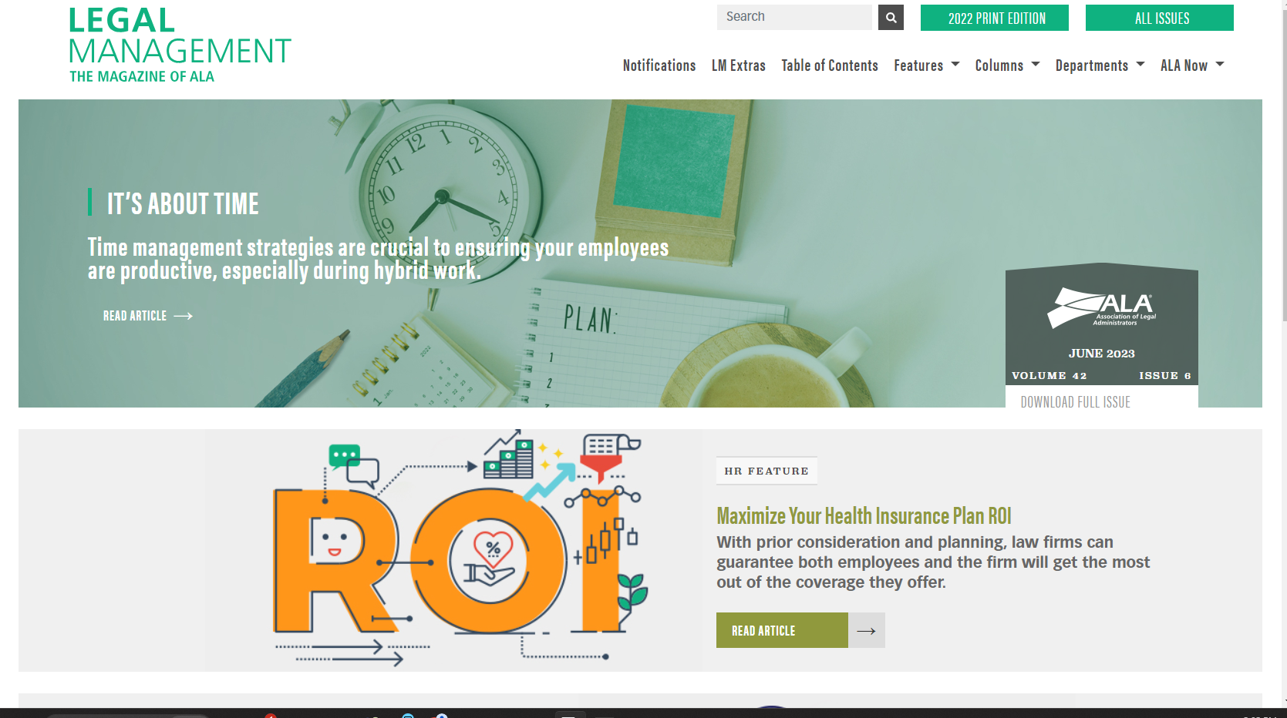
Legal Management Magazine
Published digitally 10 times a year with one print issue every July
Covers wide range of topics, including HR issues, DEIA, business development and tech
Listen to articles on the go: Offers an audio playback option
LM Extras delivers fresh content in between issues
Check out the latest issue:
alanet.org/legal-management.

Slide 17
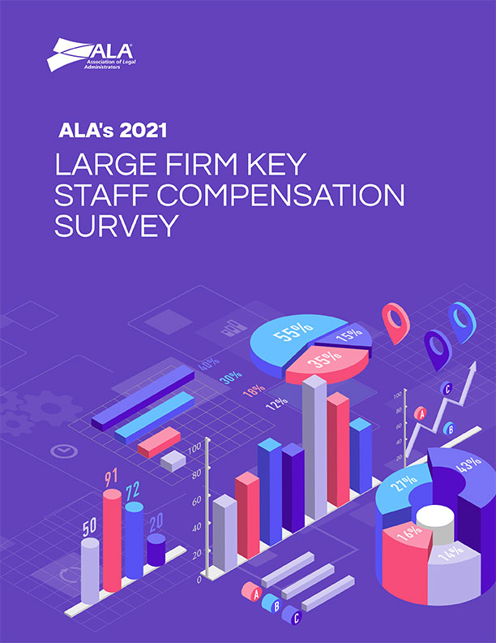
Compensation and Benefits Survey
2023 Compensation and Benefits Survey
Over 200 participants submitted data
Survey data is compiled into comprehensive reports
Benchmarking data now included in report
Available in September: alanet.org/compsurvey
Questions? Contact: compsurvey@alanet.org
Notes:
The compensation and benefits survey contains nearly 400 pages of data. The details are broken down by position and in some cases, location. One can also purchase the Large Firm Key Staff survey.

Slide 18
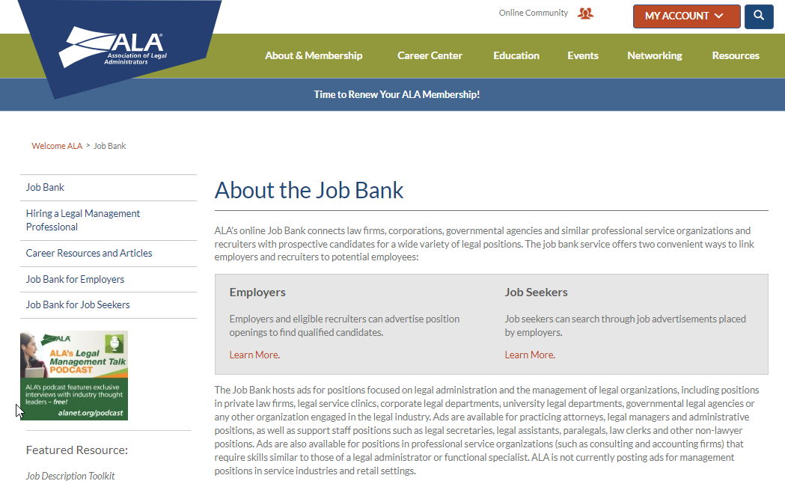
Job Bank and Career Center
In 2023
About the Job Bank continues to be the most viewed page on ALAnet.org, aside from the homepage
242 jobs posted in the Job Bank
176 applications sent through our system
Added a new remote option to the location section for employers

Slide 19
Job Bank and Career Center
ALA’s Job Bank is your go-to solution connecting law firms, corporations, governmental agencies and similar professional service organizations and recruiters with prospective candidates for a wide variety of legal positions. You can get your listing in front of 8,000 legal management professionals.
The Job Bank hosts ads for positions focused on legal administration and the management of legal organizations, including positions in private law firms, legal service clinics, corporate legal departments, university legal departments, governmental legal agencies or any other organization engaged in the legal industry.

Slide 20
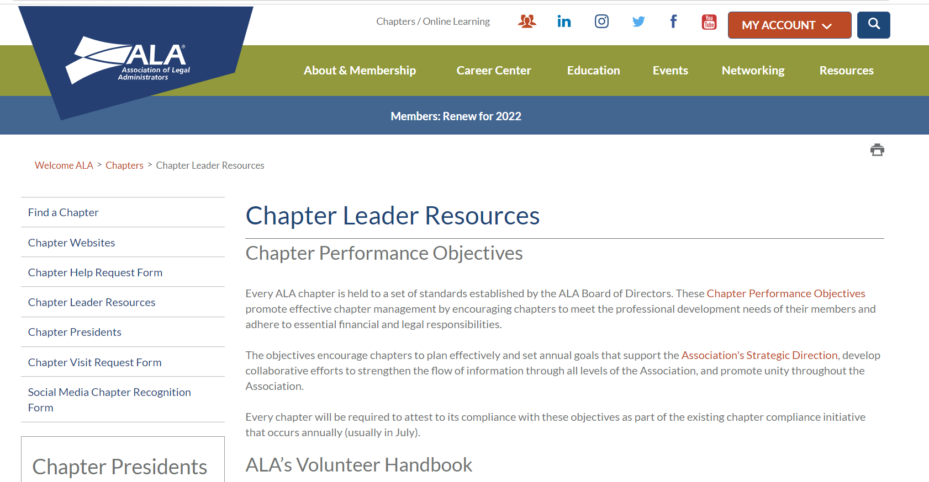
Chapter Support
The Chapter Resource Team (CRT) assists chapters by:
Providing guidance in the development of initiatives
Providing support and resources to chapters
Serving as mentors to chapter leaders
Serving as subject matter experts on a variety of chapter-related matters
Find more information regarding CRT and which focus chapter liaison is assigned to your chapter.
Find a wide range of resources on the Chapter Leader Resources page.
Notes:
In addition to serving as mentors to their assigned chapters, the CRT is responsible for hosting virtual sessions provided as part of the Chapter Leader Educational Series. These sessions, which are open to all, focus on topics related to chapter leadership. They are similar in content to what you might expect of CLI session and are recorded for future reference.
A chapter may fill out the Chapter Help Request Form with a question, and the CRT will reply.
A chapter can also request an in-person or virtual visit by completing the Chapter Visit Request Form.
The CRT also assists chapters by providing content for Just the Facts, ALA’s monthly e-newsletter for chapter leaders.

Slide 21
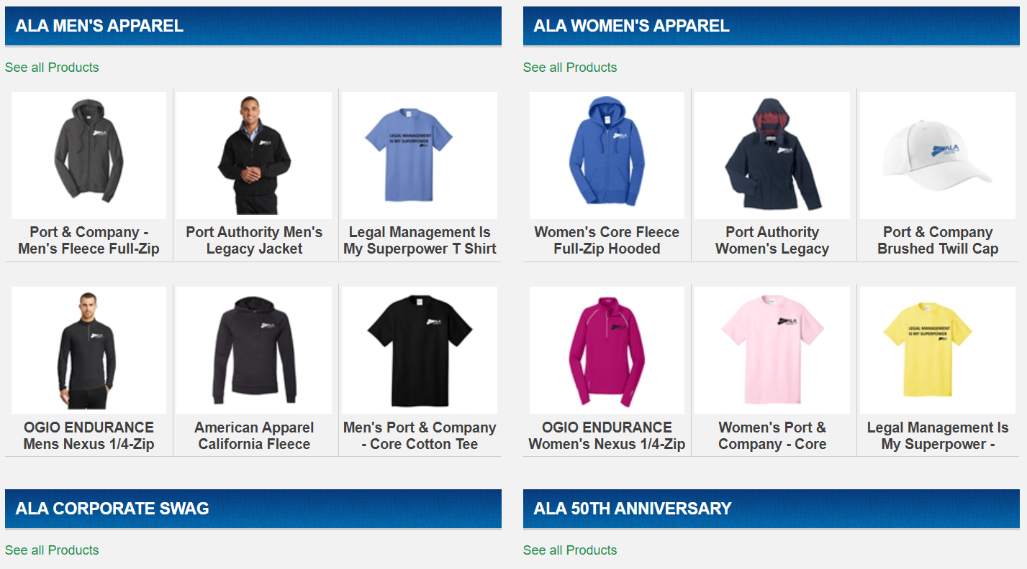
ALA Logo Shop
Show your ALA pride!
Find exclusive ALA-branded apparel and accessories.
Visit the ALA Logo Shop.

Slide 22
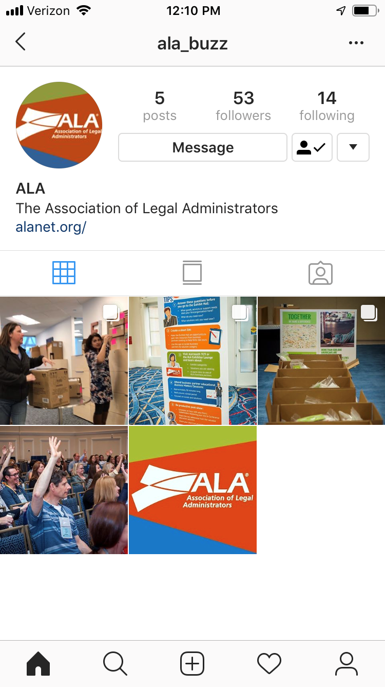
ALA Social Media Channels
Follow us, tag @ALABuzz and use #ALABuzz:
Instagram
Facebook
LinkedIn
Looking for Diversity, Equity, Inclusion and Accessibility OR Professional Development content? Simply search #ALADEIA or #ALAPDAC to find the latest posts!
Notes:
Follow ALA’s official Instagram account — @ALA_buzz
ALA’s social media channels can keep you up-to-date on the latest in industry trends, education opportunities, chapter news and member events. In 2019, ALA is emphasizing increased engagement on all social media platforms. Be sure to follow us, tag ALA in your posts and use #ALABuzz.
LinkedIn - linkedin.com/company/alabuzz/mycompany/verification/?viewAsMember=true or search "Association of Legal Administrators (ALA)"
Facebook - facebook.com/AssociationLegalAdmin
Instagram - @ALA_Buzz
We also implemented #TestimonialTuesday's featuring member testimonials on the first Tuesday of the month to further promote ALA's membership. If you're interested in providing a testimonial, please reach out to Meghann Krone (mkrone@alanet.org).
In early 2023, ALA introduced snippets or "teasers" on social media of the latest podcast episodes to garner more attention and engagement. Specifically, we've implemented IG Reels which is a new feature on Instagram to allow for longer videos.

Slide 23
Weekly E-Newsletters and Emails
Each day of the week delivers focused content:
Monday — BOLD Bites
Tuesday — E-Learning
Wednesday — Membership News
Thursday — Events
Friday — Thought Leadership
Now you’ll always know what to expect in your ALA emails!
Notes:
ALA emails cover standard content topics each day, so audiences will learn to expect specific information (education, or events, or leadership, etc.) on set days during the week.

Slide 24
ALA Business Partners
ALA Marketing Opportunities
Online resource for all current and prospective ALA business partners to find information related to ALA events and marketing opportunities.
Legal Marketplace
A comprehensive online directory of top solution providers to the Legal Management industry. Search by company name or category to find trusted ALA business partners waiting to solve your most challenging issues.
Watch the website for the next Solutions Series webcast that provide unique subject matter expertise and business insights for law firms. These are free to join and cover a wide range of topics.
Notes:
ALAbp.org: ALA business partners, current and prospective, can find all the information they need related to ALA events and marketing opportunities at the ALA Business Partner Portal. The ALA Business Partner Portal was awarded the 2017 Gold Excel Award by the Association Media & Publishing, recognizing the best, and the brightest in association media and publishing.
Legal Marketplace: ALA's free, one-stop resource for business solutions and services is visited more than 2,700 times each month by members seeking a competitive edge for their legal organization. Legal Marketplace features enhanced business partner profiles, interactive content, and easy-to-navigate solution categories like “exhibitors,” “business development,” “finance” and “human resources.”

Slide 25
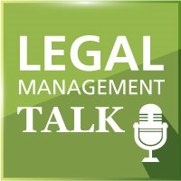
PODCASTS
Legal Management Talk is the official podcast of ALA
Episodes cover a wide variety of topics — from finance to operations to HR trends — and feature ALA members, business partners and industry leaders
Each episode is 20-30 minutes long and can be found on YouTube and most podcast streaming platforms
alanet.org/podcast

