Slide 1
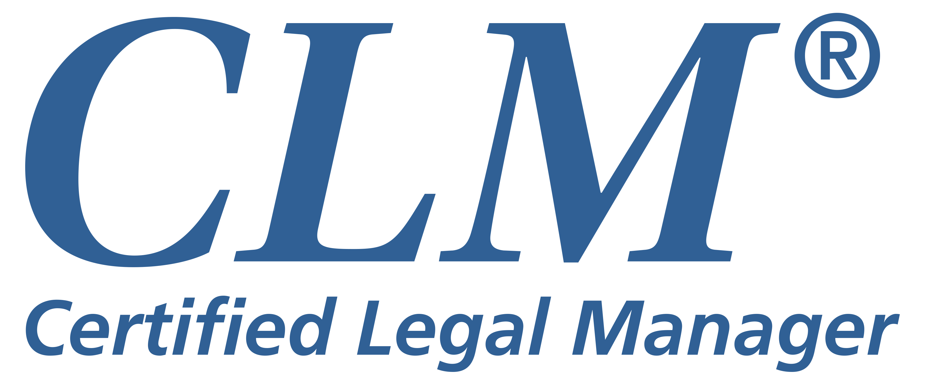
How to Launch a CLM Study Group

Slide 2
Getting Started
Find out if there’s interest
Determine the goals of each participant
What test date are they interested in
How far along in completing their Education Worksheet for the application are they
Work backwards from the earliest preferred test date to build a set schedule of meetings
Determine your budget for a meeting space, speakers, study materials, etc.
Review and Print the CLM Application to review application requirements, exam content, study resources, etc.

Slide 3
Create Your Study Plan
Follow the Competencies of Legal Administrators and the information about the exam to determine your study plan.
This will also help to determine which of the CLM resources your group will use.
Assign each member with a study section so no one member feels overburdened. If possible, include a member who is a CLM to assist. The CLM Directory can be found online.
Use chapter resources (financial, knowledge base, contacts, etc.)

Slide 4
Study Resources
The Study Resources will detail potential resources
for reading.
At first glance this list may appear to be overwhelming, but it can systematically be broken down and organized into units suitable for study within your group.
Your group may find it useful to collect these and other resources to form a lending library with one person responsible for checking books in and out.

Slide 5
Application Requirements
All exam candidates must meet the General Education and the Employment/Experience Requirements as described in the Application Requirements.
If participants of your group need help with, or have questions about their application requirements, please have them
contact ALA for help at certification@alanet.org.

Slide 6
Sample Exam
Participants should review the 10-question Sample Exam
The items are presented in the sample exam are in the same
format and in random order, as they are on the actual exam.
This will not predict how well they will do on the actual exam,
but will show their strengths and weaknesses. In addition,
it will familiarize them with the exam.

Slide 7
Level of Knowledge
Earning the CLM® designation requires an above average knowledge
of the areas listed in the Body of Knowledge.
Strive to cover each topic at a level that includes an understanding
of the more complex skills, laws, and procedures crucial to effective
law firm management.
If hiring speakers, make sure they understand the level of instruction expected.

Slide 8
Further Information
We recommend you review the Guide to Developing a Certified Legal Manager CLM® Study Group for complete information.
We also recommend you contact other CLM study groups for
tips on how they have successfully launched a study group.
For all questions on the application, please contact certification@alanet.org.

