Slide 1


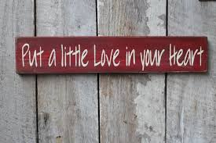
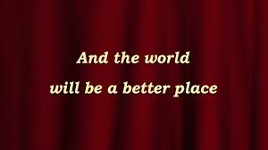

Put a Little Love in Your Heart
The Foundation of ALA’s Journey
Orchestrated by:
Frederick J. Esposito, Jr., CLM, MBA
Vice President, ALA Foundation

Slide 2

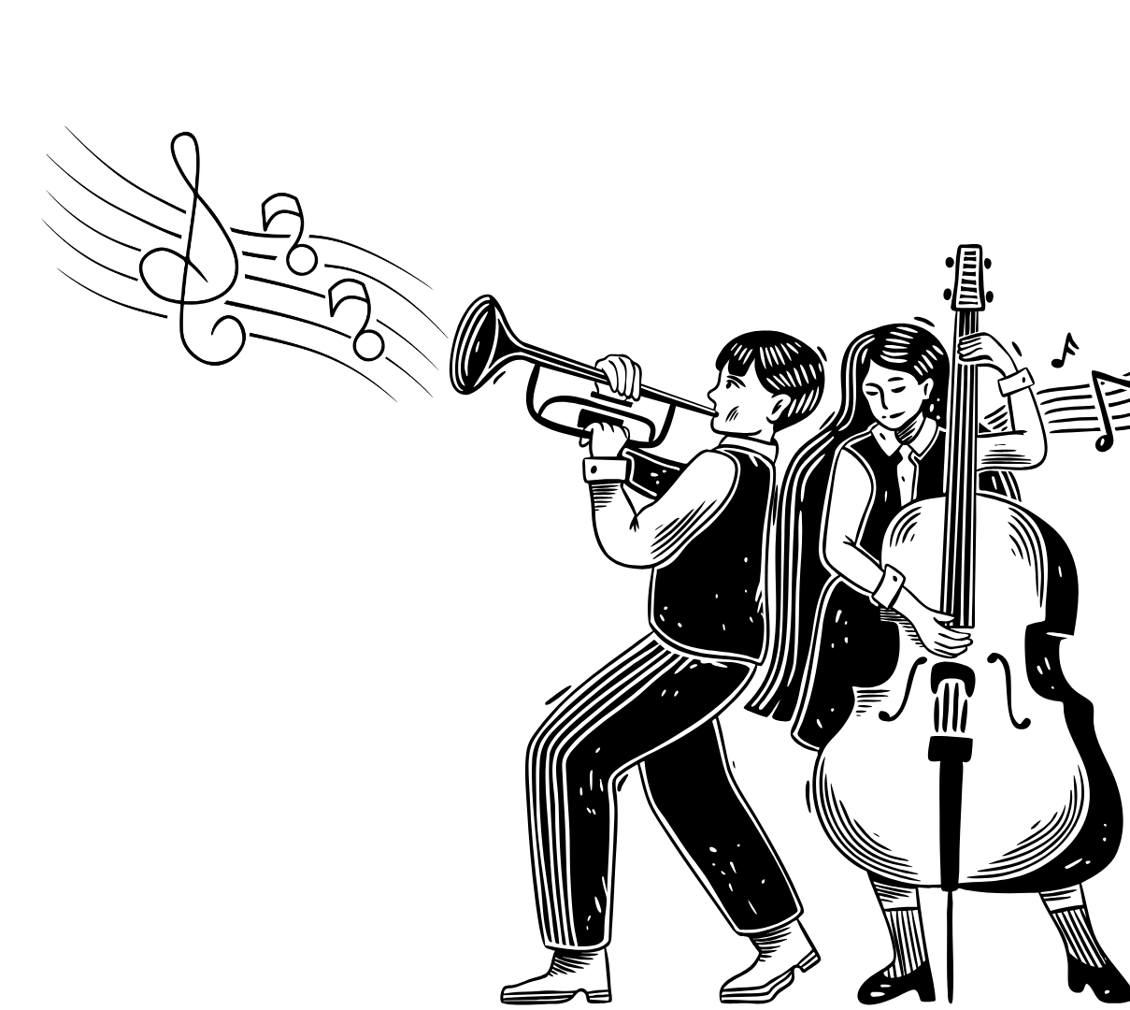

The Foundation of the Association of Legal Administrators is the
Heart of ALA.
Our mission is to help educate, mentor and inspire current and future legal management professionals in inclusive ways that foster the development and increase awareness of the profession within the legal industry and our communities.

Slide 3

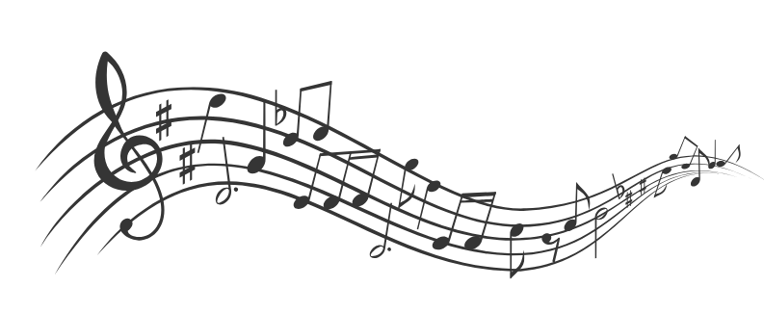

Who Are We?
We’ve got our mission, but who are the people making the journey on the Foundation of ALA this year?
How do we write the songs?
How will we know we’ve got the music in us?

Slide 4
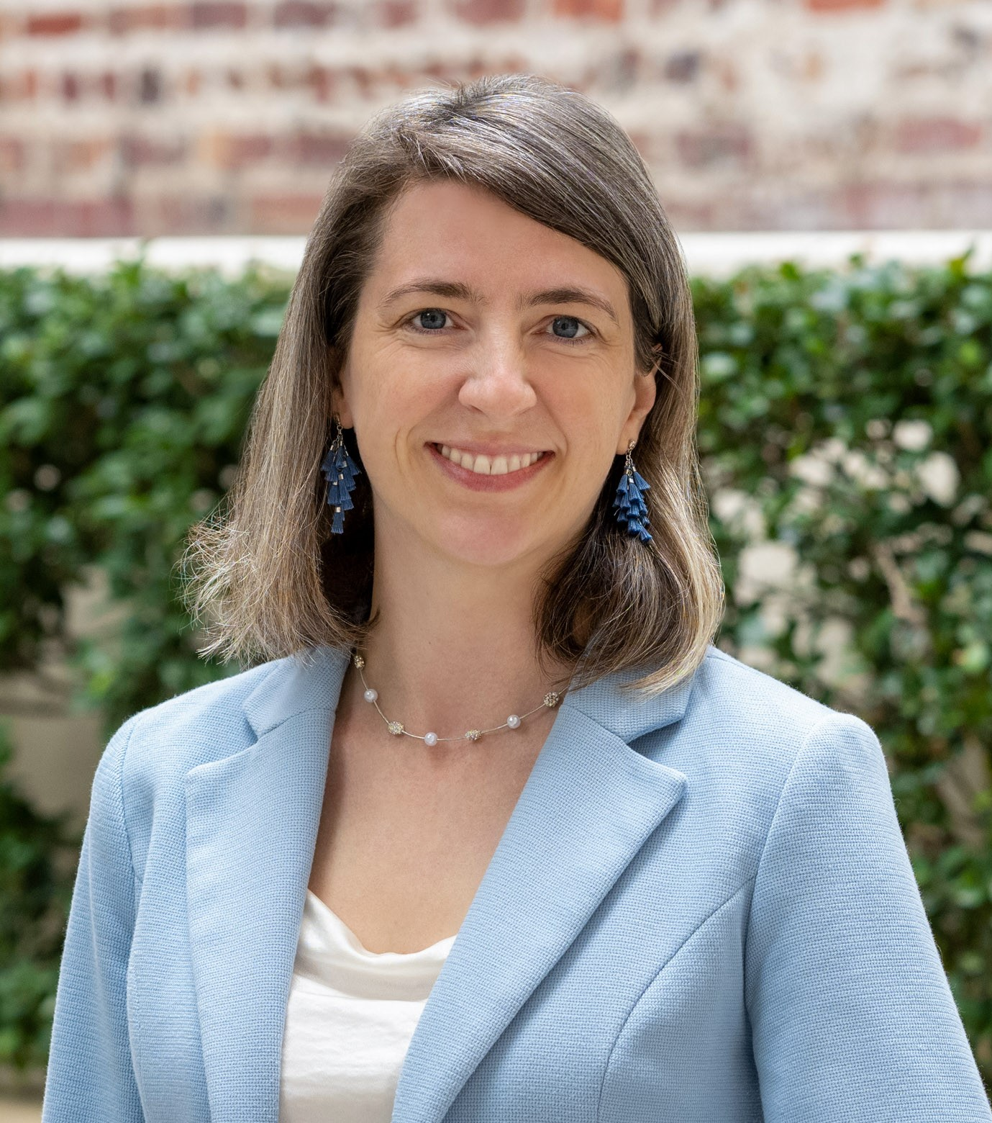
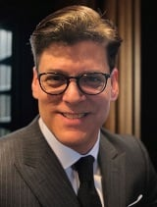
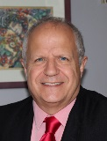
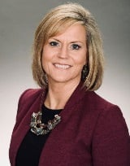
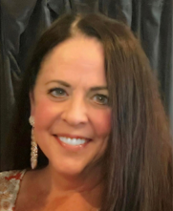
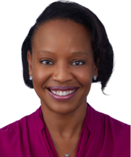
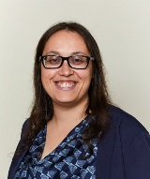
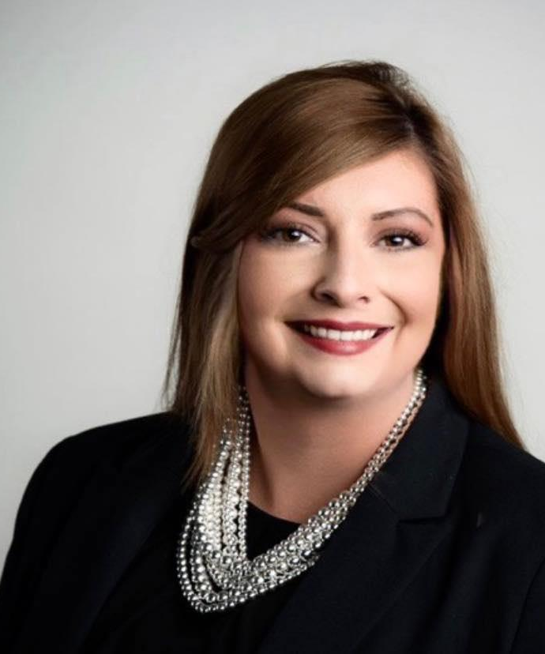
2025-2026 BOARD OF TRUSTEES
Kira L. Hansen, CLM
President
Frederick J. Esposito, Jr.
CLM, MBA
Vice President
William MF Davis
Treasurer
Julie S. Logan,
SPHR, SHRM-SCP
Secretary
Karen Michelle Beasley
Eryn Carter, CAE
Executive Director
Elyssa A. Goldstein, CLM, PHR, SHRM-CP
ALA President-Elect
Emily C. Spehar

Slide 5

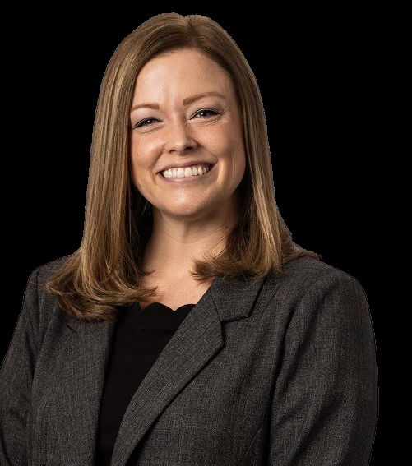
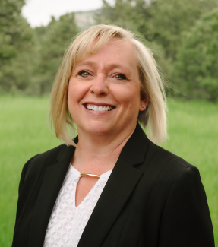
Trustee Changes for 2026-2027
Kira L. Hanson, CLM,
President
Sarah E. Cramer
Director of Human Resources
Baker Sterchi Cowden & Rice LLC
Carole Gandera, CLM
Operations Manager
Telios Law PLLC
Thank you for your incredible service to the Foundation of ALA, from 2022 to 2026, Kira Hansen!
The Foundation of ALA welcomes Sarah E. Cramer to the Board of Trustees,
2026-2030
The Foundation of ALA welcomes Carole Gandera to the Board of Trustees,
2026-2030

Slide 6

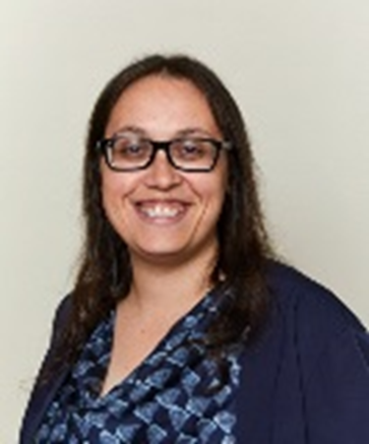
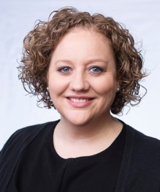


Trustee Changes for 2026-2027
Elyssa A. Goldstein, CLM, PHR, SHRM-CP 2025-2026
ALA President-Elect
Jessica VanTroost
2026-2027
ALA President-Elect
Thank you for your support and advocacy for the Foundation of ALA this past year. We look forward to your leadership as the 2026-2027 ALA President!
We look forward to working together in the coming year, Jessica VanTroost!

Slide 7



Strategic Direction
Engagement Draw people into the Foundation to enhance their overall experience within ALA. | Impact Expand the value and scope of all initiative so the ALA community and other key audiences know who we are and what we do. | Endurance Shape and define a legacy that others will recognize and remember by honoring the past and celebrating the future.

Slide 8



impact Report top of the charts!
Each year, the Foundation releases its publicly available Annual Report that summarizes and celebrates our achievements “Top of the Charts”
This is a tool of accountability as well as a communication tool for members and stakeholders.

Slide 9

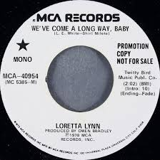

We’ve Come a Long Way Already
The last few years have seen incredible growth and maturity for the Foundation.
Let’s take a look at some of the initiatives that keep us motivated to write the songs that make the whole world sing……

Slide 10

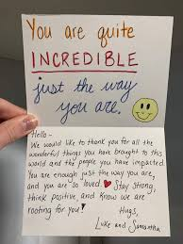
Our Initiatives
Member Tribute Cards
  Members can make a tax-deductible contribution to acknowledge a colleague/friend or to honor a loved one’s memory with a tribute card.
  The recipient will receive a personalized card acknowledging the donation.

Slide 11
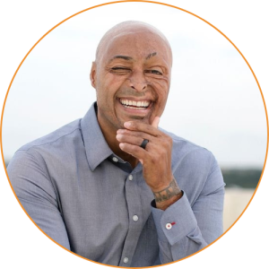
Our Initiatives
David W. Brezina Memorial Session
  At Annual Conference, we sponsor a speaker who personifies the spirit of community, professional ethics, personal fortitude, and high personal standards of human civility that David represented.
  This year’s speaker, J.R. Martinez, is presenting his signature session Facing Adversity with Optimism and Resilience. By embracing resilience, we uncover our strength, adaptability and potential to become our best selves.

Slide 12


Our Initiatives
Student Scholarship and Visibility
  We believe that students are the future of our profession.
  We offer scholarships for college and post-graduate students that have an interest in pursuing research or a career in legal management, including any role supporting the management functions in a law firm or legal service organization.
  A mentor is assigned to each scholarship recipient.
  Awarded a total of $15,000 to three students in 2025; recipients for 2026 soon to be selected!

Slide 13

Our Initiatives
Susan L. French Emerging Leader Fellowship Program
  Two-year fellowship developed to assist up to three ALA members who have a strong desire to enhance their personal and professional leadership skills.
    Registration and travel stipend to CLI (1st and 2nd year in the Fellowship)
    Leadership and mentorship coaching sessions
    Fellows receive an assigned mentor in their first year and become mentors in their second year
  2026 applications will open in April!

Slide 14


Our Initiatives
Growing Seeds
  Growing Seeds creates a program accessible and inclusive to all members, whether independent or belonging to a chapter.
  Each year up to $1,000 is awarded to chapters and members proposing new programs needing “seed” money.
  In 2025, grants were awarded to the Golden Gate Chapter and Kevin S. Lee, J.D., M.Div., FMP
  We hope to support even more great ideas
  in 2026!

Slide 15
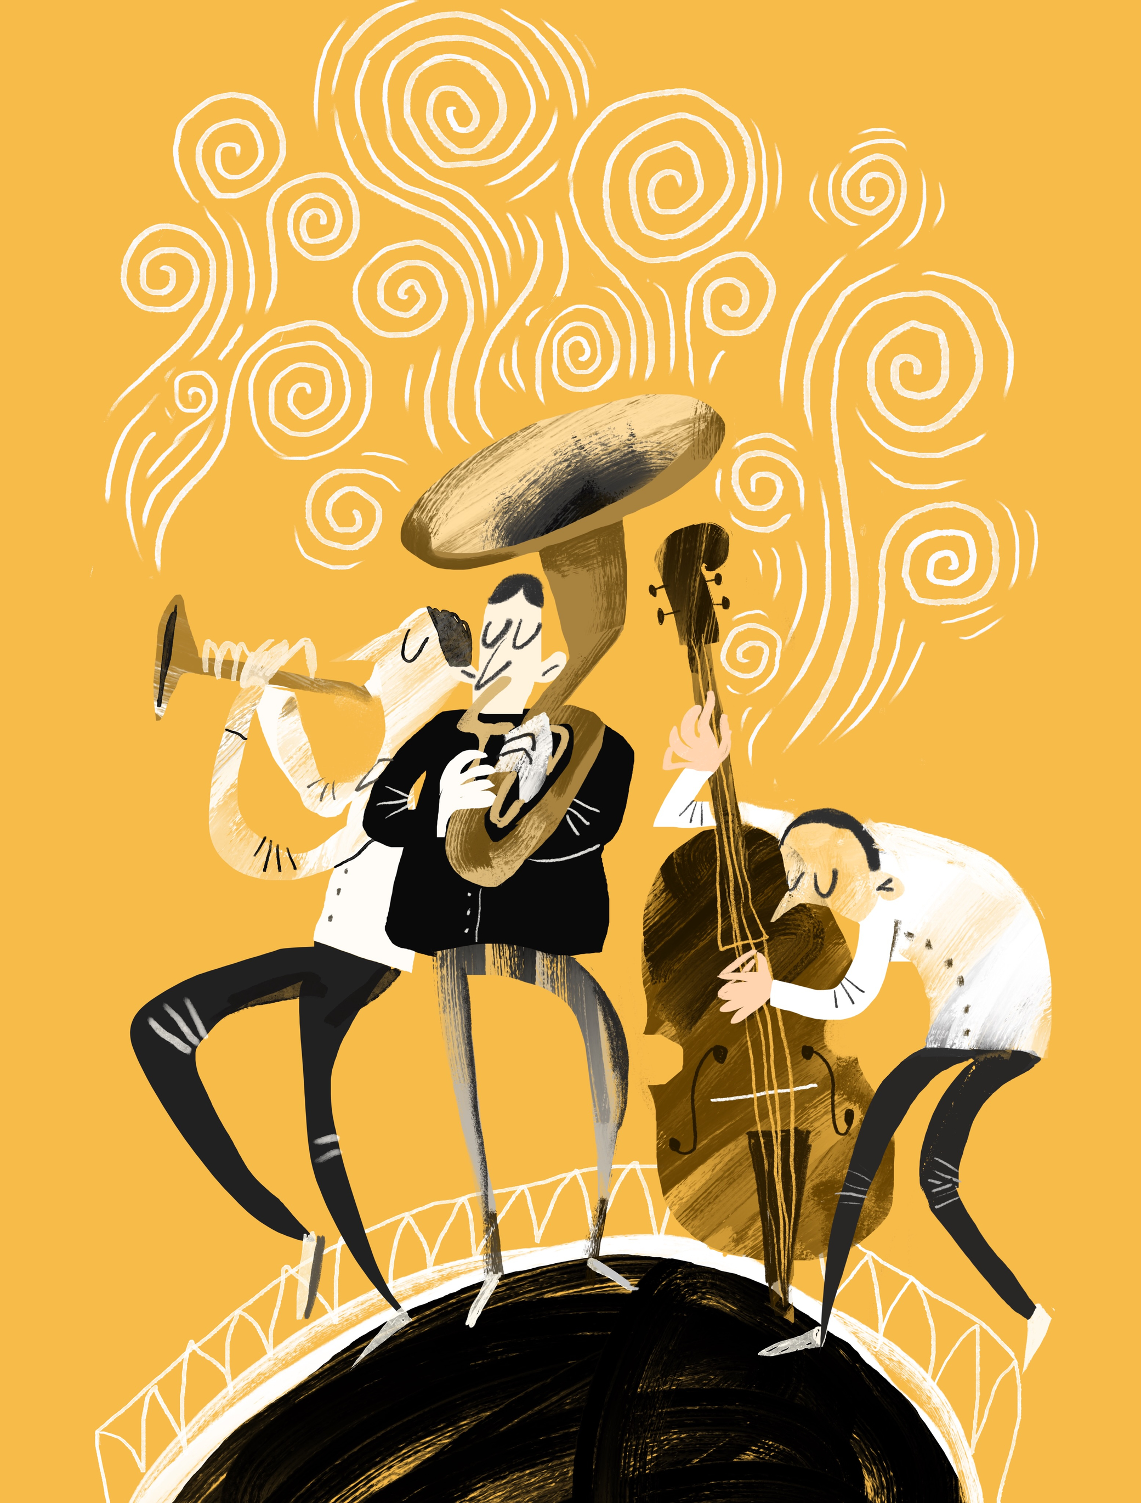

Our Initiatives
Corporate Donor Program
  This program provides corporations an opportunity to establish and build their support of educational, leadership development and inspirational initiatives led by ALA’s charitable organization.
  Our 2026 levels are:
    Visionary ($15,000)
    Champion ($10,000)
    Advocate ($5,000)
    Friend ($2,500)
  The majority of inaugural donors are back for 2026, and we also have some new faces in our program!

Slide 16

Our Initiatives
The Foundation Heart of ALA Award
  Originally brainstormed at ALI 2023, this award recognizes two member of the ALA community who promotes and/or embodies the Foundation’s mission to educate, mentor and inspire people in inclusive ways.
  Will be awarded during the Brezina Memorial Session at the 2026 Annual Conference to two members with outstanding community service in 2025 outside of ALA.

Slide 17


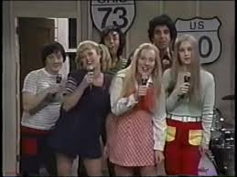
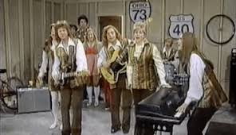

Remix: What’s Coming….
Composing the future…..
“Ok, Jan, Let’s Jam!.....”

Slide 18

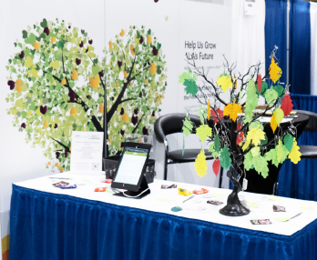
Turning up the Tempo
CLM Exam Support
  Collective efforts to create monetary support for those sitting for the CLM exam last Fall and this Spring!
  Excited to collaborate with ALA Marketing Team regarding the CLM’s 30th Anniversary!
Annual Conference –National Harbor
  Visit us at the ALA Foundation Booth and meet our trustees! “Listen to the Music”
  Check out our Foundation Shout Out tree!
  Enjoy the excitement of our Silent Auction!
  Meet and support our corporate donors!

Slide 19

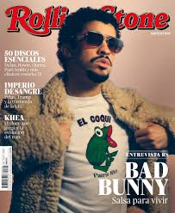

What Will Keep us on the Billboard top 10?

Slide 20

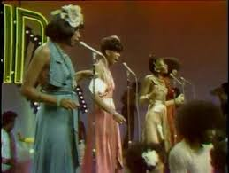
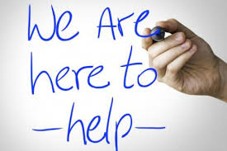
ALA foundation - “Yes we can can!”
Communication..
Visibility….
Partnership….
Collaboration….
SUPPORT….
CLM Support Committee
We are committed to lowering the barriers to certification by offering scholarships to cover the cost of the exam fee for anyone wishing to take their career to the next level.
Annual In-Person Meeting
It’s not all virtual! We hold in-person Trustee meetings coinciding with Annual Conference to deepen relationships and foster an environment of collaboration.

Slide 21

Three Giving Campaigns
–Working Together!
Fall Campaign
Traditional week-long giving campaign in September focused on uplifting the Foundation’s impact on ALA members
Raised $7,100 in 2025
Giving Tuesday
Participated in the national day of giving
Raised $175 in 2025
February Campaign
Branding awareness campaign where donors can guess the number of candy hearts in a jar for a prize
Raised $850 in 2025 and raised $670 in 2026

Slide 22
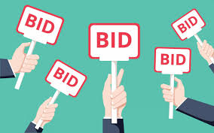

Silent Auction
Held during Annual Conference, the silent auction is a major fundraiser for the Foundation.
Held virtually, and anyone across the country can participate.
Donations come primarily from chapters, business partners, and members.
We will begin accepting donations NOW through March 30! NAME THAT TUNE!

Slide 23
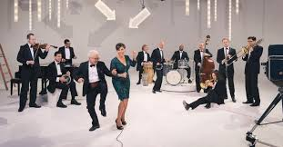



Thank you
For Your Continued Support!

Slide 24
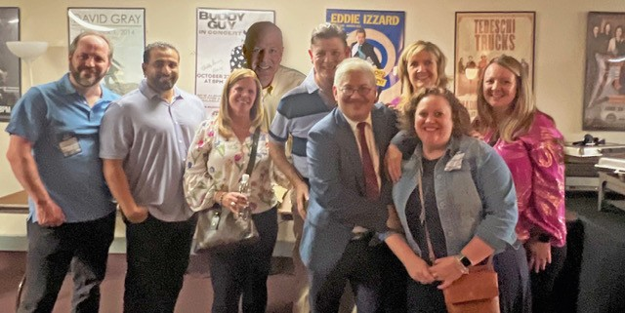

Slide 25


Party in The ALA
How Volunteers Create Connection, Culture, and Impact
PRESENTED BY
Travis Armstrong, CPA, CLM - ALA President
Laila Sanousi, CLM - Incoming Director

Slide 26

Welcome to the Show
What does it mean to “party”?
  What it’s not:
    superficial fun
  What it is:
    showing up
    engaging fully
    making meaningful connections
Notes:
When you hear ‘party,’ you might think FUN- but the best parties are the ones where you leave knowing people, feeling energized, and wanting to come back.
ALA volunteers play an important role in at ALA events Your presence + your participation = your impact

Slide 27



Why Your Role Matters
THE FACE OF ALA AT EVENTS
CULTURE-CARRIERS
PROVIDING CONNECTION
Culture isn’t what we say ALA is-it’s how if feels in the room.
Volunteers model warmth, curiosity, and professionalism with humanity.
You are ALA.
Members don’t experience ALA as a logo or mission statement- they experience it through people.
If someone is new, unsure, or a little uncomfortable, they’re going to approach someone who feels approachable.
Notes:
Volunteers sometimes underestimate their impact
(The Face) Before someone hears a speaker, joins a committee, or decides to join or renew membership- their first real experience with ALA is often a volunteer
The first smile, “welcome”, the first person to make an introduction- these moments shape whether someone feels: comfortable asking questions, confident they belong, and interested in coming back
2. (Culture) If ALA is welcoming, inclusive, and professional, people should be able to feel that within 5 minutes of walking into an event; not always what we say but HOW- how is it received and how it is perceived
3. (Connection) Volunteers are often the first POC/connection, the person who makes the room feel navigable, the first one to ask them about them
-This makes you incredible impactful – even if you don’t realize it
*You don’t need a title to be influential- you need intention.*

Slide 28


Maximizing Your Role at ALA Events
BEFORE THE SHOW
Show up prepared!
It’s your time to shine ✨
DURING
Be a connector, not a collector!
Get there early, linger a little longer
Make introductions
Ask meaningful questions
AFTER
Follow through!
The real connection starts now!
Notes:
*Opportunity to demo the steps*
BEFORE: what’s the purpose of this event? (learning, connecting, serving); Prepare your intro, Name, Role at ALA, One sentence of what you are excited about
*REMEMBER: if you walk in hoping something will happen, you miss the chance to make something happen!*
DURING: How many real connections can I make?
Ask what brought you to ALA?, What are you hoping to take back to your organization?
Be approachable, phone down, smile, badge visible – look for those FTA ribbons and introduce yourself
REMEMBER: YOU may be their first impression of ALA
AFTER: The real value of this PARTY starts when the event ends. Connect on LinkedIn – send short follow-ups like, “it was great to meet you at…” or “I came across this article that reminded me of our conversation…”
(*Setup for next slide – okay, so I am a volunteer leader, but I’m not the type of person who feels comfortable talking to strangers – Introvert v. extrovert)

Slide 29

No Need for Stage Fright!
If networking feels awkward, you’re not alone. Not all volunteer leaders are EXTROVERTS.
You are not there to impress – you are there to CONNECT.
Notes:
Reframing networking anxiety: many volunteer leaders feel uncomfortable networking. Reframe as service-based – you are helping others feel welcome, making introductions, and asking thoughtful questions.
This is an ensemble – not a solo act.

Slide 30
Authentic Participation
ALA thrives when volunteers bring their whole selves.
Share experiences-not just successes
Be curious
Give yourself permission to learn and grow
As volunteer leaders:
Share your experience as a volunteer
Identify potential future volunteers/leaders
Encourage others to volunteer
Notes:
You don’t have to put on a façade – share who you are! Your strengths are what brought you here! Sharing your story of service will inspire others; your leadership role also offers you an opportunity for growth

Slide 31

How to party in the ALA?
Present- Be engaged, not distracted
Approachable- Invite connection
Resourceful- Share who and what you know
Thoughtful- Follow up and maintain the connection
Yes- Say yes to opportunities to make an impact
Notes:
Show up. Step in. Reach out. Follow through.
Your Presence+Your Participation=Your Impact!

Slide 32
Encore – Next Steps
IMMEDIATE ACTION
(You already have)
CONNECTION ACTION (Before you leave today)
LEADERSHIP ACTION
(This month)
🎯One goal you have for this year at ALA
🤝Identify one person you will follow up with:
A new volunteer
A future collaborator
Someone you want to learn from
Commit to sending a message within 48 hours.
🌱Say ”yes” to one opportunity
Invite someone else to volunteer
Mentor, support, or connect someone
Notes:
“An encore isn’t about starting over—it’s about carrying the energy forward.”
“If you do nothing else, do these three things:
set one goal, follow up with one person, and say yes to one opportunity.”
“That’s how ALA stays vibrant.
That’s how leaders are developed.
And that’s how we keep the party going.”

Slide 33
🎭 Take a Bow – Key Insights
YOUR PRESENCE IS POWERFUL
CONNECTION IS AN ACT OF LEADERSHIP
SMALL ACTIONS CREATE LASTING IMPACT
Your presence + your participation= your impact
Creating welcome, making introductions, and following up is leadership in action at ALA.
Showing up prepared, staying engaged, and saying yes builds stronger events, leaders, and community.
Notes:
If you remember nothing else, remember this:
your presence matters, connection is leadership, and small actions add up.

Slide 34

Thank you for your leadership!

Slide 35


Don’t Stop Believin’
Identifying Future Leaders and Promoting Volunteer Opportunities
Lisa Waligorski, CLM, PHRca, SPHR
Board Member, Association of Legal Administrators

Slide 36

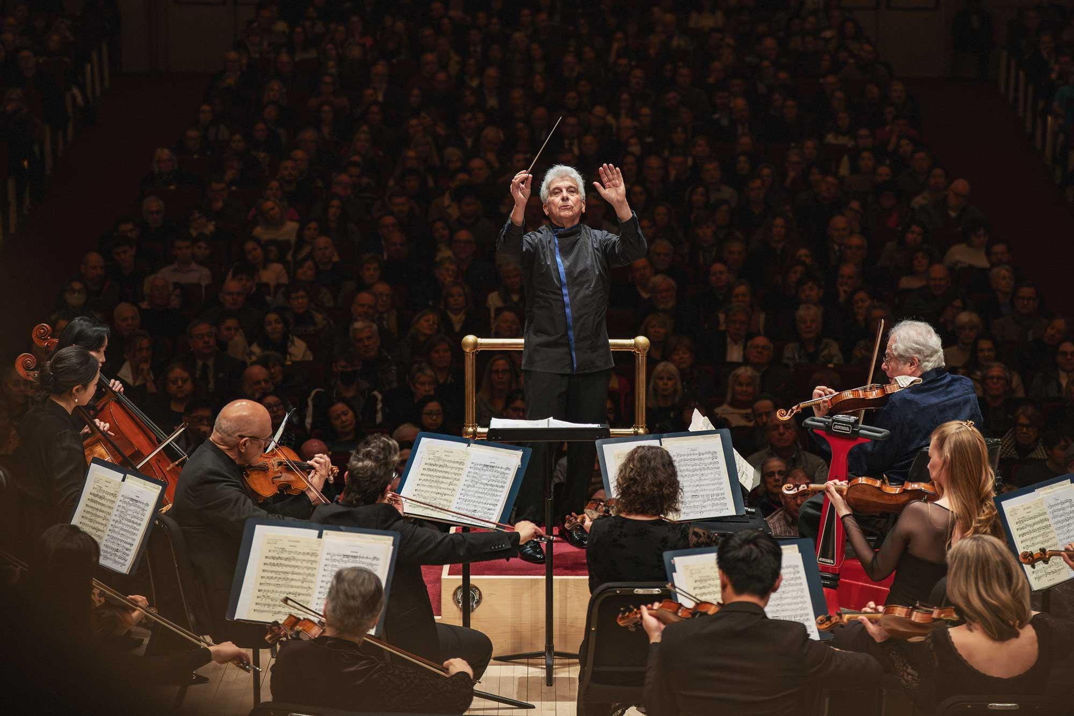
How We Think About Leadership
  Leadership starts before titles
  Potential isn’t always obvious
  Identifying leaders requires intention
Leadership begins with belief, not permission.

Slide 37

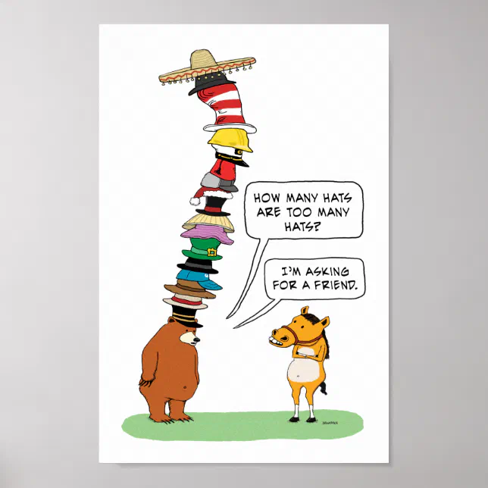
Why This Matters Right Now
The same names step up again and again
  Burnout at the top is real
  Willing people sit on the sidelines
  Limited diversity of thought limits progress
When the circle stays small, the thinking does too.

Slide 38

My Leadership Story (Raising My Hand Anyway)
I did raise my hand for leadership
  I checked the volunteer box three years in a row
  No one ever reached out
  The system missed the signal
  So I finally spoke up
Willingness doesn’t matter if no one is listening.

Slide 39

What That Taught Me
  Willing leaders don’t always get seen
  Systems can fail even when people don’t
  Silence feels like rejection
  Many people won’t ask twice…or three times… you know, like me
Most people won’t ask again if the first yes goes unheard.

Slide 40


What We Think Leaders Look Like
Outspoken
  Highly visible
  Always available
  Confident from day one
  Already “ready”
We often confuse confidence with readiness.

Slide 41


What Future Leaders Actually Look Like
  Curious
  Reliable
  Thoughtful
  Asking good questions
  Quietly doing the work
Potential shows up long before polish.

Slide 42
Leadership Starts Where You Are
  • In conversation
  • In committee work
  • In task-based projects
  • In short-term assignments
  • In informal influence
Every great performance starts with rehearsal.

Slide 43
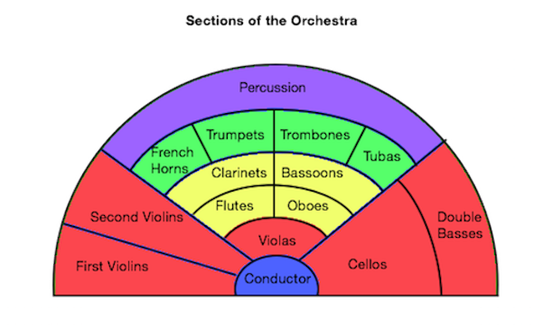
We Don’t Fill Holes. We Place People.
  New members often don’t know what exists
  It’s our job to explain the landscape
  Ask what interests them
  Describe roles clearly
  Let them choose where they feel comfortable
Not every musician belongs in the percussion section.

Slide 44

Volunteer Talent Is Not Prey
  New members are not a resource to be consumed
  Enthusiasm is not unlimited
  Volunteer fatigue is real
  Over-inviting feels overwhelming, not welcoming
Overbooking ruins the performance.

Slide 45
Make It Inviting. Make It Worth It.
  Start small and build confidence
  Make roles clear and manageable
  Create a welcoming experience
  Recognize contributions early
  Make it fun
If it’s not fun, people won’t stay for the encore.

Slide 46
How People Actually Get Involved
  Someone explained the options
  Someone asked what interested them
  Someone made the path clear
  Someone made it personal
People don’t join systems. They join people.

Slide 47
You Can’t Spot Potential From the Sidelines
  You can’t identify future leaders you don’t talk to
  Conversations create visibility
  Listening reveals interest, hesitation, and potential
  Patterns emerge when you listen broadly
  You don’t need more time…just more intention
Leaders don’t just ask questions. They listen for what’s underneath the answer.

Slide 48

Diversity of Thought Is a Leadership Responsibility
  Same solutions recycled
  Groupthink
  Risk avoidance
  Better questions and innovation come from expanded circles
Doing the same thing over and over and expecting different results isn’t leadership. It’s stagnation.

Slide 49
The Ask We Don’t Make Often Enough
Most people:
• Don’t nominate themselves
• Don’t assume they’re ready
• Don’t see themselves as leaders
• Don’t want to look presumptuous
• Don’t want to overstep
Sometimes leadership starts with a simple question.

Slide 50

Barriers Future Leaders Face
• Perceived lack of time
• Imposter syndrome
• Fear of visible failure
• Unclear expectations
• Not knowing the path forward
• Not seeing someone like themselves in the role
Fear doesn’t mean no. It usually means not yet.

Slide 51
When Someone Hesitates, That’s Information
  Hesitation is not a lack of interest
  It often signals uncertainty, not unwillingness
  A longer-term commitment can feel overwhelming
  Leaders should listen before assigning
Listening is how leaders turn uncertainty into insight.

Slide 52
Short-Term Opportunities Build Confidence
  A clear start and end
  A defined scope
  Low risk, high learning
  Space to observe and grow
  A way to say yes without overcommitting
A short-term yes often leads to a long-term leader.

Slide 53


Volunteer Roles Are Leadership Laboratories
Safe places to learn
Opportunities to test skills
Growth without perfection
Leadership grows where learning is allowed.

Slide 54
How We Lead Differently (Starting Now)
  Name potential out loud
  Create on-ramps, not cliffs
  Invite, don’t wait
  Place people intentionally
  Make learning visible
Leadership multiplies when we pull people in.

Slide 55
Don’t Stop Believin’
  Believe in potential before it’s polished
  Expand the circle intentionally
  Protect diversity of thought
The future is already here — it’s just waiting to be invited.

Slide 56



Final Note
Who am I overlooking because they don’t look like I once did?
Excellence is orchestrated one invitation at a time. The End.

Slide 57

Signed, Sealed, Delivered
How Meaningful Feedback Elevates Volunteer Leadership
Presented by:
Terri Moore-Natal, SPHR
ALA Board of Directors
Notes:
We’re close to the finish line of ALI, so my goal here is to keep this focused and useful. Think of this session as setting a steady tempo; not rushed, not heavy.
When leadership is done well, it creates harmony. Everyone knows the rhythm, the expectations, and how their part fits into the whole.
When feedback is unclear or missing, even strong leaders start drifting off‑beat.
Today I’ll share a simple framework you can use to keep leadership work in rhythm—clear expectations, steady connection, and meaningful recognition.
This is the count‑in—setting tempo before the music starts.
57

Slide 58

Why This Matters
Volunteers want to:
Contribute in the right ways
Feel guided
Be recognized
♪ Signed, Sealed, Delivered ♪
Notes:
Most leadership strain doesn’t come from lack of effort; it comes from uncertainty.
When feedback is unclear, leaders start guessing: Is this the priority? Am I focusing on the right thing? Should I push or pause?
Guessing creates friction. Over time, that friction leads to disengagement—not because people don’t care, but because they’re unsure how to stay in sync.
“Feedback sets the tempo. A steady tempo reduces friction.”
58

Slide 59
Why Feedback Matters
Alignment
Fairness
Sustainability
Trust
♪ Signed, Sealed, Delivered ♪
Notes:
Thoughtful feedback protects four outcomes: alignment, fairness, sustainability, and trust.
Alignment keeps everyone playing the same song. Fairness ensures expectations feel consistent. Sustainability prevents burnout. And trust grows when people know where they stand.
In a distributed volunteer structure, feedback is what keeps everyone reading from the same sheet of music; even when different parts are being played.
59

Slide 60
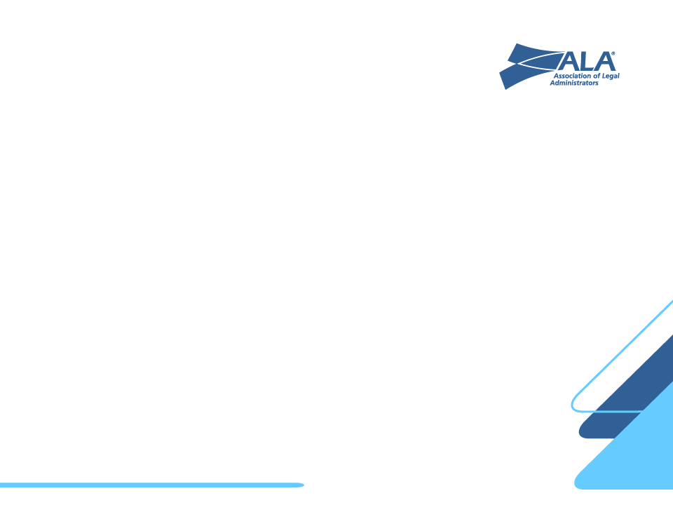
The Leadership Feedback Loop
Clarify
Celebrate
Observe
Support
♪ Signed, Sealed, Delivered ♪
Notes:
This framework is intentionally simple: Clarify, Observe, Support, Celebrate.
Clarify sets the key and tempo. Observe listens for patterns—not just outcomes, but energy and engagement. Support removes barriers or redirects effort. Celebrate reinforces what’s working.
This loop runs best when you use your liaisons well; staff help hold continuity, board liaisons help ensure you’re still playing in the right key.
“This loop is your rhythm section. If it’s steady, everything else holds.”
60

Slide 61

What Great Volunteer Feedback Sounds Like
How to give great volunteer feedback
Be specific and timely (name the behavior, not the person)
Offer direction (what success looks like next time)
♪ Signed, Sealed, Delivered ♪
Notes:
Volunteer feedback sounds different than employee feedback. You’re leading peers.
Being specific and timely helps people adjust without feeling corrected. Offering direction answers the question, what does success look like next time?
When feedback is delivered with care, it builds confidence instead of defensiveness.
“You’re not changing the song—you’re helping someone stay in key.”

Slide 62
Phrases You Can Borrow
Supportive for peer-to-peer leadership
” Here’s what I appreciated about your approach…”
“One thing that will make this even stronger next time is…”
“ From your perspective, what helped and what got in the way?”
♪ Signed, Sealed, Delivered ♪
Notes:
These phrases work because they lower defensiveness and raise openness.
Think of them as go‑to chords you can play under pressure-language you can rely on when feedback matters but time is tight.

Slide 63

✓
Signed: Setting Clear Expectations
Deliverables
Timelines & Tools
Communication rhythm
(Agenda posted in advance, decisions recorded, owners named)
♪ Signed, Sealed, Delivered ♪
Notes:
Most leadership challenges don’t start with conflict—they start with assumptions.
Clear expectations around deliverables, timelines, tools, and communication rhythm prevent rework and frustration.
If participation is slipping, instead of guessing why, try offering options: Would meeting every other week help? Should we adjust the time?
Clarity isn’t rigid—it’s what allows people to stay engaged.
“Signed is the count‑in. Everyone knows when to come in and how fast to play.”

Slide 64

Sealed: Staying Connected
Virtual touchpoints
Structured agendas
Quick reflections
♪ Signed, Sealed, Delivered ♪
Notes:
Staying connected doesn’t require more meetings. Structure creates freedom.
When schedules don’t align, seal the work by using the online community—post recaps, confirm action items, invite async input.
If energy drifts mid‑meeting, it’s okay to say: I’m hearing great ideas—let’s capture a few and come back to the agenda so we finish strong.
“This is how you keep the groove going between rehearsals.”

Slide 65
Delivered: Recognition Matters
Highlight contributions in public and sincerely
Reward progress over perfection
Connect efforts to ALA’s mission
Short. Specific. Consistent
♪ Signed, Sealed, Delivered ♪
Notes:
Recognition is how the work lands. It’s not fluff—it’s fuel.
Short, sincere recognition reinforces what matters and connects effort back to purpose.
People stay engaged when they feel seen—even briefly.
“Recognition is the applause. It tells people the performance mattered.”

Slide 66

Common Scenarios
Time Zone conflicts
Dominating voices
Off-track enthusiasm
Quiet but reliable volunteers
♪ Signed, Sealed, Delivered ♪
Notes:
These situations are normal rhythm disruptions.
If one voice dominates: Let’s pause and hear from someone we haven’t heard from yet.
If enthusiasm goes off‑track: This is great energy—let’s capture it and return to today’s goal.
If someone is quiet but reliable: I’d really value your perspective here.
“This is bringing the group back in time when someone rushes the tempo.”

Slide 67
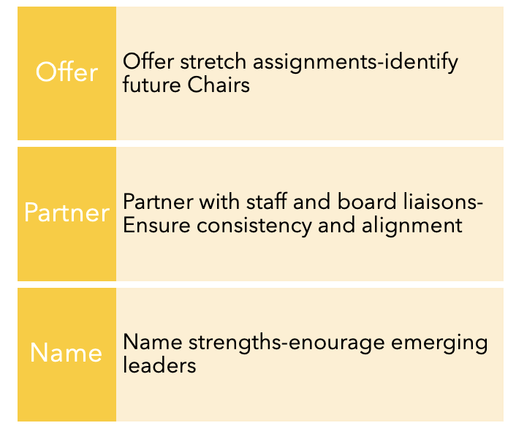
Building the Leadership Pipeline
Feedback today build’s ALA’s leaders of tomorrow
♪ Signed, Sealed, Delivered ♪
Notes:
Feedback isn’t just about today—it’s how we develop future leaders.
Naming strengths out loud and offering stretch opportunities helps people see themselves as leaders before they’re asked to step up.
Would you be willing to introduce the speaker for this session? Would you be willing to take the lead on this next agenda topic?
Most leaders don’t self‑nominate—they’re invited.
One additional resource I want to name—new this year—is ALA’s Volunteer Development and Experience Advisory Council.
This group is focused specifically on the volunteer journey: how we train, support, and sustain leaders over time. They work with staff to assess what’s working, identify gaps, and recommend scalable training and tools that complement what you’re doing day‑to‑day.
Think of them as helping design the long‑term leadership score—so Chairs and Vice Chairs aren’t reinventing the music every year.
Then land it musically:
“They help make sure we’re not just filling roles, but developing leaders who want to stay engaged.”
“They’re helping write the score, not conduct the meeting.”

Slide 68
Final Thoughts
Every volunteer deserves
Clear expectations
Caring feedback
Recognition
A path to grow
♪ Signed, Sealed, Delivered
Notes:
Clear expectations. Caring feedback. Meaningful recognition.
When those are delivered consistently, leadership feels purposeful rather than draining.
A good encore doesn’t need volume; just intention.
That’s how volunteer leaders feel truly signed, sealed, and delivered.
68

