Slide 1

Right Here, Right Now:
Updates from ALA HQ
Eryn Carter, CAE
Executive Director
ALI, February 2026

Slide 2
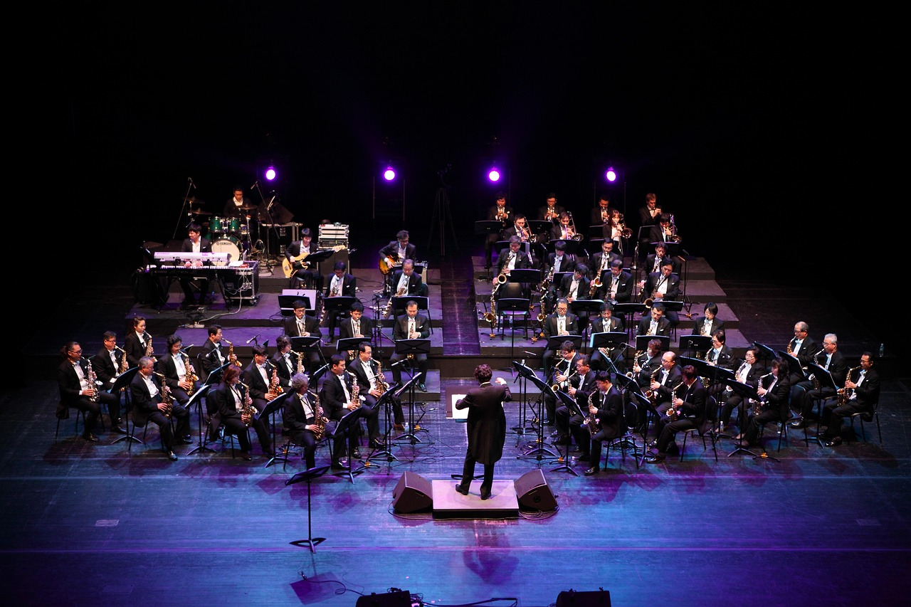
ALA Headquarters: The Ensemble
Notes:
HQ Staff as the Core Ensemble

Slide 3

HQ Staff as the Core Ensemble
Staff Structure
Vision, Mission, and Values
Culture and Community
Training and Development
Notes:
ALA Headquarters serves as the central ensemble driving the operational, strategic, and administrative rhythm of the Association of Legal Administrators. Much like a well‑coordinated orchestra, HQ staff work in harmony across numerous functional areas—membership, education, communications, finance, technology, and business partner relations—to ensure that every program, initiative, and service is delivered with precision and consistency. This unified effort ensures that members experience a cohesive and reliable support system, regardless of their chapter or area of specialization. For instance, the education and events team functions like the percussion section, keeping tempo through consistent programming and national conference planning, while marketing and communications act as the woodwinds, providing clarity, tone, and message resonance across channels. Similarly, membership and chapter relations serve as the string section, fostering deep, continuous engagement and ensuring the association’s mission resonates broadly. To illustrate the importance of this integrated approach, consider the coordination required for ALA’s Annual Conference & Expo, where multiple HQ teams synchronize logistics, sponsorships, registration, content curation, and attendee experience. Without centralized alignment, the member experience would fragment, diminishing the value that chapters and legal management professionals rely upon. As volunteers interface with members and guide chapter activities, understanding HQ’s orchestral structure helps contextualize the support available to them and highlights the dependable infrastructure behind every ALA initiative.

Slide 4

Following the Soundtrack
Notes:
Professional Development and Learning Tracks

Slide 5

Understanding ALA
The Basics
Experience
Experiment
Engagement
Growth Opportunities
Service

Slide 6

Strategy as the Sheet Music
Notes:
Guiding Members Through Thought Leadership

Slide 7

The Evolution of ALA
ALA’s Strategic Direction
Tactics development and review
SOAR Analysis
The RACI model
Board oversight and authority
Accountability
Partnerships

Slide 8

Amplifying Our Presence
Notes:
Strengthening Industry Partnerships

Slide 9
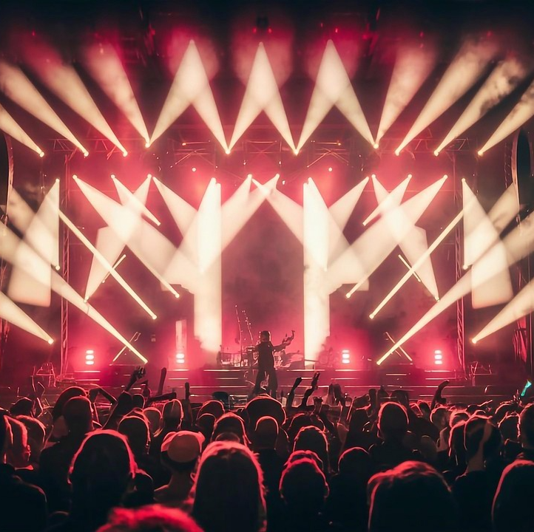
Essential Tools for Success
New Brand Identity Guidelines
Education Strategy
Member Gamification
Law Firm Strategy
Content Development
Business Partner Engagement
Customization/Personalization

Slide 10

Membership as the Choir
Notes:
Supporting and Growing the Member Community

Slide 11
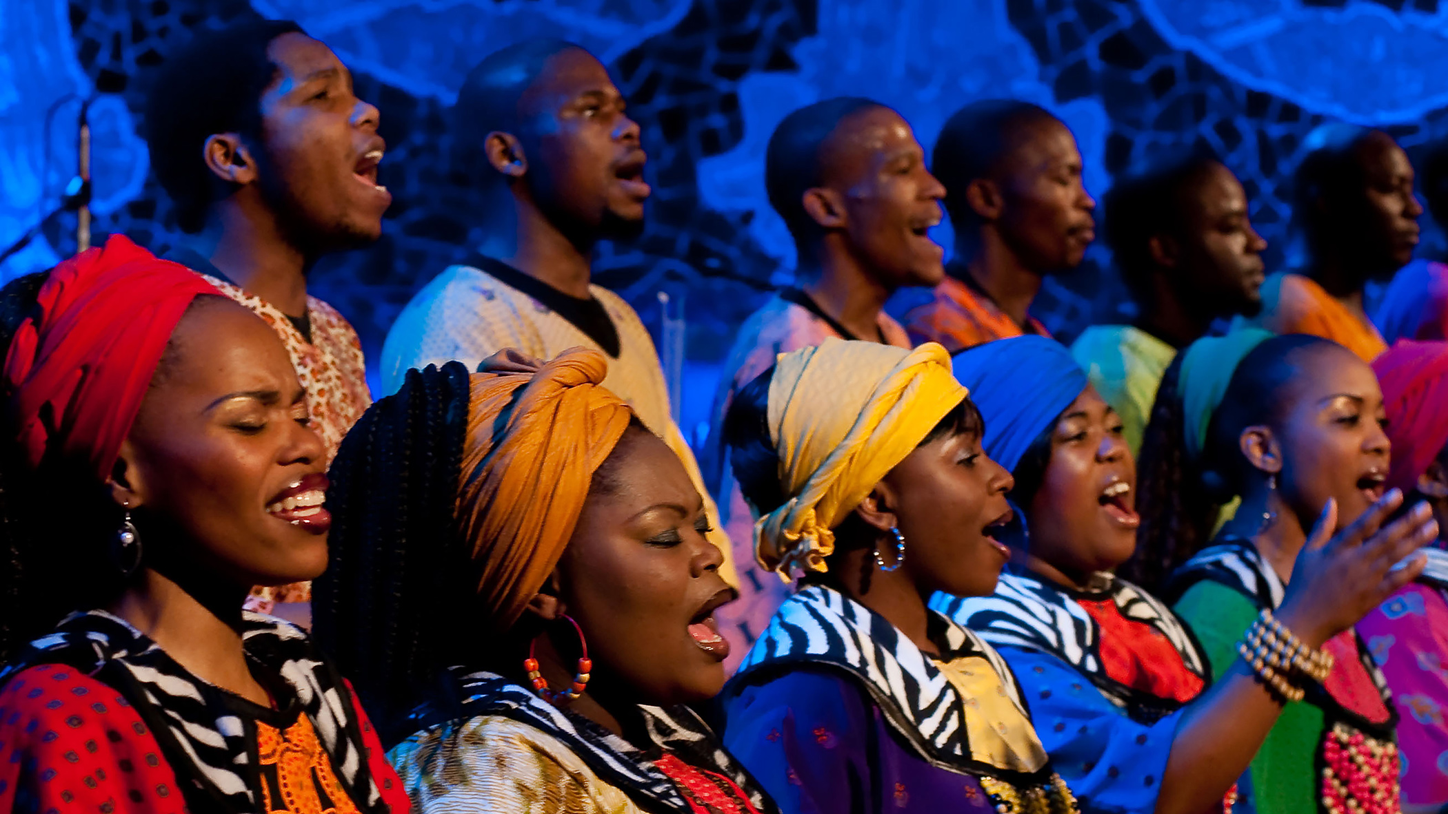
Supporting and Growing the Member Community
Membership as Collective Voice
  Membership forms the collective voice shaping the association's identity, energy, and impact.
HQ Support Functions
  HQ coordinates recruitment, engagement, resource management, and digital systems to support members effectively.
Member Recruitment, Retention and Engagement
  Managing onboarding, outreach communications, and online communities fosters member connection and shared insights.
Data-Driven Programming
  Using surveys, feedback and insights, HQ tailors programming and content on trending topics.
Notes:
Membership represents the choir of ALA—the collective voices that create the association’s identity, energy, and impact. HQ staff support this choir by coordinating recruitment campaigns, developing engagement pathways, managing chapter resources, and maintaining digital membership systems. Their work ensures that members feel welcomed, supported, and connected to the broader legal management community. This includes managing onboarding workflows, producing membership communications, and maintaining online communities where administrators share insights and seek guidance. HQ also collaborates with chapters, helping leaders navigate growth opportunities, retention challenges, and member‑experience improvements. Through surveys, analytics, and direct feedback, HQ identifies member needs and tailors programming and communication strategies accordingly. For example, members increasingly request guidance on AI literacy, hybrid workforce management, and financial forecasting—topics HQ integrates into both national and chapter‑level resources. Volunteer leaders benefit greatly from understanding how HQ orchestrates this support system, as it empowers them to mirror best practices, strengthen local engagement, and advocate effectively for their chapter’s needs. Ultimately, the choir thrives when every member feels heard, valued, and connected—and HQ’s work ensures this harmony remains strong.

Slide 12

The Crescendo
Notes:
Maintaining Excellence in CLM Administration

Slide 13
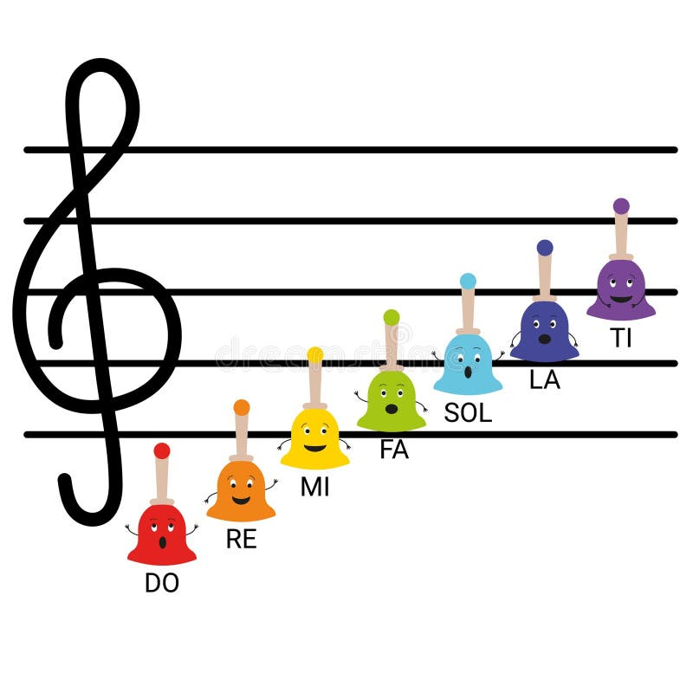
Strategic Tactics – Climbing the Scale
Responsibilities and expectations
Making an impact
Collaboration and teamwork
Success Stories

Slide 14

The Rhythm & Melody Continue
Notes:
Operational Infrastructure and Brand Stewardship

Slide 15

Learning and Growing Together
Staying engaged and involved
Creating opportunities
Challenging assumptions
Highlighting achievements, offerings, and value
Growing our community
Strengthening our brand

Slide 16
"If you write great songs with meaning and emotion, they will last forever".
Elton John

Slide 17
“Message In A Bottle”
ALA Member Demographics
Mike Donovan
ALA Association Leadership Institute
February 28, 2026

Slide 18

Membership Snapshot
9,148 members representing 3,639 Legal Organizations
  Member Type
    54.98% Regular Members
    41.01% Group Members
    4% Combined Other Categories

Slide 19
Where Members Work
Firm Size Distribution
38.45% Small (≤24 attorneys)
29.64% Medium (25–199 attorneys)
31.91% Large (200+ attorneys)

Slide 20
Where Members Work
Firm Type Distribution
Private Law Office — 88.40%
Unemployed — 5.64%
Other — 2.46%
Nonprofit Organization — 0.77%
Consulting — 0.71%
Government Legal Dept./Judicial — 0.63%
Law Firm/Solo Practitioner — 0.60%
College/University — 0.42%
Bar Association — 0.19%
Corporate Legal Department — 0.18%

Slide 21
Professional Roles of Members
Management Roles
Office/Business Manager — 39.79%
Functional Management (HR, Finance, Marketing, IT) — 29.62%
CEO/Executive Director — 11.79%
Branch Office Manager — 6.03%
Consultant — 0.62%
President/Owner — 0.29%

Slide 22
Professional Roles of Members
Legal Roles
Managing Partner — 0.41%
Partner in Private Firm — 0.29%
Associate — 0.17%
General Counsel — 0.06%
Judge — 0.03%
Solo Practitioner — 0.03%

Slide 23
Professional Roles of Members
Other Roles
Pre-Management/Support Staff — 4.52%
Paralegal — 1.26%
Law Librarian — 0.27%
Students/Faculty — <0.2% combined
Other — 4.61%

Slide 24
Highest Representation Practice Areas
Employment Law — 26.66%
Intellectual Property Law — 26.57%
Legal Services — 24.39%
Corporate Law — 21.17%
Personal Injury Plaintiff — 20.47%
Multi Office Management — 19.95%
Real Estate Law — 18.12%
Trust & Estates Law — 16.38%
Appellate Litigation — 14.63%
Personal Injury Defense — 13.15%

Slide 25
Member Segment
People — 79.42%
Processes — 74.75%
Finance — 60.81%
Technology — 58.34%
Marketing — 45.60%

Slide 26
Professional Experience Distribution
1–5 Years — 12.53%
6–10 Years — 13.29%
11–15 Years — 13.05%
16–20 Years — 14.57%
21–25 Years — 15.65%
26–30 Years — 13.36%
31–35 Years — 8.14%
36–40 Years — 5.92%
41–45 Years — 2.58%
46–50 Years — 0.70%
51–56 Years — 0.22%

Slide 27
Key Takeaways
Membership is overwhelmingly private law office–based.
Strong representation of operational and administrative leadership roles.
Practice areas concentrate in Employment, IP, Corporate, and Legal Services.
Balanced representation across firm sizes.
Members are predominantly mid-career professionals.
High focus on people and process management.

Slide 28
Membership Gamification
Mike Donovan
ALA Association Leadership Institute
February 28, 2026

Slide 29
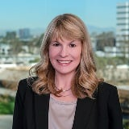
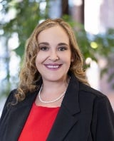
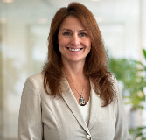
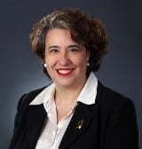
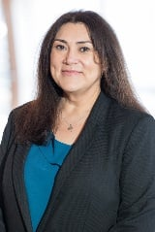
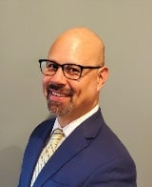
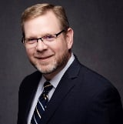
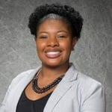
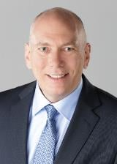
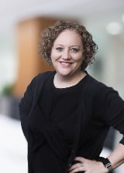
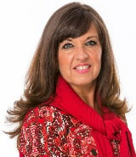
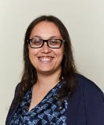
1
7
10
4
5
8
2
11
3
6
9
12

Slide 30
45
20
25
22
45
23
22
18
23
22
16
36

Slide 31
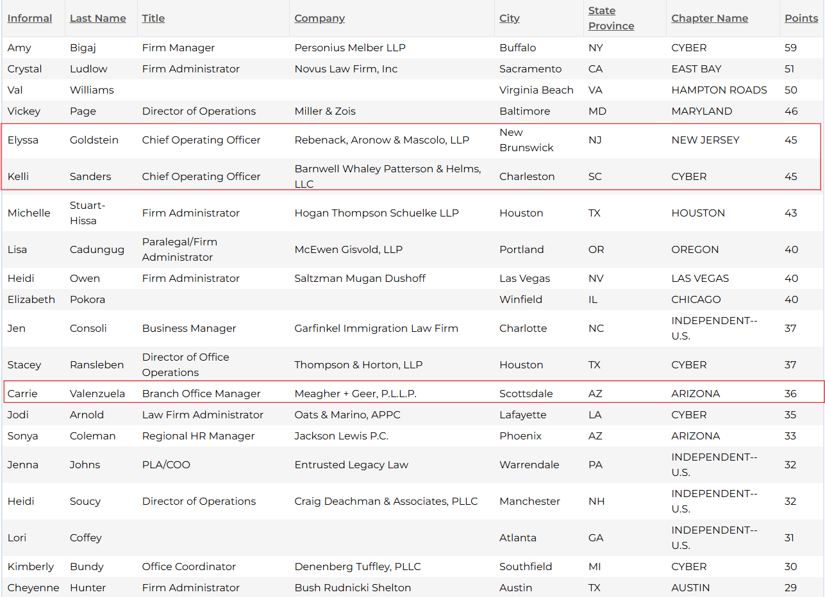

Slide 32
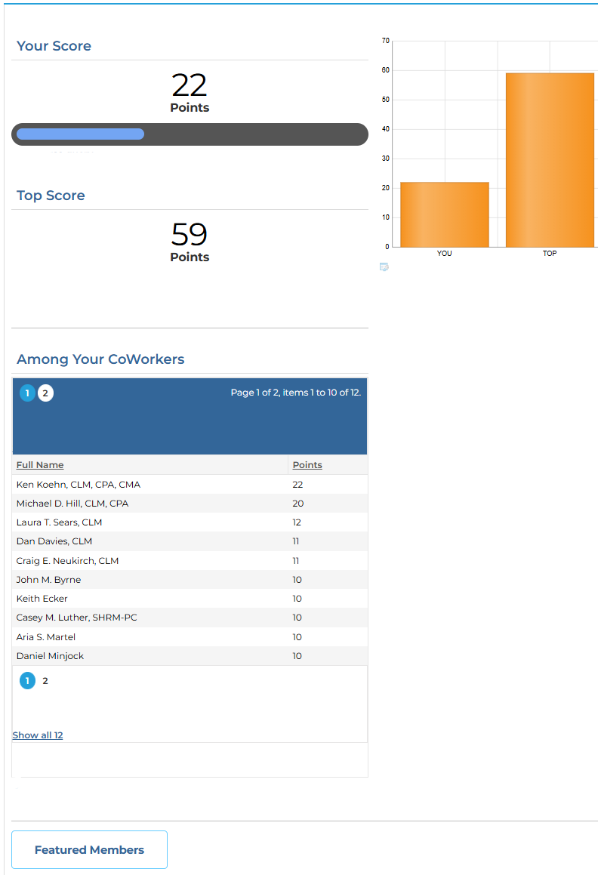

Slide 33
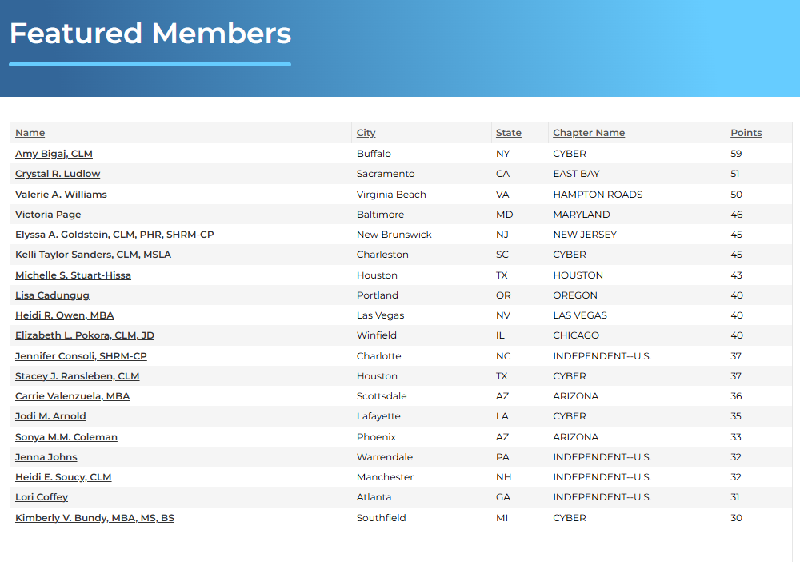

Slide 34
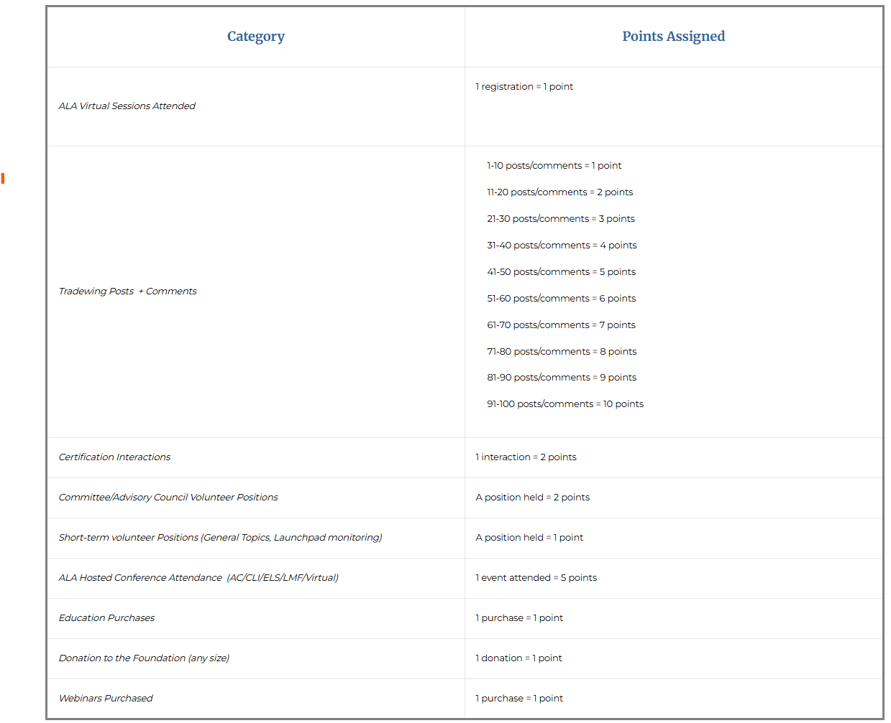

Slide 35
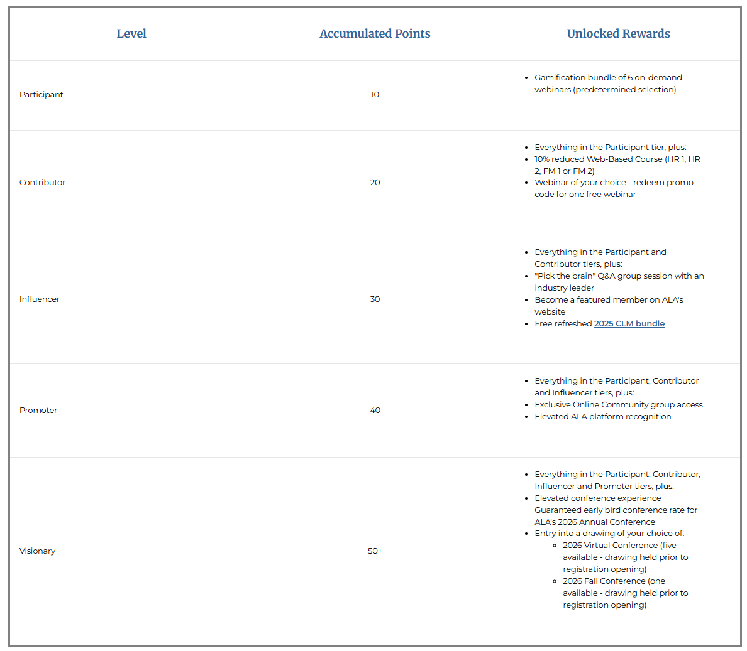

Slide 36
Key Stats
3,165 members have reached the Participant tier and above
464 members in Participant tier have redeemed their Gamification webinar bundle reward
10 members in the Contributor tier have redeemed their free webinar reward
Out of 97 members in Contributor tier and above, 89 are Chapter members

Slide 37
ALA Online Communities
Mike Donovan
ALA Association Leadership Institute
February 28, 2026

Slide 38
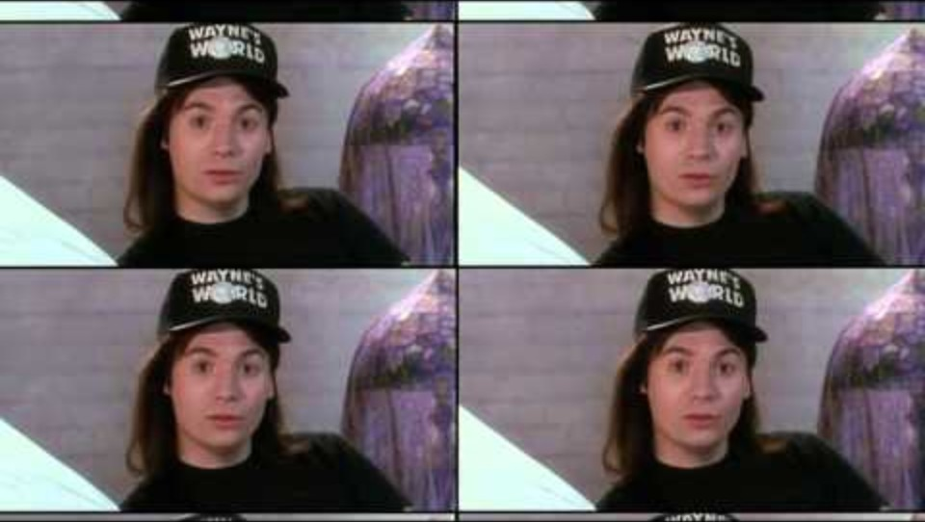

Slide 39
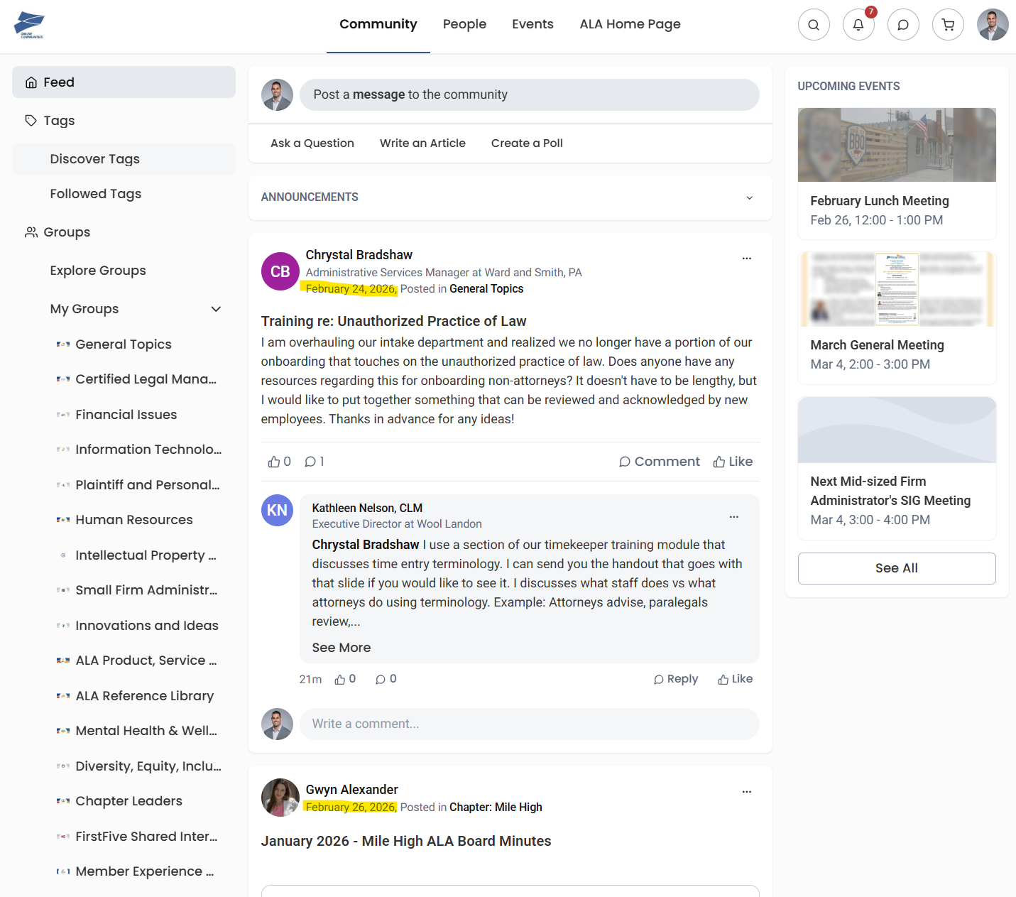

Slide 40

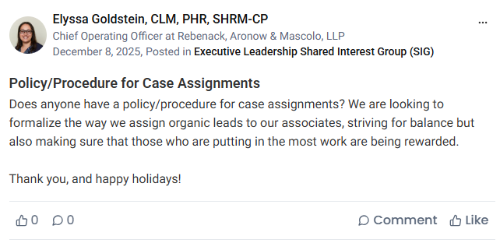


Slide 41
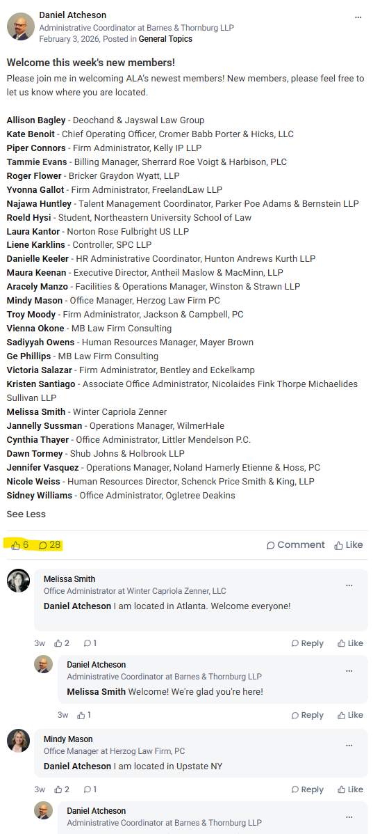

Slide 42

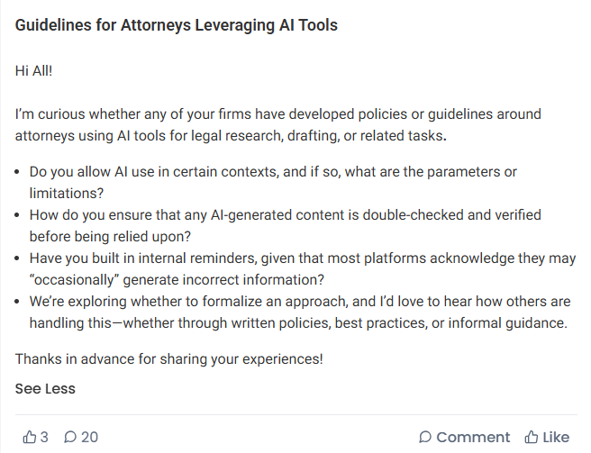
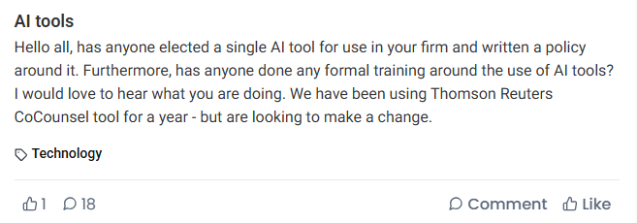
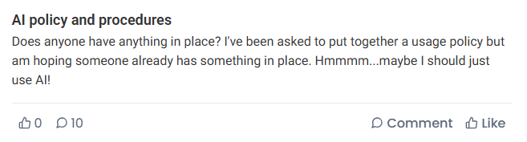
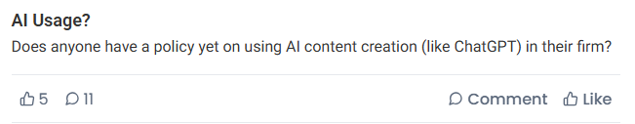





Slide 43
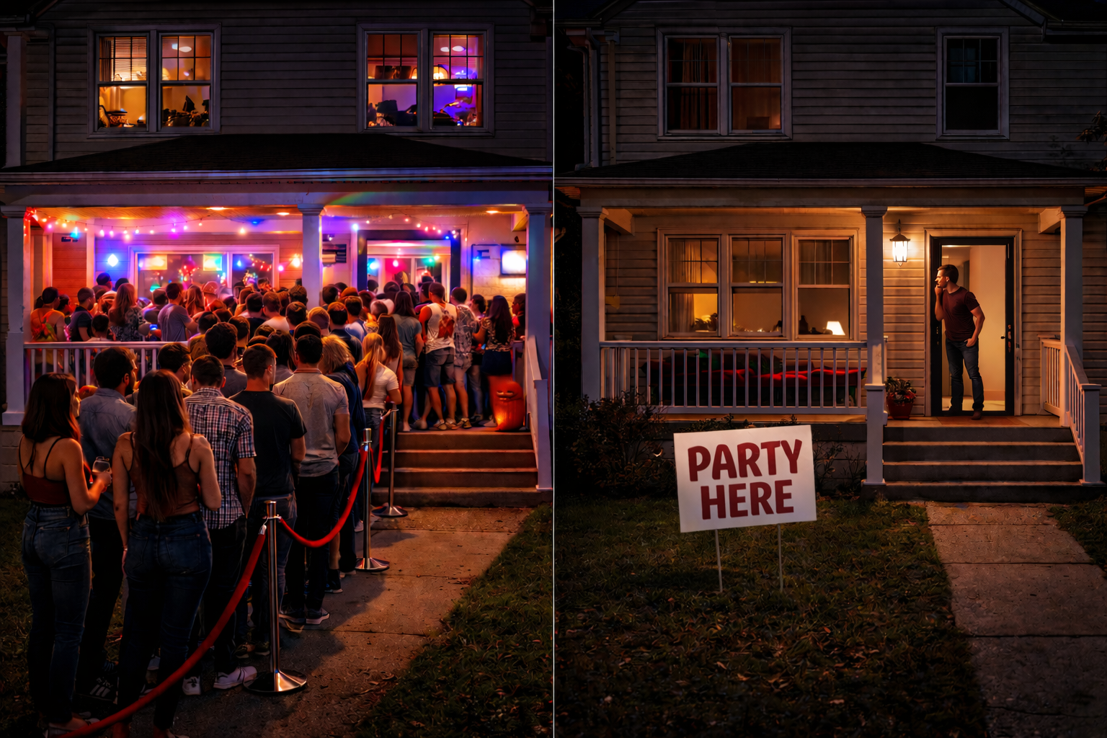

Slide 44





Slide 45

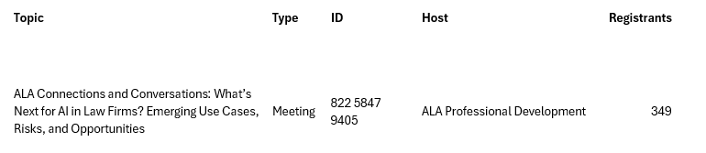


Slide 46
How can I help?
Comment on posts
Comment on posts
Comment on posts
Activity sparks more activity!

Slide 47
Contact us for more information!
membership@alanet.org

Slide 48

“Takin’ Care Of Business”

Slide 49


Fred Ullman, Director, Business Development
Phone: 847-267-1375
Email: fullman@alanet.org
LinkedIn: www.linkedin.com/in/fredullman/
Responsible for non-dues revenue through building and fostering relationships with our Business Partners and VIP Partners.
Ensure that our Business Partners and VIP Partners have the right mix of branding, visibility, thought leadership tools and access and engagement with ALA members.
Build collaborative integrated marketing packages (needs and solution based)
Develop new revenue streams based on the Win-Win-Win (Member-ALA-BP) model.
Here to help! Let’s orchestrate great things together.

Slide 50

ALA VIP Program
(Value In Partnership)
A value-add/ discount program exclusively for ALA members that connects our top business partners with the ALA community looking for solutions.
Invite only to our top business partners.
Potential business partners complete an application and are vetted by ALA to ensure quality and alignment of mission and values.
Only 20 VIPs max for the program. Currently 7 active VIP Partners.
In 2025 the VIP program brought in $200,000 in revenue and we are looking to bring in 4 new additional partners in 2026.
In 2026 ALA is reexamining the program to ensure VIP Partners and members are receiving consistent value and the right benefits.

Slide 51

ALA Business Partners (BPs)
Annual Revenue from Business Partners and VIPs in 2025 - $2.4M
80% comes from conference exhibits and sponsorships
9% comes from VIP Business Partners
11% comes from advertising in our various publications, web site, etc.
Currently have approximately 160 business partners.
All programs have incorporated the Win-Win-Win (Member-ALA-BP) approach.
BP focus groups to convene after ALA events to capture success and feedback to improve both BP and member experience.

Slide 52
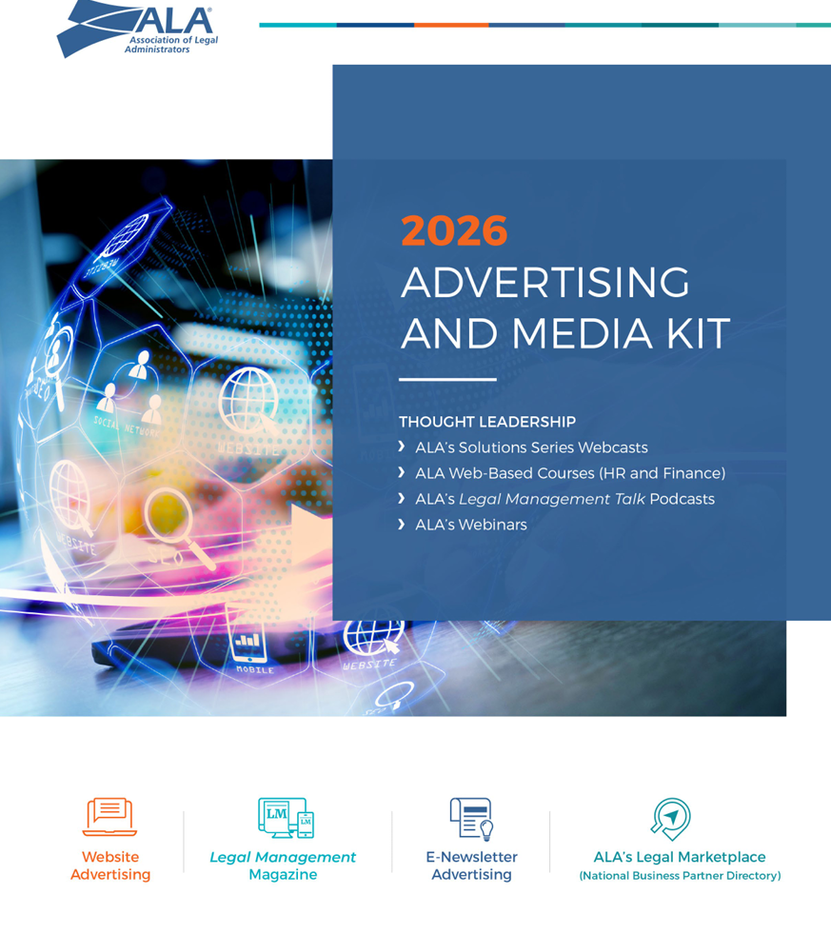
ALA Business Partners (BPs) 2026 Programs
Opportunities for BPs to better reach and engage our members…
Exhibit and Sponsoringing at ALA events
  ALA Annual Conference
  Chapter Leadership Institute
  LevelUp: ALA’s Legal Management Fundamentals
  LegalLeaders: ALA’s Executive Leadership Summit
Thought Leadership
  Webcasts
  Podcast
  Article submissions
  Resources place in the ALA Business Partner Directory
Digital Advertising
  Legal Management Magazine
  Bold Bites E-Newsletter
  ALAnet.org

Slide 53

ALA Business Partners (BPs)
Looking to the future…
  Continue to focus on BP engagement and using quantitative and qualitative data to make better informed decisions on how they want to reach ALA members
    BP focus groups and surveys
  61% of BPs engage with ALA international exclusively through the Annual Conference. (39% of BPs engage with ALA HQ beyond just the Annual Conference)
  Package offerings that showcase year-round engagement with the ALA Community that drives results and ROI.
  Focus on thought leadership and tailored opportunities.
  ALA Chapters play an important part in local, in-person, ALA engagement for BPs
    Continue lead sharing between ALA HQ and Chapters.

Slide 54

ALA Business Partners (BPs)
What can ALA leaders do to foster engagement
    Attend ALA and BP events both on the chapter and national level. (Show up and be interactive)
    Bring someone new to ALA events. (Tell your friends and colleagues)
    Be active on social media. (Post, comment, and share)
    Introduce yourself to ALA BPs. (Start a conversation and be interested)
    Utilize BP’s as resources. (They have great content and thought leadership)
    Engage with them on the ALA Business Partner Directory & Resource Center
    Be active of our online community (tradewing) sharing BP experiences.
    Refer any prospective new BP’s to Fred Ullman and or local chapter BP liaisons.
    Thank our BP’s for supporting ALA and our programs. (We can never thank them enough)

Slide 55


Slide 56




Elevating the ALA Brand:
Growth, Engagement & Impact
Marketing and Communications
February 28, 2026

Slide 57



Why Our
Brand Sets the Tone
Today we will:
Clarify the role of brand & marketing within ALA
Demonstrate impact on membership, CLM and revenue
Outline priorities for the coming year
Identify how you can support brand alignment
Notes:
SEAN
Core idea: Our brand is how we build trust, drive growth and advance the profession

Slide 58


The Rhythm That Drives Us
To grow, strengthen and elevate ALA through our strategic brand and marketing initiatives.
We drive:
Membership recruitment & retention
Event attendance
Certification growth
Publication engagement and ad revenue
Sponsor visibility and non-dues revenue
Marketing amplifies every department.
Notes:
SEAN

Slide 59






Amplifying the ALA Brand
Membership growth
Certification adoption
Event attendance growth
Revenue diversification
Chapter visibility
Everything we do ties back
to measurable growth.
Notes:
SEAN

Slide 60
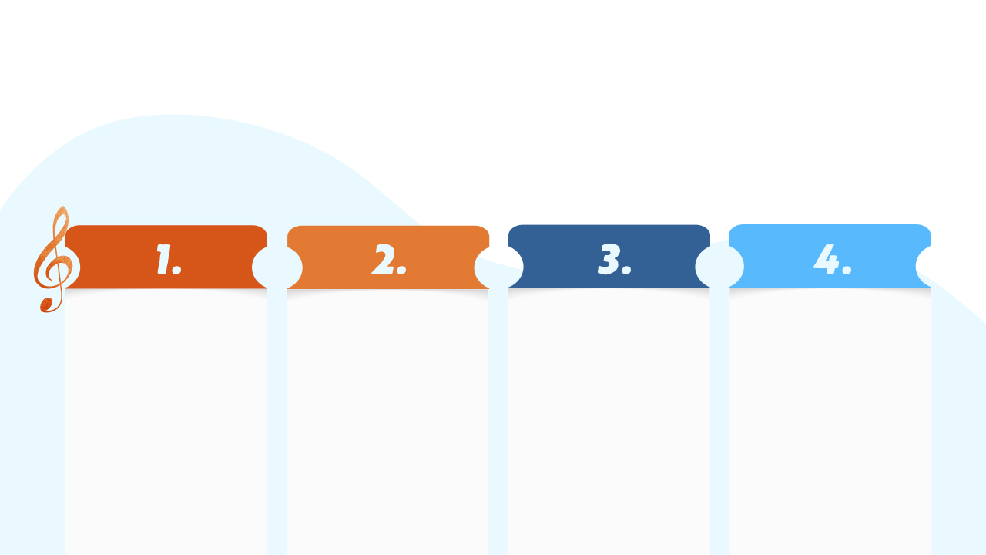
Key Impact Areas for ALA
Growth
Marketing
Recruitment, segmentation and paid media
Engagement Marketing
Email strategy, onboarding, personalization
Brand
Stewardship
Consistency, positioning, credibility
Revenue Support
Event attendance, advertising, sponsorship visibility
Notes:
SEAN

Slide 61


Your Part in the Symphony
Brand & marketing improves:
Clearer professional identity
Stronger onboarding experience
Better communication relevance
Easier event discovery
Increased career credibility through CLM
Strong brand = stronger
member confidence.
Notes:
SEAN

Slide 62
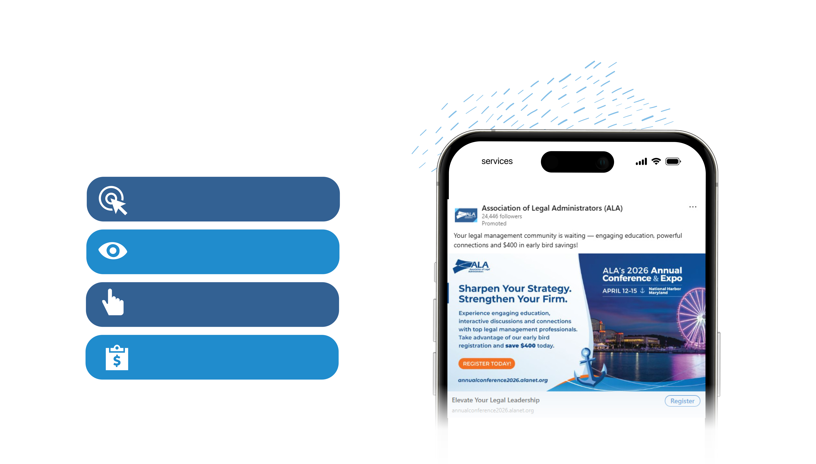
Results
Snapshot
384,038 REACH
Key Results
843,683
Impressions
196
Clicks
$1.30
Cost Per Key Result
Notes:
**Meghann's Slide**
We're doing more to expand our brand which includes running paid campaigns on LinkedIn.
This slide highlights a current Annual Conference campaign running on LinkedIn.
In the top right, you can see the ad creative as presented to our target audience.
The analytics below reflect campaign performance, including more than 850 clicks to the Annual Conference webpage and nearly 75,000 impressions.

Slide 63
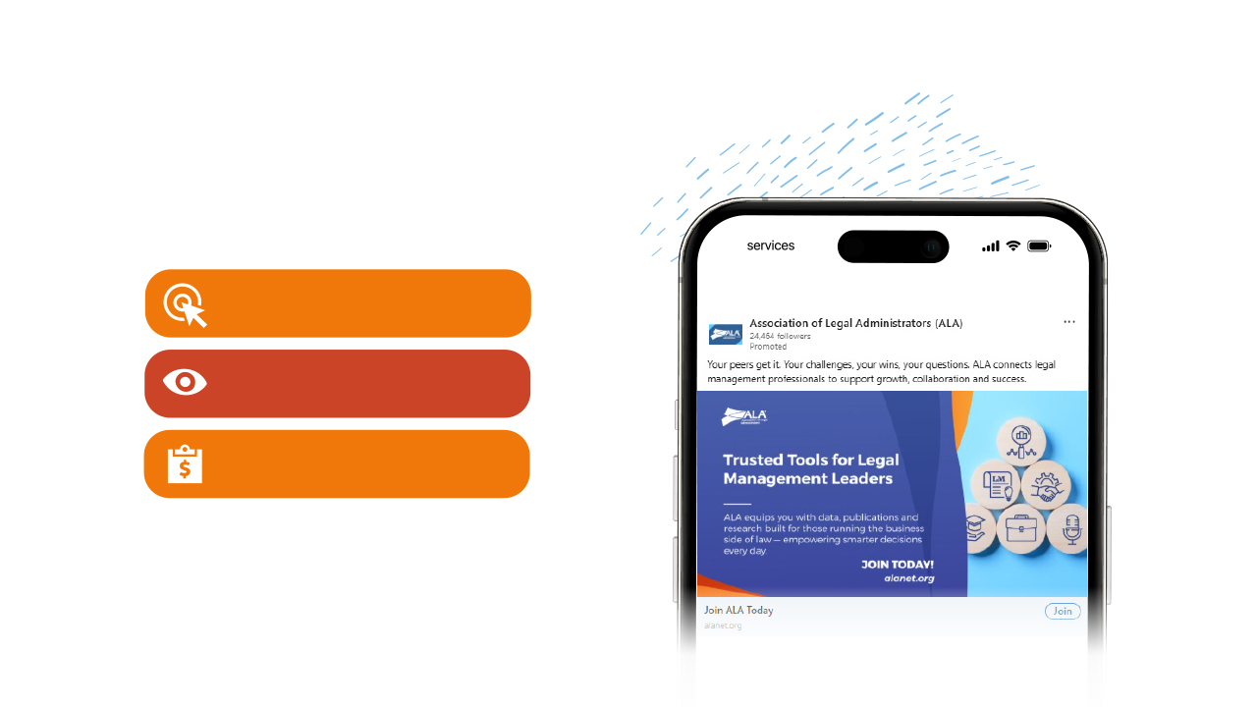
Results
Snapshot
314 Website Visits
Key Results
31,479
Impressions
$0.49
Cost Per Key Result
Notes:
**Meghann's Slide**
We're doing more to expand our brand which includes running paid campaigns on LinkedIn.
This slide highlights a current Annual Conference campaign running on LinkedIn.
In the top right, you can see the ad creative as presented to our target audience.
The analytics below reflect campaign performance, including more than 850 clicks to the Annual Conference webpage and nearly 75,000 impressions.

Slide 64


Fresh Beats in
Legal Management
Legal Management Talk
New look and studio setup
Legal Collective series
More in-person episodes (including today!)
Legal Management magazine
Themed editorial calendar based on Online Community
Online only as we adapt to the times of a digital magazine
LinkedIn account for increased reach
Notes:
**Nav and Justin**
Podcast
This year, we'll be introducing a new look and feel for the podcast. You'll notice that no longer will it just be me looking into the camera. Nav and I will be cohosting from an official podcast studio, making the episodes feel more conversational while still giving our viewers and listeners the info they need to know about the trends in the legal industry. You can also look forward to a new logo and potentially some new music in the months to come.
You may recall that back in the fall, we had an event scheduled called the Legal Collective that didn't end up panning out. The good news is that we will still be harnessing the insights of those speakers, just in podcast form. Over the course of the year, look out for several installments of the Legal Collective series covering topics such as law firm marketing, recruitment and retention, and getting buy-in for projects.
Lastly, one of my favorite things about doing the podcast is when I get to interview people in-person instead of virtually. With our new setup, we'll be able to host more guests in-studio when they're in Chicago. Plus, we'll be making an effort to create podcast content around our events that are being held in Chicago, including Legal Management Fundamentals in September and of course, here at ALI later today. So if you can, please stick around after the program ends today and be part of the audience for our live taping!
Mag
Starting this year, you'll see that we now have a themed calendar with each month focusing on specific topics such as recruitment, DEIA, benefits and negotiations, and more. We looked at trending and repeating topics in the online community to assess what our community really wanted to learn to develop the magazine to be as valuable as possible to ALA
And, we are officially online only. We found that the vast majority of our readers don't read the digital magazine, and while we enjoyed putting it together, focusing our time on the website will allow us to enhance LM's online presence.
Later this year, you'll see us on LinkedIn! The magazine and podcast will have a joint LinkedIn account to increase our readership and share articles and clips related to current events and, again, trending topics in the online community.

Slide 65

Hitting a Sour Note
Wait… it’s not always sunshine and rainbows.
Some of our challenges are:
Competitive legal events market
Digital communication overload
Brand inconsistency across chapters
Budget constraints vs. growth goals
Data segmentation limitations
This shows awareness and strategic maturity.
Notes:
KATIE
We're fighting for dollars because there are a lot of events in the market and people are optimizing what they're purchasing: if they can go to 2 events for the price of our event or access free online education, we struggle to compete with those other opportunities.
Right now, we're moving away from the heavy emphasis on emailing and are using paid and organic social to get across our messaging.
Our chapter logo initiative aims to create a cohesive brand across ALA, emphasizing our unity.
You can't win if you don't play. There's over a million people in this space, but we don't have the budget to serve enough ads to make them consider becoming members. We're working on optimizing our budget so that we can achieve our marketing goals.
Data segmentation will allow us to implement targeted content that shows you only what you need to know. Now that we are moving to a new email platform, we'll be able to enhance our member experience.

Slide 66


The Crescendo
Ahead
Help us grow
Stronger chapter-national alignment
CLM as a unique differentiator
More personalization and lifecycle marketing
Publication monetization expansion
Social media thought leadership positioning
Relay network for onboarding and engagement
Opportunity outweighs challenge.
Notes:
Sean

Slide 67


Setting the Stage
Marketing and Communication's Vision:
Position ALA as the indispensable professional home for legal management leaders.
Notes:
SEAN

Slide 68

Our Tempo
  Strengthen brand consistency nationally and locally
  Advance segmentation and lifecycle campaigns
  Increase certification awareness and conversion
  Grow event attendance strategically
  Expand Legal Management and Legal Management Talk’s reach
  Improve reporting and ROI transparency
Notes:
SEAN

Slide 69

How Volunteer Leaders
Can Get *NSYNC
Leaders can:
Use official brand logos (just email us if you need them)
Reinforce consistent messaging
Share national campaigns across social media
Encourage certification to your colleagues
Tell us how we’re doing
Brand consistency starts locally.
Notes:
ANDREA
Again, by unifying our chapter logos, we'll establish brand consistency and alignment as an organization.
When you're holding your own chapter meetings and sending out chapter emails, the look should still reflect ALA. Our brand guidelines are available in the chapter resource hub for your convenience.
There are ALA branded ads and graphics available for your use in the chapter resource hub for you to share our events like Annual Conference and publications like Legal Management.
Our CLM program is ALA's biggest asset, and spreading the word of the certification is one of the most effective forms of increasing awareness.
How can we help? Let us know what's been working for you and what you need!

Slide 70

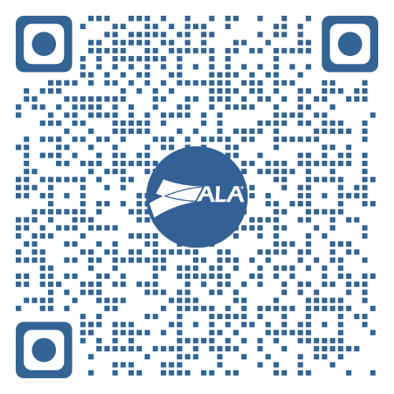
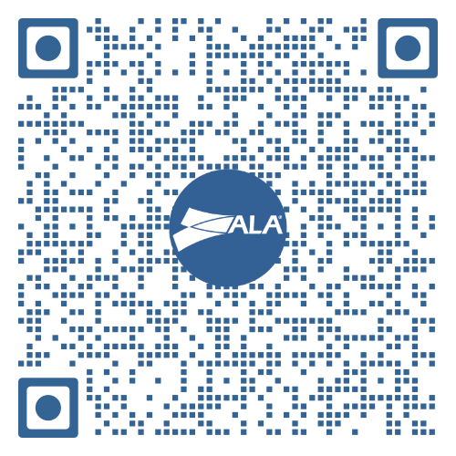
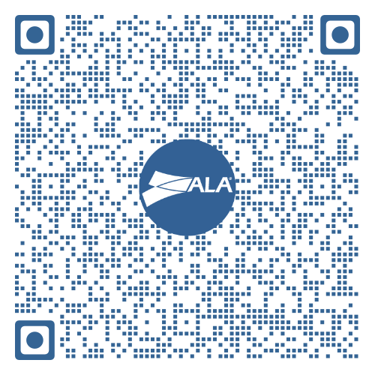
Chapter
Resources
Chapter Resource Hub
Chapter Newsletters
ALA Brand Identity Style Guidelines
Login required
alanet.org

Slide 71

The Grand Finale
ALA’s brand is one of our most valuable strategic assets.
When aligned and data-driven:
We grow membership
We increase engagement
We strengthen financial sustainability
We elevate the profession
Together, we amplify ALA’s voice.
Notes:
SEAN

Slide 72



