Slide 1




Playin’ By The Rules
Dan Atcheson
Board of Directors
Compliance Officer

Slide 2



Setting the Tone
Updates to the Governance Practice Statements and Policies
Conflicts of Interest
Media Policy
Member-to-Member Non-Solicitation Policy
Serving in Multiple Volunteer Roles

Slide 3
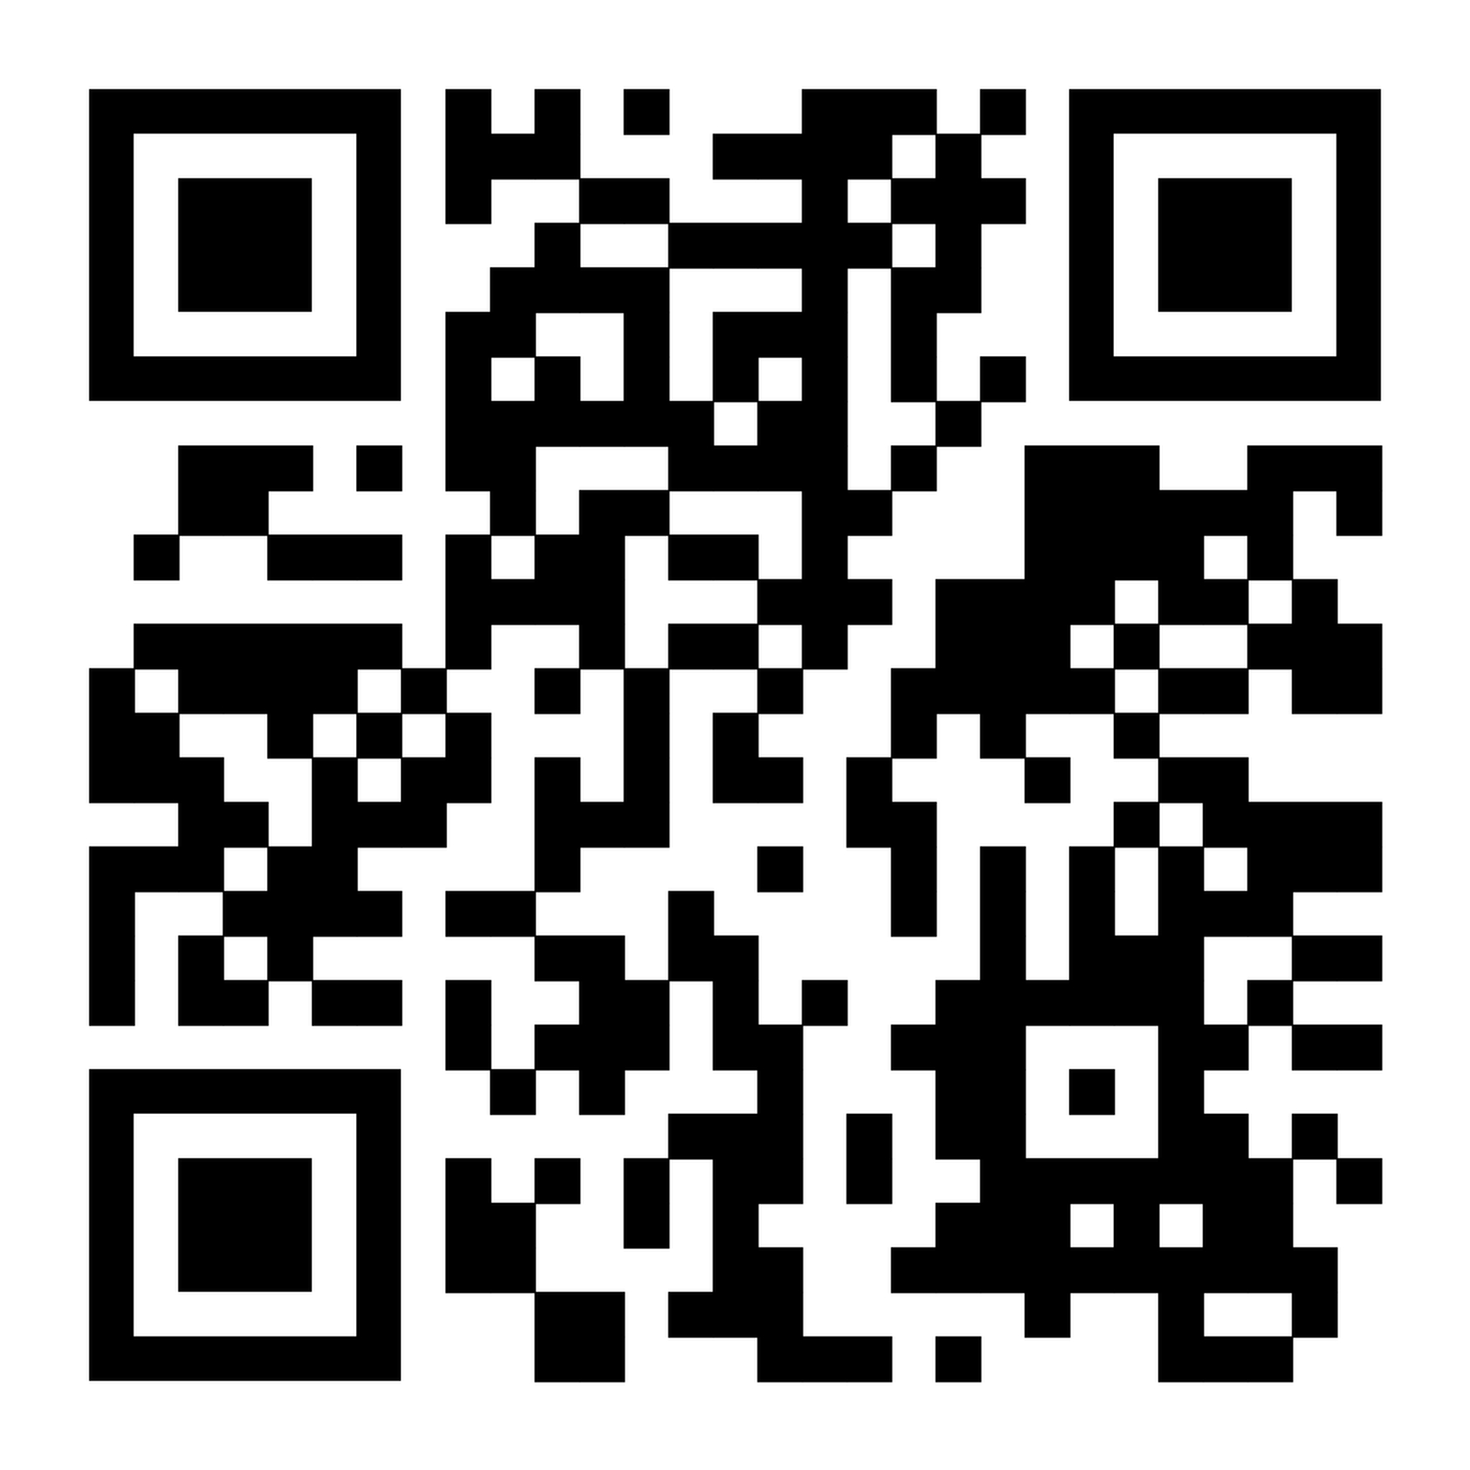
Governance Practice Statements and Policies
(Updated January 2026)

Slide 4

Updates to the Governance Practice Statements and Policies
  Definition for Affinity Groups was added (p.1)
    An ALA Affinity Group is a member-driven community created to connect individuals with a shared identity, background, or experience within the Association. Affinity groups add member value in safe and supportive spaces for connection, representation, and leadership development while reinforcing ALA’s DEIA commitments. Affinity groups are open to members who identify themselves as a member of the named group and those who are allies of the group. Within the ALA structure, affinity groups will operate, be supported, and be held to the same standards as a Shared Interest Groups (SIG).

Slide 5
Updates to the Governance Practice Statements and Policies
  Evaluation of Partnership Proposals (p. 18)
    The Board of Directors approved specific written guidelines that will be used when evaluating business partner collaboration opportunities.
    An example from last year was the ALA collaboration with Clio’s virtual conference
  Survey Governance Policy (p. 20)
    This policy was developed and added to ensure that all surveys are developed, fielded, analyzed, and reported in accordance with best practices for survey research and are aligned with the Association’s vision, mission, and strategic direction.

Slide 6
Updates to the Governance Practice Statements and Policies
  Volunteer Travel Policy (p. 21)
    (p. 21) Receipts clarified to note that “itemized” receipts must accompany all reimbursement requests, particularly for meals. [Note that hotel folios are NOT to be submitted in lieu of itemized receipts for in-room dining, as they lack sufficient detail]
    (p. 22) Event site visits – volunteer participation in site visits was eliminated since site visits are operational in nature and handled by HQ. Event planning project teams focus on educational content and experience.
    (p. 22) ALI attendance – In the event a new standing committee or advisory council is created, and no prior leadership exists, the incoming Chair and Vice Chair are eligible to receive funding for all allowable lodging, travel and meal expenses. Invitations to ALI will only apply to standing committees and advisory councils that will be operational during the Association year immediately following ALI

Slide 7
Updates to the Governance Practice Statements and Policies
  Chapter Visit Policy (for Board Members) (p. 27)
    The language was clarified.
  Speaker Engagement Policy (p. 28)
    Was reworded to better align with ALA’s commitment to diversity, equity, inclusion, and accessibility (DEIA). The revised policy calls for proactive outreach to historically underrepresented groups and the implementation of inclusive practices in speaker selection.
  Speaker Fee & Reimbursement Policy (p. 29)
    The language has been amended to reflect the current practice of awarding a one-day complimentary registration to Annual Conference & Expo Speakers, rather than a full complimentary registration.

Slide 8
Updates to the Governance Practice Statements and Policies
  Investment Policy (p. 33)
    A clarifying note has been added indicating that ALA maintains a separate Investment Committee for its employee retirement plan.
  Third-Party Vendors, Consultants and Contractors (p. 40)
    Recognizing that proposal submissions can never be guaranteed, we have amended this language to reflect that ALA will actively solicit proposals from qualified firms that are classified as diverse or have minority ownership.
  Miscellaneous
    Any references to “employees” were removed, as they are governed through the Employee Handbook, not the volunteer governance policies.

Slide 9

Conflicts of Interest
  Per the Volunteer Participation and Confidentiality Agreement that you all signed, you must promptly disclose any personal, professional, or business interests that may conflict or potentially conflict, directly or indirectly, with your volunteer group’s activities or decisions.
  Loyalty to the interests of ALA and its members is paramount when serving in a volunteer role.

Slide 10
Media Policy
  The Executive Director (or a designee) will handle all routine media matters and/or inquiries.
  Media matters that are not “routine”, including inquiries that relate to sensitive Association matters or controversial legal management issues, are referred to the Executive Director for appropriate review or disposition.
  On matters where the statement of a position by the Association is required, necessary or advisable, and where no formal position or policy exists, the Executive Director makes a recommendation to the Board President, the Executive Committee, or the Board of Directors as to how handle.
  The ONLY volunteer who is authorized to speak on behalf of the Association is the ALA President (or their designee).

Slide 11
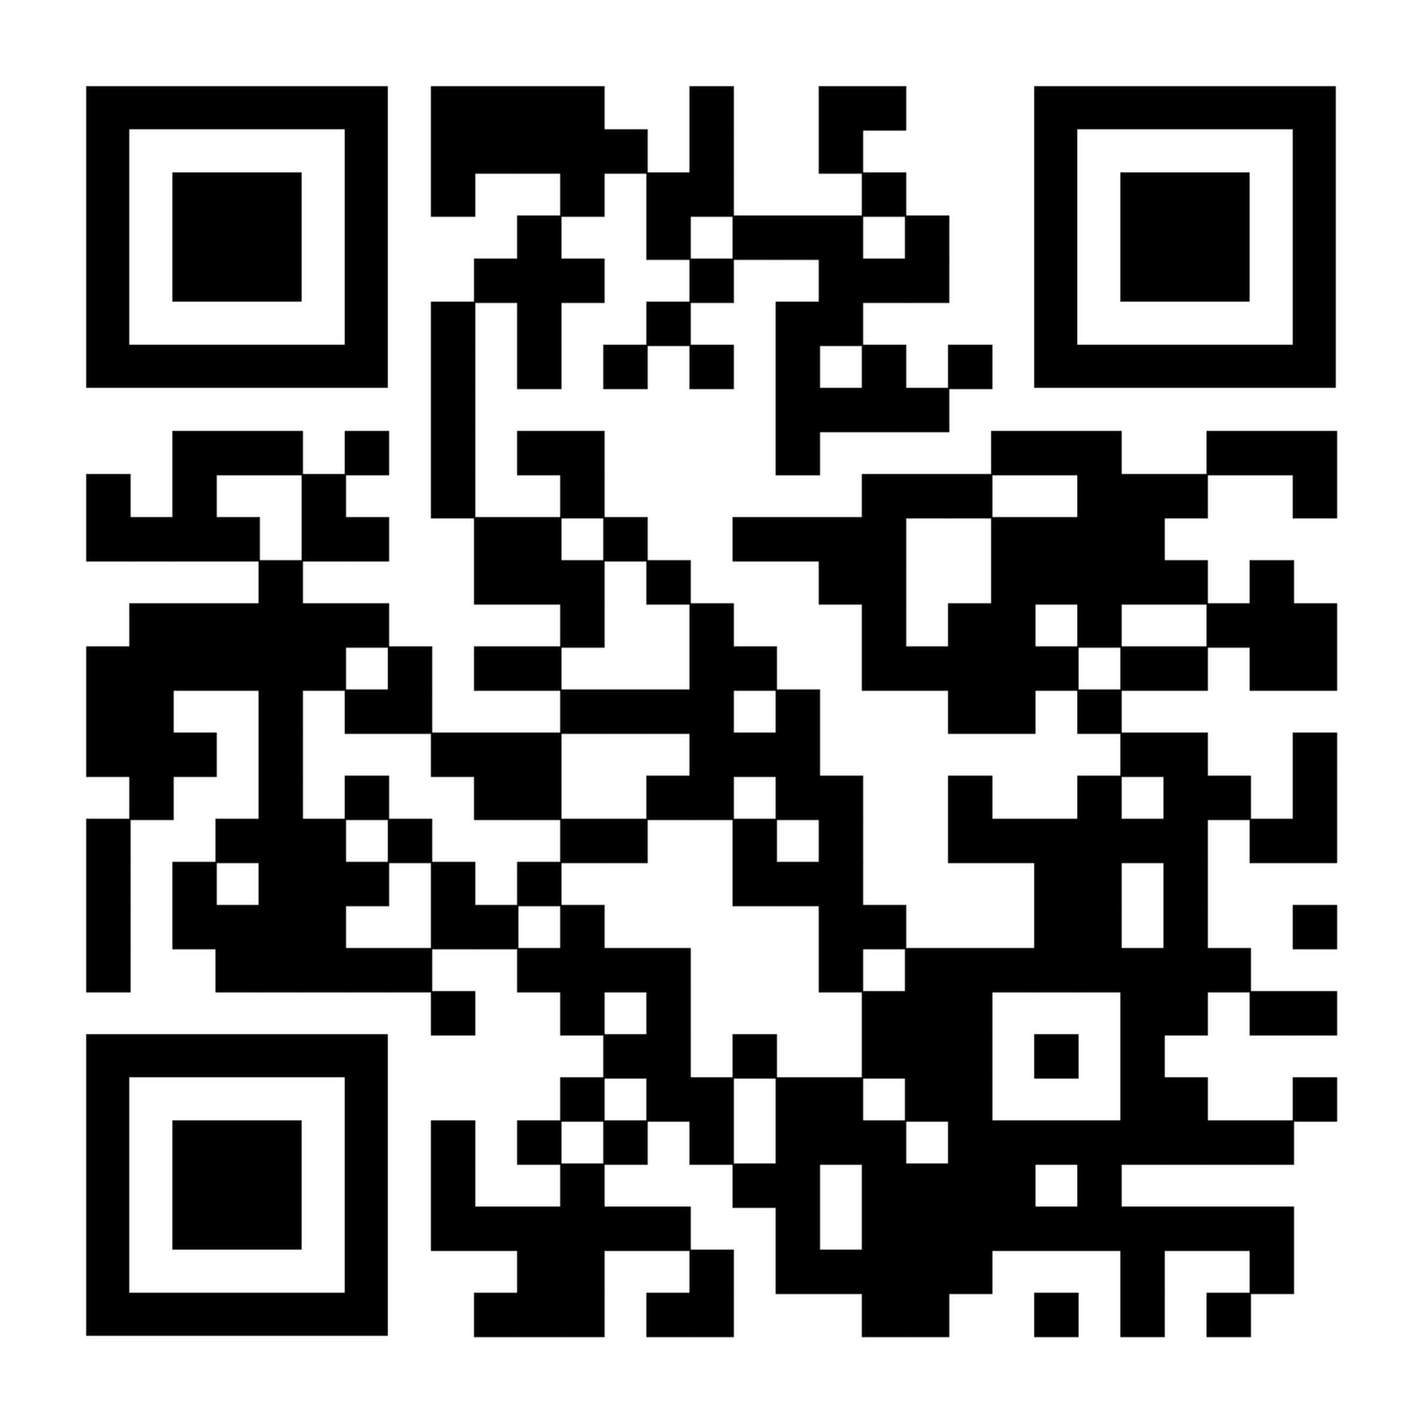
Member-to-Member Non-Solicitation Policy
  Overt solicitation, misuse of the Member Directory for business development or marketing, or sharing of member information with non-members without the prior approval of the association is strictly prohibited. Violations are subject to immediate cancellation of membership, without refund, and loss of all rights and privileges.
  FAQ Available on ALA website

Slide 12
Serving in Multiple Volunteer Roles
  Typically, an individual serves in only one ALA leadership position at a time. The Board of Directors has the discretion to allow an individual to serve in more than one leadership position at the same time.
  For purposes of the policy, “leadership positions” are defined to include (but are not limited to) service as a member of the ALA Board of Directors, chair, vice chair or member of a standing committee, ad hoc committee, advisory council or project team or Foundation Trustee. This policy does not apply to service in chapter-level positions.

Slide 13


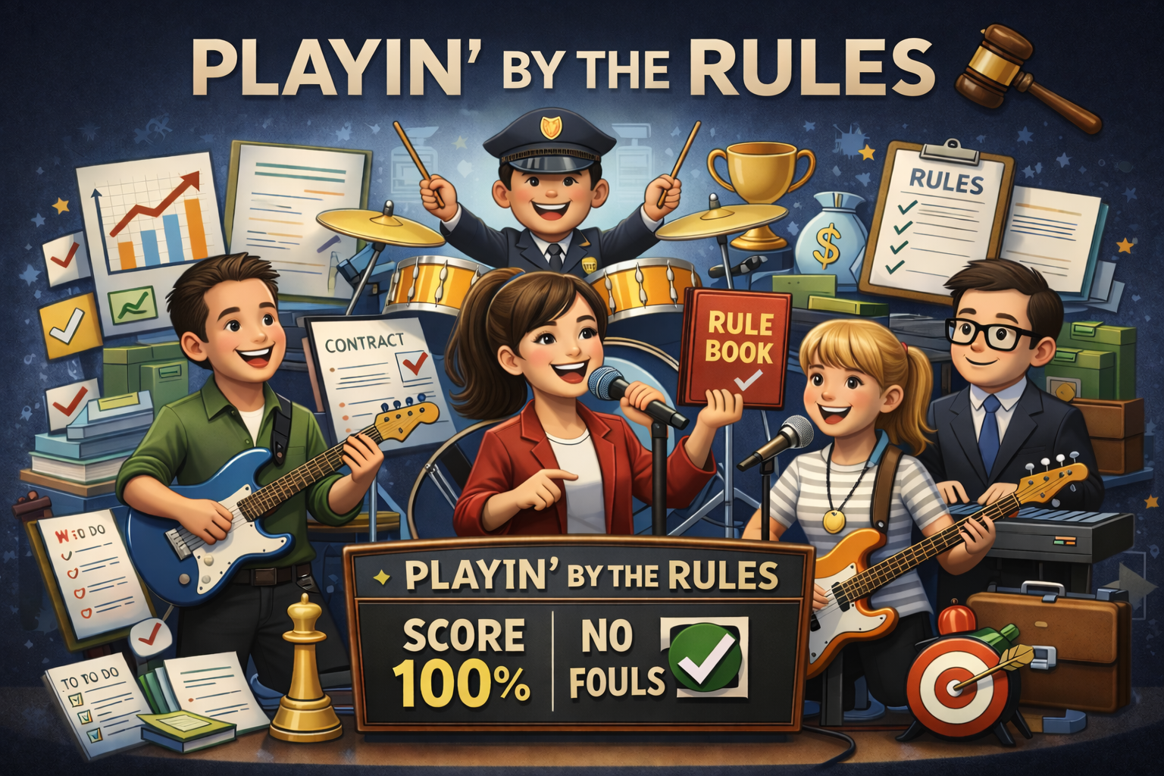

Thank you!

Slide 14

Association Leadership Institute
Presented by
Angelina Angelov, CLM, MBA
Carrie Valenzuela, MBA
Chicago, IL
February 2026

Slide 15

Lean On Me
Volunteer Handbook highlights
Chicago, IL
February 2026

Slide 16
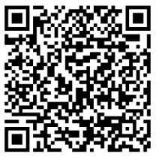

This is ALA
From the ALA Volunteer Handbook
Notes:
Carrie
ALA was established to support legal management professionals with education, networking, and strategic solutions. The organization focuses on professional growth, diversity, and leadership development.

Slide 17

ALA Code of Ethics
Guiding Principles: The Code of Ethics provides a framework for the ethical and professional conduct of legal management professionals, ensuring integrity in legal service organizations.
Commitment to Ethical Practice: ALA members are expected to uphold high ethical standards, aligning with the ABA Model Rules of Professional Conduct and promoting accountability.
Continuous Professional Growth: Members must engage in ongoing education and stay informed about trends and best practices in legal management.
Respect & Collaboration: Professional interactions should demonstrate honesty, fairness, courtesy, and inclusivity within the legal management community.
Diversity & Inclusion: Members should actively foster an inclusive environment in legal organizations, ensuring equal opportunities and respectful workplaces
Governance Resource Hub
Notes:
Angelina

Slide 18
Responsibilities to the Legal Management Profession
Support ALA’s vision and mission and uphold the Code.
Conduct compatible with ABA Model Rules of Professional Conduct.
Maintain professional competence through continuing education.
Demonstrate honesty, fairness, respect, and collaboration.
Promote awareness and practice of professional legal management.
Actively pursue diversity, equity, inclusion, and accessibility.
Notes:
Carrie
The COE includes this specific list of responsibilities we owe to the LEGAL MANAGEMENT PROFESSION.
All ALA members, and particularly its volunteer leaders (you), should strive to exhibit conduct that …
1. Upholds the integrity and dignity of the profession
2. Actively contributes to its growth & credibility; and
Consistently advances professional knowledge
We encourage you to read through the specific list later when you can take your time and really absorb each item on the list

Slide 19
Responsibilities to Legal Service Organizations and Others
Act as a faithful agent serving the interests of employers, clients, and employees.
Implement sound business practices and promote continuous improvement.
Foster high standards of client service and employee development.
Maintain effective communication and practice objectivity and good judgment.
Promote equal opportunity employment practices and accountability for professional and ethical conduct.
Engage with others in a manner that promotes the public interest and demonstrates respect and sincerity.
Notes:
Angelina
There is a separate list of responsibilities that ALA members owe to their ORGANIZATIONS and OTHERS.
ALA members should act as a faithful agent serving the interests of their employers, clients, and employees by demonstrating:
Competence
Diligence
Respect; and
A commitment to implementing best practices in legal management.
As a global organization, We'd like to highlight that the Code of Ethics in the Dominican Republic shares many similarities with those of the US and other countries. It prioritizes values such as integrity, professionalism, confidentiality, and respect within the legal profession.
Also in the DR, ethical breaches can lead to various sanctions, ranging from admonishments to disbarment, underscoring the significance of ethical conduct.
Despite the existence of professional codes and laws with associated sanctions and fines, scandals continue to surface worldwide. Ultimately, the responsibility lies with us, our honor, and our commitment to our own consciences. Once we prioritize these values, navigating ethical dilemmas becomes much easier.

Slide 20

Antitrust guidelines and concerns
Associations like ALA are subject to strict federal and state antitrust laws.
The Sherman Antitrust Act and Federal Trade Commission Act prohibit anti-competitive behavior.
ALA members are competitors in the legal management industry.
Even small or local associations can face civil and criminal liability under antitrust laws
Notes:
Carrie

Slide 21
Four Key Antitrust Concerns
Price Fixing – Any agreement affecting pricing is strictly illegal.
Membership Policies – Exclusionary practices can create legal risks.
Standardization & Certification – Must not restrict competition.
Industry Self-Regulation – Must avoid unfair competitive restrictions.
Notes:
Angelina
1) price fixing; 2) membership; 3) standardization/certification; and 4) industry self-regulation.

Slide 22
Topics to Avoid in Meetings & Gatherings
Billing rates, wages, or fees (past, present, or future).
Profit margins, pricing strategies, or fair pricing levels.
Standardizing prices or limiting competition.
Surveys & Data Collection Guidelines:
  Collected by an independent third party
  Open to non-members
Notes:
Carrie

Slide 23
Severe Penalties for Antitrust Violations
Criminal fines up to $1M for individuals and $100M for corporations.
Jail sentences from 4 months to 3 years for bid rigging or price fixing.
Civil lawsuits can result in triple damages and attorney fees.
  Lawsuits from consumers or competitors.
  Reputational harm and financial losses
  Government supervision or disbanding of the association.
Notes:
Angelina

Slide 24

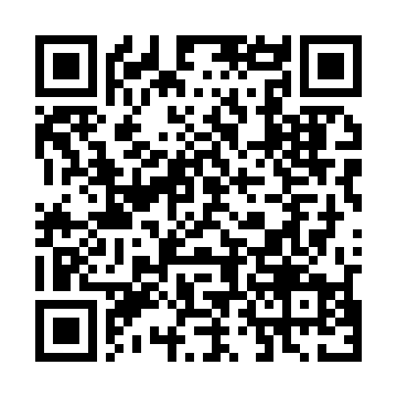
ALA Leadership Groups
Notes:
Carrie

Slide 25

Key Attributes of Successful ALA Leaders
Strategic Alignment
Vision/Strategic Stewardship
Respectful Communication
Inclusive Collaboration
Notes:
Angelina
Leadership is the foundation for all organizations. Leaders set high standards for themselves and are an example to those they expect to lead. ALA leaders are ambassadors of the Association and should strive to reflect the highest standards of leadership excellence through the following attributes: strategic alignment; vision/strategic stewardship; respectful communication; inclusive collaboration; passion for ALA; reliability and compsure; and balance. Effective leaders are also expected to mentor others to develop and exemplify these attributes as they become future leaders.
Strategic Alignment
Actively supports ALA’s priorities, supports collective goals and avoids personal agendas.
Vision/Strategic Stewardship
Ability to understand the broader context of the work and contribute ideas aligned with ALA’s direction and goals.
Respectful Communication
Demonstrates respect for others and self in all interactions. Communicates clearly, respectfully and constructively in all formats. Effectiveness in written and verbal communication, listening skills and professionalism in interactions.
Inclusive Collaboration
Willingness to work with diverse perspectives and contribute to a positive and inclusive outcome. Builds trust and alignment through clear, respectful communication.

Slide 26

Key Attributes of Successful ALA Leaders
Passion for ALA
Reliability and Composure
Balance
Notes:
Carrie
Passion for ALA
Demonstrated engagement, enthusiasm and commitment to ALA’s mission and volunteer work.
Reliability and Composure
Meets deadlines, follows through on commitments and has the ability to remain constructive and steady in challenging situations.
Balance
Handles conflict and change professionally; maintains fairness and objectivity.

Slide 27
Working with Headquarters Staff
  The Executive Director and Board establish policies and communication channels.
  Do not assign tasks directly to staff; work through the appropriate liaison or ALA ED.
  Keep professional relationships with staff professional, avoiding personal friendships.
  Avoid direct criticism or praise; direct feedback should go through the ALA ED.
Notes:
Angelina

Slide 28
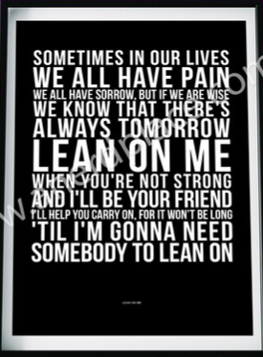
Working with Headquarters Staff
If a staff member raises concerns about leadership, redirect them to their supervisor.
Do not engage in discussions that bypass proper reporting channels.
For any questions about volunteer-staff relationships, consult the Executive Director.
Notes:
Carrie

Slide 29
Membership Criteria
Any individual involved in legal management may apply for ALA membership
Chapter leaders should actively recruit and welcome professionals in legal management.
Independent members
Familiarity with ALA Bylaws and membership criteria is essential for effective recruitment.
Notes:
Angelina

Slide 30
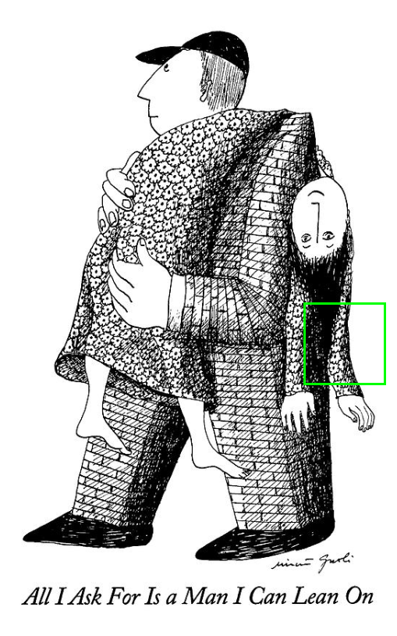
Financial Responsibilities
Headquarters Responsibilities
Pays approved invoices for leadership group activities
Manages recordkeeping, audits, and tax reporting
Requires original invoices for payment
Disburses and tracks funds according to Board-approved plans of work
Provides regular financial reports to appropriate stakeholders
Expense Processing
Reimbursements and invoices processed within 30 days or less
Exceptions may be granted upon request
Notes:
Carrie
Non-Reimbursable Expenses
Entertainment
Travel agency or booking fees
Mobile phone charges
Other expenses primarily personal in nature
Personal Responsibility
Costs resulting from:
Personal travel changes
Incorrect bookings
Restricted ticket changes
Failure to cancel hotel reservations
Room upgrades
These are the responsibility of the individual

Slide 31
Financial Responsibilities
Planning & Budgeting
Committee and Advisory Council Chairs (with ALA staff):
  Develop an annual plan of work
  Plan is approved and may be amended by the Board
Project Teams:
  Focus on a single Board-assigned project
  Do not prepare annual plans of work
Once approved, the plan:
  Integrates with the overall ALA budget
  Guides all activities and controls spending for the fiscal year
Notes:
Angelina
Standing Committees & Advisory Councils
Limited to one in-person meeting per calendar year
Meeting held in conjunction with the Annual Conference & Expo
ALA funds:
One night of allowable lodging for members attending committee meetings
Allowable lodging, travel, and meals for:
Current and incoming Chairs attending the Association Leadership Institute
Event Attendance
Current project team members:
Complimentary registration (1 event per year)
Current Chairs:
Reimbursed allowable lodging and travel
Incoming Chairs:
Funded lodging, travel, and meals for the Association Leadership Institute
Incoming Annual Conference & Expo Project Team members:
One night of allowable lodging during the Annual Conference

Slide 32

Financial Responsibilities
Travel for ALA Business
Airfare may be booked:
  Directly with airlines
  Via sites like Expedia or Orbitz
  Through personal travel agents (booking fees not reimbursable)
Access to ALA airline discounts (e.g., Delta, United)
Discounts apply to official ALA meetings and conferences
Refer to the ALA Volunteer Travel Policy for full details
Notes:
Carrie
Coverage
ALA pays or reimburses round-trip, economy/coach airfare for approved ALA business
Travel should use the most direct and cost-effective route
Booking Requirements
Book at least 45 days in advance, unless otherwise approved
Select the lowest reasonable fare, regardless of carrier preference
Advance approval required for round-trip base fares over $500 USD
Reimbursable Costs
Economy/coach airfare
One checked bag
Refundable/no-penalty tickets allowed if ≤ $100 more than nonrefundable
Not Reimbursable (Absent Approval)
Business or first-class airfare
Travel agent fees
Higher fares chosen for personal airline preference
Airline “personal choice” fees (seat selection, early boarding, food/beverages)
Additional Guidelines
Extra baggage fees reimbursed only for:
Extended ALA travel (6+ consecutive nights), or
Transporting ALA business materials
Combined ALA/personal travel:
Reimbursement limited to documented ALA-only airfare cost
Ticket changes or cancellations:
Must be approved in advance by the President or Executive Director

Slide 33
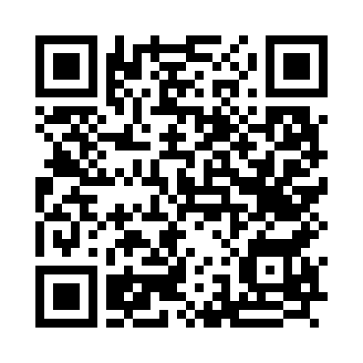

ALA Calendar of Events
Notes:
Angelina
ALA was established to support legal management professionals with education, networking, and strategic solutions.The organization focuses on professional growth, diversity, and leadership development.

Slide 34
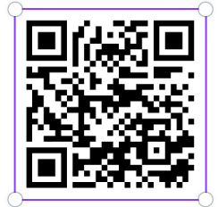

Online community
Notes:
Carrie

Slide 35
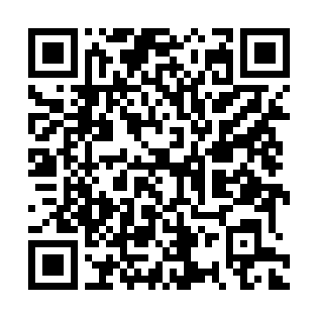
Volunteer Resource Hub
Notes:
Angelina

Slide 36
I'll Be There For You!
Presented by: Shirley Laboy
& Rose A. Jaworecki

Slide 37
Orchestrating Excellence
Clarifying Roles
Strengthening Partnerships
Delivering Results
Notes:
Rose
Excellence in associations doesn’t happen by chance — it is intentional and requires effort clarity in roles, strong partnerships, and committed teamwork. We will focus on support systems that help everyone succeed.

Slide 38
Session Purpose
Great associations don’t just recruit volunteers — they orchestrate them into a symphony of success.
Every role matters, every instrument has its place, and when we play together, we create something beautiful. This session clarifies roles so everyone can confidently say: “I’ll be there for you.”
Notes:
Rose
This session aims to build a shared understanding of how different roles align and interact. The phrase “I’ll be there for you” highlights the importance of mutual support and reliability within teams (from volunteers to board liaisons to staff).

Slide 39
Learning Objectives
Understand
Understand key leadership roles
Know
Know who leads, supports, and advises
Avoid
Avoid role confusion and burnout
Leave
Leave with a shared playbook
Notes:
Shirley
Let’s walk through what you can expect to gain:
Clarity on support roles
Understanding who leads, who supports, and how those functions complement each other
Ways to prevent burnout and confusion by ensuring tasks match roles
A shared “playbook” so teams leave with actionable alignment
Make clear that these learnings strengthen collaboration and performance.

Slide 40
The Orchestra Metaphor
Chair = Conductor
Volunteer Members = Musicians
Board Liaison = Executive Sponsor
HQ Staff = Producer
Coordination creates excellence.
Notes:
Shirley
This metaphor illustrates that excellence comes from coordination, not individual effort alone.
The Chair as the Conductor: sets vision and tempo.
Volunteer Members as Musicians: execute the work.
Board Liaison as Executive Sponsor: ensures strategic alignment.
HQ Staff as Producer: provides continuity and operational grounding.
Note: Highlight how harmony results when everyone contributes to the larger whole.

Slide 41

Volunteer Chair – The Conductor
Sets vision and tone
Leads meetings
Delegates work
Holds accountability
Notes:
Rose
The Chair provides leadership direction—not by doing everything, but by guiding the group. Their responsibilities include setting vision, leading meetings constructively, and delegating effectively. Chairs maintain accountability structures, ensuring the group stays on track.

Slide 42
Chair: What & What Not
IS: Leader, Facilitator, Decision‑maker
IS NOT: Doing all the work or working alone
Notes:
Rose
A Chair is a leader, facilitator, and decision‑maker.
A Chair is not supposed to do all the work or operate in isolation.
These distinctions are essential for preventing role overload and fostering a collaborative environment.

Slide 43

Volunteer Members
Execute assigned tasks
Communicate progress
Meet deadlines
Collaborate
Notes:
Shirley
Volunteer members are responsible for executing assigned tasks and keeping momentum flowing. Notes can emphasize:
Importance of meeting deadlines
Communicating progress proactively
Collaborating when challenges arise
This reinforces accountability and teamwork.

Slide 44
Volunteer Members Need
Clear scope
Clear timelines
Clear communication
Feedback
Notes:
Shirley
As volunteers we thrive when we have:
Clear scope and expectations
Timelines that help to plan effectively
Open communication channels
Feedback that reinforces strengths and guides improvement
These things dramatically increase volunteer satisfaction

Slide 45

Board Liaison – Executive Sponsor
Strategic oversight
Board alignment
Connector, not manager
Notes:
Rose
Each committee, advisory council, and project team is assigned a Board Liaison – the group’s vital link to the Board of Directors. The Board Liaison brings a strategic lens—not managerial oversight. They ensure alignment to the organization’s priorities and act as connectors to resources or context. They elevate issues that require board-level consideration while avoiding stepping into operational management.

Slide 46
Board Liaison Boundaries
Provides guidance
Avoids micromanagement
Notes:
Rose
The Liaison’s job is guidance, not micromanagement. They should create conditions for the group’s success without interfering in daily work. This balance maintains autonomy while ensuring alignment.

Slide 47

HQ Staff Liaison – Producer
Operational continuity
Institutional knowledge
Policy & budget guidance
Notes:
Shirley
The Staff Liaison’s role as the operational backbone of the work. They maintain continuity even as volunteers cycle in and out. They also provide institutional knowledge, help with policies, and ensure budget and operations remain compliant and stable.

Slide 48
HQ Staff Role
Supports volunteers
Ensures sustainability
Notes:
Shirley
We should emphasize the role of HQ staff is support and sustainability. Staff ensure that the volunteer work is preserved beyond individual terms and that the organization maintains consistent practices. This role safeguards long-term effectiveness.

Slide 49

Harmony Check
Right people doing the right work prevents conflict
Notes:
Rose
This is a moment for reflection: Are the right people doing the right tasks? Misalignment can cause conflict or frustration. When responsibilities match strengths and positions, teams operate more smoothly and effectively.

Slide 50

I’ll Be There For You
Support means setting others up to succeed
Notes:
Shirley
Support doesn’t always mean doing tasks for others—it means creating conditions where others can succeed. Emphasize the mindset of shared responsibility, encouragement, and proactive partnership.

Slide 51
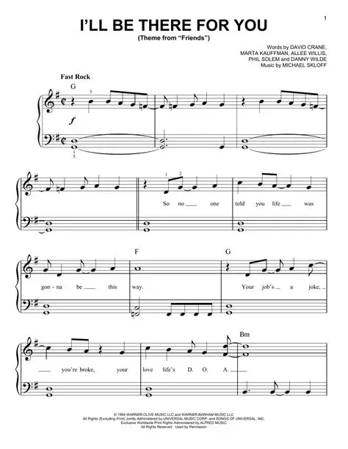
Finale
When the Conductor (Chair) leads with clarity, the Musicians (Volunteer Members) play with passion, the Executive Sponsor (Board Liaison) provides unwavering support, and the Producer (HQ Staff Liaison) ensures everything runs smoothly – the result is a masterpiece.
When everyone plays their part, excellence follows.
Notes:
Excellence happens when each person understands and embraces their role. Collaboration, clarity, and mutual support allow teams to deliver exceptional outcomes — just like a well‑orchestrated performance.

Slide 52

🎵
Charters & Plans of Work
Your Volunteer Playlist
Association Leadership Institute 2026
🎶
Amanda Koplos, CLM, CPA ~ Immediate Past President
Kelli Sanders, MSLA, CLM ~ Board of Directors

Slide 53
🎼 Your Charter Is Your Sheet Music
Without sheet music...
⭐
One person plays jazz, another plays country, and the triangle player thinks it's a drum solo!
YOUR NORTHSTAR
Your charter keeps everyone on the same page:
The charter is approved by the Board of Directors.
Defines your PURPOSE
— why you exist
Outlines your SCOPE
— what you're responsible for
Establishes BOUNDARIES
— what's NOT your gig
When you're wondering:
"Should we propose this project?"
Look at your charter first.

Slide 54
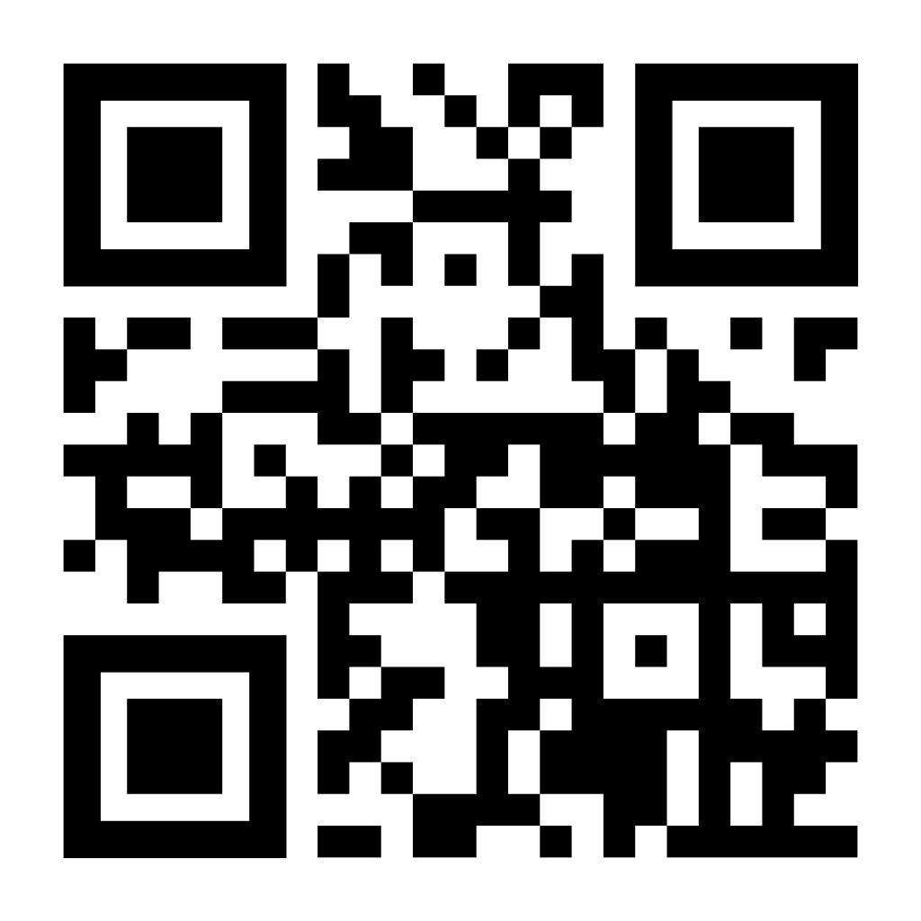
🔍 Finding Your Sheet Music
alanet.org/membership/volunteer-at-ala
1
Navigate to the Volunteer at ALA page
2
Scroll to find committees, advisory councils, and project teams
3
Click on any group name — the charter accordion expands!
💡 Pro Tip: Bookmark this page. You'll reference it more than you think!

Slide 55
📋 Anatomy of a Charter — The Key Signatures
PURPOSE
CONSTRUCT / SIZE
Your "why" — the essence of what your group exists to do. If purpose statements were song lyrics, this is the chorus.
How many musicians in your band? Typical numbers range from 4-22 volunteers including Chair and Vice Chair.
CHAIR EXPECTATIONS
TERM OF SERVICE
Specific requirements for who can lead. Some require CLM certification, volunteer experience, or special knowledge.
How long is your tour? Terms range from 1-4 years. Many are staggered for continuity — there's always someone who knows the melody.

Slide 56
📋 More Charter Elements
⏱️
👥
📊
TIME COMMITMENT
MEETINGS
REPORTING
Year-round or seasonal sprint? Some groups work 6 months, others 12. Know what you're signing up for!
When does the band rehearse? Most groups meet virtually + once in-person at Annual Conference.
Think of the Board as venue managers — they need to know the show is going well. Regular activity reports keep them informed.
EXPECTATIONS & RESPONSIBILITIES + QUALIFICATIONS
Your detailed job description — what you'll actually DO, and what credentials/experience you need to participate.

Slide 57
⚡
THE GOLDEN RULE
"The work of all volunteer groups must align with ALA's Vision Statement, Mission Statement, and Strategic Direction."
This appears at the bottom of EVERY charter.
Your charter is your band's sheet music, but ALA's strategic direction is the album you're all contributing to.

Slide 58
🎼 → 🎵
From Sheet Music to Setlist
Your charter tells you WHAT to play.
Your Plan of Work is the setlist — the specific songs for THIS year.

Slide 59
🎵 What Is a Plan of Work?
An annual planning document for committees and advisory councils
(Note: Event project teams have their own planning process)
🔗
Connects your work to ALA's Strategic Direction
🎯
Identifies specific outcomes you're pursuing
📈
Sets key performance indicators (KPIs)
🤝
Identifies collaboration opportunities
📋
Requests resources from the Board
✓ Reviewed, modified, and APPROVED by the Board of Directors

Slide 60
👥 Who Writes the Setlist?
A collaborative effort between four key players:
🎤
🎸
🎹
🥁
CHAIR
VICE CHAIR
BOARD LIAISON
STAFF LIAISON
The bandleader. You're driving the vision.
Your co-pilot. Learning the ropes, bringing fresh perspective.
Your connection to the Board. Helps align work with strategic priorities.
Your HQ connection. Knows resources available and what other groups are doing.
This isn't a solo performance — the best Plans of Work reflect input from all four!

Slide 61
🎯 Connecting to Strategic Direction
Show HOW your work ties to ALA's five focus areas:
🌍
📚
💪
💡
⭐
Diversity, Equity, Inclusion & Accessibility
Education & Professional Development
Impact
Innovation
Member Experience
For each area, answer: "How does our work tie to this focus area?"
Not every group connects to every focus area — and that's okay. Draw clear lines to the ones that matter for your work.

Slide 62
📈 Setting Your KPIs — Your Hit Singles
Good KPIs should be:
💡 Example KPIs:
✓ Aligned with focus areas
✓ Demonstrate achievement AND progress
✓ Active yet manageable
✓ Measurable and specific
"Increase Ambassador program mentee satisfaction by 10%"
"Publish findings report by Q3"
"Host 4 virtual roundtables with min. 15 attendees each"
Pick goals that are ambitious but realistic.
Better to knock out 3 meaningful KPIs than set 10 and accomplish 2.
⚠️ "Do good work" is NOT a KPI. "Train 20 new Ambassadors" IS.

Slide 63
🤝 Resources & Collaboration
📋 BOARD RESOURCES
🎵 COLLABORATION
What assistance can the Board provide to support your work?
Which other groups work in similar areas?
The template lists all committees, advisory councils, and other groups.
• Budget for special projects
• Access to specific data
• Help removing obstacles
• Cross-group coordination
Why? Collaboration prevents duplication and creates synergy.
Work in harmony — pun intended! 🎶
Don't be shy — if you don't ask, they can't help!
Outline existing collaboration efforts. This keeps the Board informed and helps everyone work together.

Slide 64
✅ The Approval Process
1
2
3
4
5
Draft Plan of Work with your team (Chair, Vice-Chair, Board Liaison, Staff Liaison)
Board Liaison submits to Board to be added to an agenda
Board reviews, suggestions modifications, asks questions
Additional modifications may be requested by the group
Final plan approved
This isn't rubber-stamping!
The Board genuinely reviews to ensure alignment with strategic priorities and identify cross-group opportunities.

Slide 65
🎼 Putting It All Together
🎼 YOUR CHARTER
🎵 PLAN OF WORK
= Sheet Music
= Setlist
• Your foundational purpose
• What you're supposed to play
• Board-approved
• Rarely changes
• Your specific songs for this year
• How you'll achieve your purpose
• Collaborative effort
• Renewed annually
The charter is the WHAT and WHY. | The Plan of Work is the HOW and WHEN.
Together, they keep your volunteer group focused, aligned, and making beautiful music. 🎶

Slide 66
⭐ Key Takeaways
1
Know your charter inside and out
alanet.org/membership/volunteer-at-ala
2
The charter is your Northstar
When in doubt, refer back
3
Plans of Work are collaborative
Chair + Vice Chair + Board Liaison + Staff Liaison
4
Connect everything to strategic direction
Your work serves ALA's bigger mission and vision
5
Set measurable KPIs
Pick your hit singles wisely
6
Identify collaboration opportunities
You're part of a larger symphony

Slide 67
❓ Questions?
Resources
📋 Find Charters:
alanet.org/membership/volunteer-at-ala
🎯 Strategic Direction:
alanet.org/about-membership/about-ala/ala-strategic-direction
👤 Your Staff Liaison:
Your go-to resource for questions
If you're ever lost, look at your charter.
It's always there to guide you back to the melody. 🎵

Slide 68
🎶
Thank You!
Now go make some beautiful music!

Slide 69
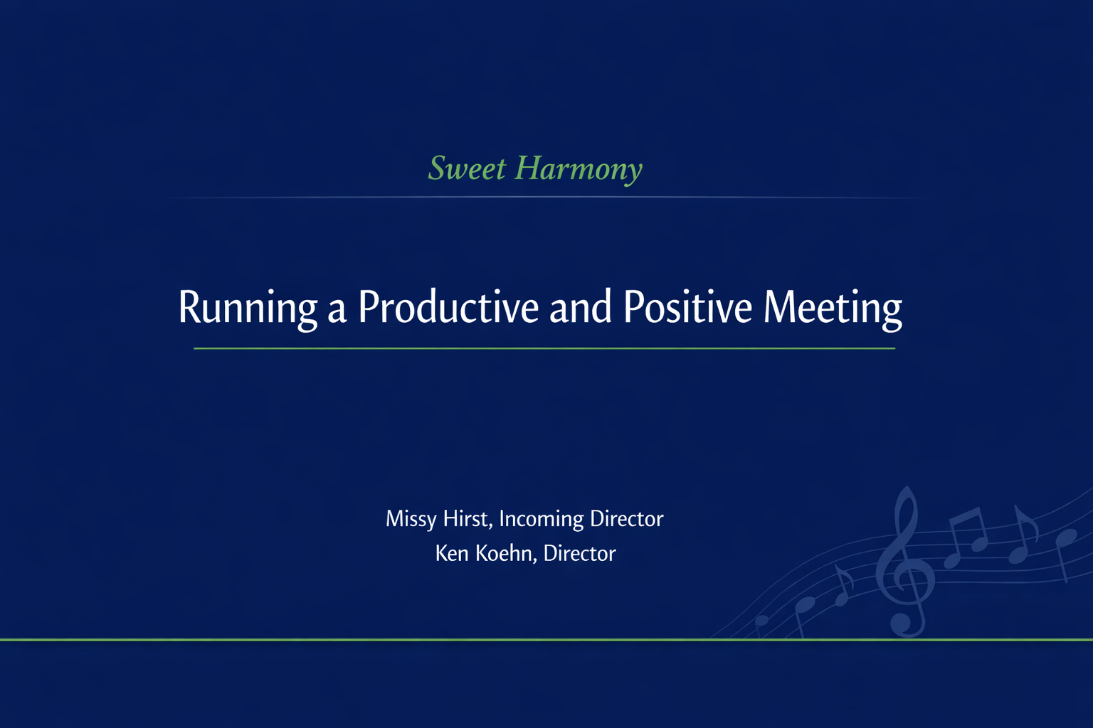


Slide 70

Meetings shape culture
They either build momentum -
or quietly drain it

Slide 71
Movement I
Prepare
♪

Slide 72
Preparation determines whether a
meeting creates progress -
or consumes time
Great meetings begin before the
room gathers

Slide 73
Meetings Should Respect Volunteer Time
Volunteer time is a gift - treat it that way
♪ Meet only when collaboration or decision-making is required
♪ Design conversations that move work forward
♪ Create space where every voice can contribute
♪ Recognize that diversity of thought improves outcomes
Respect for time builds trust

Slide 74
Only Meet When It Adds Value
Not every update requires a meeting
♪ Convene for decisions, problem solving,
or meaningful collaboration
♪ Distribute reports and routine updates in advance
♪ Use shared documents to inform, not meeting time
If the purpose is unclear, the meeting is optional

Slide 75
Start with Outcomes, Not an Agenda
Agendas list topics
Leaders define outcomes
♪ Identify the decisions that must be made
♪ Clarify which discussions are necessary to reach them
♪ Define the result you expect by the end
♪ Build the agenda backward from those outcomes
Clarity of outcome sharpens focus

Slide 76
Agenda That Drives Action
A well-designed agenda signals seriousness
♪ Label items as Decision, Discussion, or Update
♪ Schedule decision items first, while energy is highest
♪ Assign topic owners with clear preparation expectations
♪ Distribute materials early
♪ Use a parking lot to protect priority time
Structure creates momentum

Slide 77
Simple Meeting Blueprint
Keep it simple and intentional
Example:
♪ 5 minutes - Purpose and desired outcomes
♪ 15 minutes - Decisions while energy is high
♪ 5 minutes - Essential updates only
♪ 5 minutes - Actions, owners, and next steps
End with clarity, not ambiguity

Slide 78
Preparation earns engagement
When people see thoughtful design,
they lean in

Slide 79
Movement II
Facilitate
♪

Slide 80
Meetings do not run themselves
Facilitation is leadership in action

Slide 81
Share the Responsibility
A strong meeting is a shared responsibility
♪ Chair - steers the conversation and protects the purpose
♪ Timekeeper - safeguards momentum
♪ Note-taker - captures decisions and commitments
♪ Topic owners - prepare and guide their sections
♪ Rotate roles to build skills and prevent burnout
Clarity of role creates confidence in participation

Slide 82
Engage Every Voice — Keep It Constructive
In volunteer environments, engagement is everything
♪ Invite quieter members to speak early
♪ Use round-robin input for major decisions
♪ Set respectful limits with dominant speakers
♪ Separate ideas from individuals
♪ Protect the tone of the room
A negative tone spreads quickly - so does encouragement

Slide 83
Facilitation Habits That Drive Results
Consistency builds credibility
♪ Start and end on time
♪ Stay anchored to the agenda
♪ One conversation at a time
♪ Capture decisions visibly and in real time
♪ Ask regularly: What decision are we making?
If you cannot answer the question, the discussion is drifting

Slide 84
Healthy Debate Makes Better Decisions
Strong teams do not avoid disagreement -
they manage it well
♪ Focus on issues, not personalities
♪ Invite diverse viewpoints before concluding
♪ Reframe complaints into options
♪ Time-box debate to maintain forward movement
Respectful tension strengthens outcomes

Slide 85
Virtual & Hybrid Norms
Clarity matters even more in virtual settings
♪ Use and respect raised hands
♪ Mute when not speaking
♪ Leverage chat and polls intentionally
♪ Keep segments shorter and visually engaging
♪ Cameras on if at all possible
Energy must be designed - not assumed

Slide 86
How a meeting feels determines
whether people speak up next time

Slide 87
Movement III
Follow Through
♪

Slide 88
The meeting is not the work -
execution is
Without follow-through,
even a productive discussion fades

Slide 89
Make Decisions Clearly
Ambiguity undermines momentum
♪ State the decision explicitly
♪ Confirm shared understanding
♪ Assign a clear owner
♪ Establish a deadline
If it is not assigned, it is unlikely to happen

Slide 90
Capture What Matters
Notes are not transcripts - they are commitments
Capture only what drives accountability:
♪ Decisions
♪ Action items
♪ Owners
♪ Due dates
Clarity today prevents confusion tomorrow

Slide 91
Follow-Through Drives Results
Consistency builds credibility
♪ Send notes within 24-48 hours
♪ Store materials in a shared, accessible location
♪ Check progress mid-cycle
♪ Cancel meetings that no longer add value
Canceling unnecessary meetings is leadership

Slide 92
Common Pitfalls to Avoid
Most ineffective meetings fail in predictable ways
♪ Gathering only to report information
♪ Insufficient preparation
♪ Avoiding clear decisions
♪ Failing to assign ownership
♪ Allowing tone to drift negative
Discipline prevents drift

Slide 93
Prepare
Facilitate
Follow Through
Progress is designed

Slide 94
Key Takeaways
Productive meetings are not accidental
♪ Meet with purpose
♪ Prepare intentionally
♪ Facilitate inclusively
♪ Encourage healthy debate
♪ End with ownership and deadlines

Slide 95
Questions or Discussion
Before your next meeting, ask:
♪ What one change will you implement in your next meeting?

