Slide 1
Highlights From HQ!

Slide 2
ALA: Reaching New Heights
Eryn Carter, CAE
ALA Executive Director
2025 Association Leadership Institute

Slide 3
The Ascent Begins – HQ Overview
Total of 25 staff
- 21 full-time
- 3 part-time
- 1 fully remote based in the DC area
Longest serving staff (26 years)
Shortest serving staff (3 months)
Hybrid work environment

Slide 4
The Ascent Begins – HQ Overview
8 Departments
- Executive - Human Resources
- Business Development - IT
- Finance - Marketing & Communications
- Governance & Education - Membership
Vision, Mission, and Values
Culture and Community
Training and Development

Slide 5
Basecamp – Understanding ALA
The Basics
Experience
Experiment
Engagement
Partnerships
Growth Opportunities
Service

Slide 6
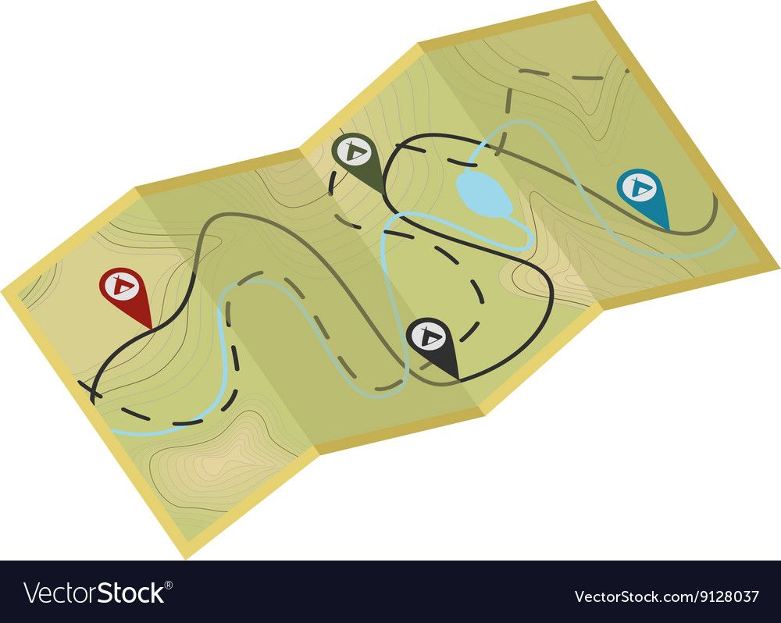
Trail Markers – What Guides Us
ALA’s Strategic Direction
Tactics development and review
SOAR Analysis
The RACI model
Board oversight and authority
Accountability
Partnerships

Slide 7
Essential Gear – Tools for Success
New Corporate Donor Program
New Website Design
Expanded PR/Media Presence and SM Outreach
New BP Offerings
New Membership Pricing Model
Newly Conceived and Branded Events

Slide 8
The Climb – Strategic Tactics
Responsibilities and expectations
Making an impact
Collaboration and teamwork
Success Stories

Slide 9
The Journey Continues…
Staying engaged and involved
Creating opportunities
Challenging assumptions
Highlighting achievements, offerings, and value
Growing our community
Strengthening our brand

Slide 10
“It isn't the mountains ahead that wear you out; it's the pebble in your shoe.” - Muhammad Ali

Slide 12
Atlanta, Georgia September 12–13, 2025
Alexandria, Virginia October 9–10, 2025
Scottsdale, Arizona October 24–25, 2025

Slide 13
Maximizing ALA's Social Media Impact: How Volunteers Can Amplify Our Reach
Meghann Krone, Marketing Administrator
Theresa Wojtalewicz, Director of Marketing and Communications

Slide 14
Reaching New Heights: The Power of Social Media Engagement
Improves online presence
Algorithm prioritizes high engagement
Volunteers = key role in pushing ALA’s content
Notes:
ALA’s online presence helps strengthen our brand, engage members and grow our reach.
Social media algorithms prioritize posts with high engagement (which are the likes, shares and comments on a post).
And finally, volunteers (like you!) are vital in pushing ALA’s content to the forefront.

Slide 15
Lifting ALA Higher: The Power of Volunteer Promotion
Sharing ALA’s content
Social media ambassadors
Engage your network
Notes:
ALA posts 2-3 times per day on social media. Volunteers can help promote ALA by sharing our mission, upcoming events and initiatives to your audience and communities. This helps spread the word to your networks.
As a volunteer, you act as a “social media ambassador” for ALA to amplify content. It’s important to engage (like, comment or share) ALA’s posts whenever possible to maximize our audience reach.
Encourage engagement within your own network. If you’re resharing a post, talk to your network and ask them to leave a comment of someone who may be interested in ALA. You can reach out to that person individually to provide them more information based on their interest.

Slide 16
Scaling the Algorithm: Unlocking the Power of Engagement
High engagement = higher in feed
Key actions that increase engagement:
Likes and reactions
Shares
Comments
Tags and mentions
​ | Average Engagement Rate​ | LinkedIn​ | Facebook​ | Instagram​
ALA​ | 6.02%​ | 6.39%​ | 4.61%​ | 7.27%​
Industry Standard​ | 2%​ | 2.26%​ | 1.61%​ | 2.47%​
Notes:
The more engagement a post receives, the higher it will be in your feed.
The key actions that increase visibility include:
Likes and Reactions: This shows approval and boost posts.
Shares: This spread content to a new audience.
Comments: Drive conversations and signal interest.
Tags and Mentions: Directly involve individuals or groups.
At the bottom, you’ll see a chart that compares ALA’s engagement rate against industry standards. The industry standard for engagement rates is 1-2% (depending on the platform). ALA is 3-5% higher than the industry standard (based on the platform). We’ve achieved this high engagement rate from consistently tagging companies, individuals and chapters in our social media posts. By doing so, our post appears at the top of our followers algorithms (and anyone who is tagged – there network will see this at the top of their algorithm, too.

Slide 17
Ascending Together: Maximizing Volunteer Impact Online
Follow ALA on LinkedIn, Facebook and Instagram.
Engage with posts regularly.
Tag colleagues/legal professionals who would benefit from ALA’s content.
Use ALA’s hashtag (#ALABuzz).
Like, comment and share posts regularly.
Post about ALA events and personal involvement.
Notes:
Make sure to follow ALA on social media! Our social media handles for LinkedIn, Facebook and Instagram are displayed.
Be sure to engage with ALA’s posts regularly – like, comment and share posts as it will help drive us up higher in peoples’ newsfeeds.
Tag a colleague or other legal professional in your network who would find ALA’s content valuable.
Make sure to tag us, or use the hashtag #ALABuzz so we can search posts to interact with yours.
Lastly, be sure to post or reshare ALA events or your personal involvement as a volunteer.

Slide 18
Practical Example of Climbing the Engagement Ladder
Notes:
Here’s an example of how you can interact with ALA’s post on social media…
We posted about the CLM webinar that took place on February 19. Daniel engaged with our post, reshared it to his network and promoted ALA’s upcoming webinar in just two short sentences! This is an excellent example of engagement because he also tagged ALA’s Chicago Chapter and Rita Neilsen, which, in turn, shared this to people who follow the Chicago Chapter, as well as Rita.
Other actions that could be taken are…
Like or commenting on the post: “Looking forward to this session!”
Share: “ALA has an incredible webinar coming up – check it out!”
Tag others: “Hey [Name], this might be valuable for your firm!”

Slide 19
Reaching New Heights in Social Media Engagement
Consistency is key
Personalize posts
High-quality images/videos
Ask questions
Notes:
Keep engagement consistent. Set aside 10 minutes per week to monitor your social media platforms to ensure you’re engaging with your audience.
When reshare a posting, make it personal. Explain why attending ALA’s Annual Conference is valuable and what someone will walk away learning. Call out a session or event or something from the Exhibit Hall worth checking out.
You should use high-quality images and videos for better visibility.
Encourage conversations by asking questions in the comments. When people respond, this boosts the post higher in the algorithm.

Slide 20
Reaching New Peaks: Volunteer Action Steps for Today
Step 1: Follow ALA on social media.
Step 2: Like/comment on ALA posts.
Step 3: Share relevant posts to your network.
Step 4: Tag colleagues.
Step 5: Post your involvement.
Notes:
Step 1: Follow ALA on LinkedIn, Facebook and Instagram.
Step 2: Like and comment on ALA’s posts – aim for at least one per week.
Step 3: Share relevant posts to your network.
Step 4: Tag colleagues that would benefit from attending an ALA event or find ALA resources helpful.
Step 5: Lastly, post about your involvement with ALA.

Slide 21
Tracking Your Ascent: Measuring the Impact of Volunteer Engagement
More engagement = greater reach
Followers, comments and shares
Attendance and participation at events
Notes:
Success is measured by several variables, being:
The more engagement we receive, the greater reach and visibility we’ll receive for ALA. The more we can increase our overall brand recognition in the legal industry.
Our growth in followers, comments and shares.
The increased attendance and participation in ALA events.

Slide 22
ALA’s Social Media Analytics: Reach, Post Impressions & Page and Profile Impressions
Notes:
Before going into this chart, I want to direct your attention to the bottom where it shows what we’re measuring:
Reach: The total # of unique users who have seen your content. Each person is only counted once, regardless of how many times they see the post.
Post Impressions: The total # of times a specific post has been displayed on users’ screens, regardless of whether they engage with it. This includes multiple views from the same person.
Page and Profile Impressions: The total # of times your social media page or profile has been viewed. This includes visits from followers and non-followers and may count multiple views from the same user.
In the past calendar year, our social media presence has reached a significant audience across LinkedIn, Facebook, and Instagram:
Reach:
LinkedIn: Over 134,000 unique accounts
Facebook: More than 106,000 unique accounts
Instagram: Nearly 28,000 unique accounts
Post Impressions:
LinkedIn: 345,000+ impressions
Facebook: 110,000+ impressions
Instagram: 27,000+ impressions
Page & Profile Impressions (Total number of times our pages/profiles were viewed):
LinkedIn: 354,000+ impressions
Facebook: 121,000+ impressions
Instagram: 30,000+ impressions
These numbers highlight the strong visibility and engagement our social media channels generate, reaching both members and nonmembers throughout the year.

Slide 23
Questions?

Slide 25
Fred Ullman, Director, Business Development Phone: 847-267-1375 Email: fullman@alanet.org LinkedIn: www.linkedin.com/in/fredullman/
Responsible for non-dues revenue through building and fostering relationships with our Business Partners and VIP Partners.
Ensure that our Business Partners and VIP Partners have the right mix of branding, visibility, thought leadership tools and access and engagement with ALA members.
Build collaborative integrated marketing packages (needs and solution based)
Develop new revenue streams based on the Win-Win-Win (Member-ALA-BP) model.
Here to help!

Slide 26
ALA VIP Program (Value In Partnership)
A value-add/ discount program exclusively for ALA members.
Invite only to our top business partners.
Potential business partners complete an application and are vetted by ALA to ensure quality and alignment of mission and values.
Only 20 VIPs max for the program. Currently 15 active VIP Partners.
In 2023 a new redesigned VIP Program was rolled out to standardize program benefits and to stabilize revenue.
Recently added VIPs include Clear Guidance Partners and Huntress.
Increased VIP revenue 39% from 2023 to 2024
Just with the VIP participation fee alone and not including the $30,000 minimum marketing spend.

Slide 27
ALA Business Partners (BPs)
Currently have approximately 140 business partners at the national level.
Moved away from transaction sales to a more relationship and solutions-based approach.
Implemented Salesforce CRM in 2023 and have grown database to 3,789 contacts.
Increased revenue by 7.4% from 2023 to 2024. (Exhibits, sponsorships, and advertising)
Redesigned the ALA Media Kit with new innovative offerings and points of engagement.
All programs have incorporated the Win-Win-Win (Member-ALA-BP) approach.
Form BP focus groups to convene after ALA events to capture success and feedback to improve both BP and member experience.

Slide 28
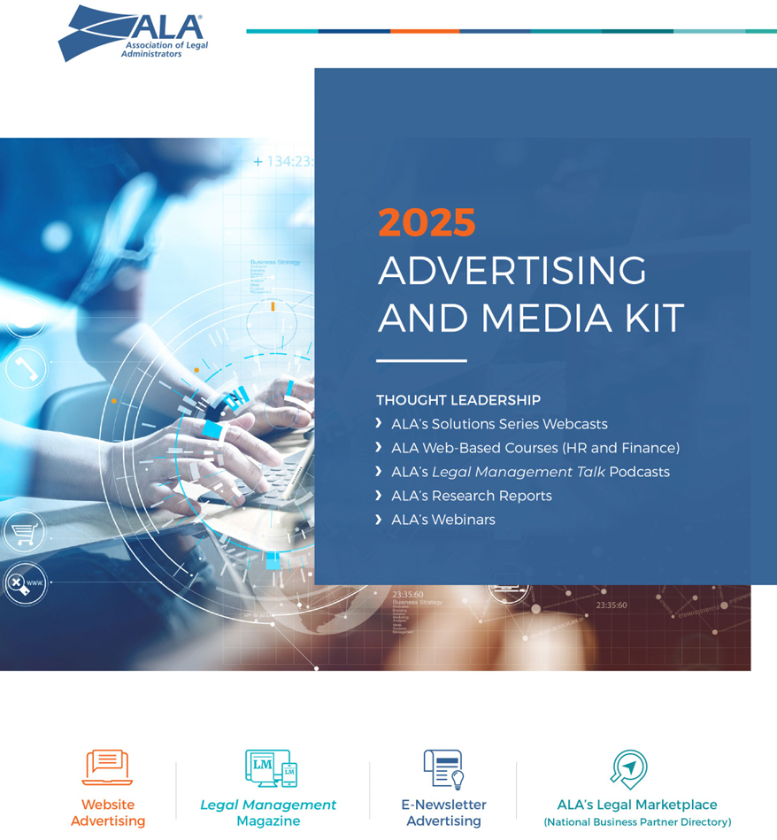
ALA Business Partners (BPs) Looking to the future…
Newly redesigned ALA Media Kit for 2025 featuring new innovative ways BPs can reach and engage the ALA community.
New ways BPs can align their brand with ALA content/ thought leadership.
Podcasts
Webinars
White Papers
Web based courses (HR and Finance)
New E-news letter Legal Lineup (sold out for 2025)
ALA’s Career Center and Career Connect E-news letter

Slide 29
ALA Business Partners (BPs) Looking to the future…
Focus on BP engagement and using quantitative and qualitative data to make better informed decisions.
The BP engagement program will encompass
BP engagement survey (Launched Feb., 2025)
BP focus groups after each live national event
Tracking and analysis of each BP’s engagement score base on event activity, marketing with ALA, content and speaking contributions, local chapter participation and more.
The BP engagement program will allow us to strengthen our BP relationships, produce better marketing channels, enhance our understanding of their business needs and objectives and how they want to engage with the ALA community.

Slide 30
ALA Business Partners (BPs) What can ALA leaders do to foster engagement
Attend ALA and BP events both on the chapter and national level. (Show up and be interactive)
Bring someone new to ALA events. (Tell your friends and colleagues)
Be active on social media. (Post, comment, and share)
Introduce yourself to ALA BPs. (Start a conversation and be interested)
Utilize BP’s as resources. (They have great content and thought leadership)
Be active of our online community (tradewing) sharing BP experiences.
Refer any prospective new BP’s to Fred Ullman and or local chapter BP liaisons.
Thank our BP’s for supporting ALA and our programs. (We can never thank them enough)

Slide 31
Thank you for all you do to support ALA and each other!

Slide 33
ALA Member Engagement
Kristin Bertsatos
ALA Association Leadership Institute
March 8, 2025

Slide 34
ALA Member Engagement 2024
All members pre-2024 overall average engagement score:
Q1 = 1.692
Average # of virtual meetings attended: .299
Average # of posts & comments in the online community: 1.557
Q2 = 1.731
Average # of virtual meetings attended: .345
Average # of posts & comments in the online community: 1.572
Q3 = 1.738
Average # of virtual meetings attended: .326
Average # of posts & comments in the online community: 1.6
*For the 1/1/2024-9/30/2024 period

Slide 35
ALA Member Engagement 2024
Members who joined prior to 2024
All members pre-2024 overall average engagement score: 1.728 (7,749 members)
Average # of virtual meetings attended: .276
Average # of posts & comments in the online community: 1.566
Individual members overall average engagement score: 1.983 (4,747 members)
Average # of virtual meetings attended: .319
Average # of posts & comments in the online community: 1.899
Organizational members overall average engagement score: 1.324 (3,002 members)
Average # of virtual meetings attended: .209
Average # of posts & comments in the online community: 1.041
*For the 1/1/2024-12/31/2024 period

Slide 36
ALA Member Engagement 2024
All members who joined in 2024 have an overall average engagement score:
Q1 = .285
Average # of virtual meetings attended: .066
Average # of posts & comments in the online community: .376
Q2 = .428
Average # of virtual meetings attended: .139
Average # of posts & comments in the online community: .565
Q3 = .522
Average # of virtual meetings attended: .254
Average # of posts & comments in the online community: .737
*For the 1/1/2024-9/30/2024 period

Slide 37
ALA Member Engagement 2024
Members who joined in 2024 (& early 2025)
All members who joined in 2024 (and early 2025) have an overall average engagement score: .551 (1,468 members)
Average # of virtual meetings attended: .264
Average # of posts & comments in the online community: .926
Individual members overall average engagement score: .739 (860 members)
Average # of virtual meetings attended: .362
Average # of posts & comments in the online community: 1.4
Organizational members overall average engagement score: .287 (608 members)
Average # of virtual meetings attended: .125
Average # of posts & comments in the online community: .258
*For the 1/1/24-12/31/24 period

Slide 38
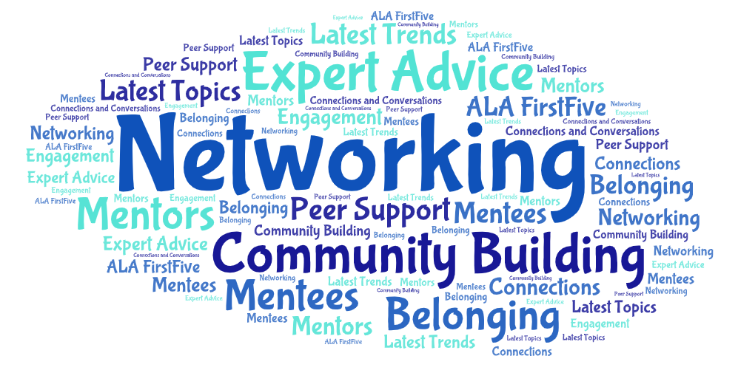

Slide 39
How Can I Help?
How can this add to a member’s experience?
How can this add to a member’s overall value?

Slide 40
Membership Segmentation
Mike Donovan
ALA Association Leadership Institute
March 8, 2025

Slide 41
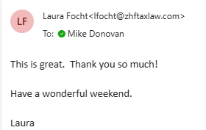
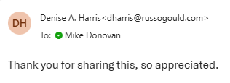
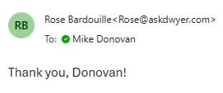
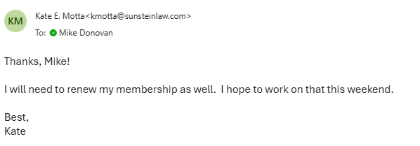
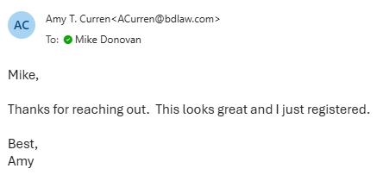
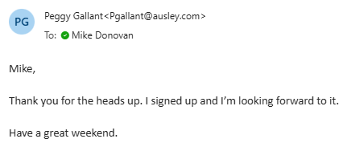
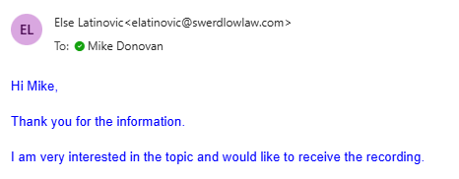
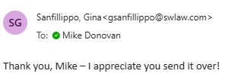
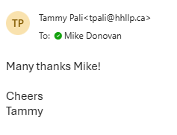
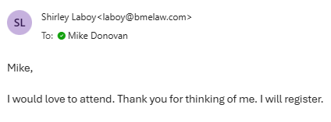

Slide 42
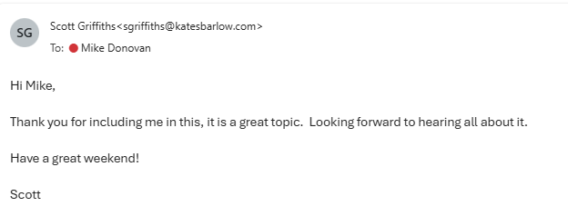

Slide 47
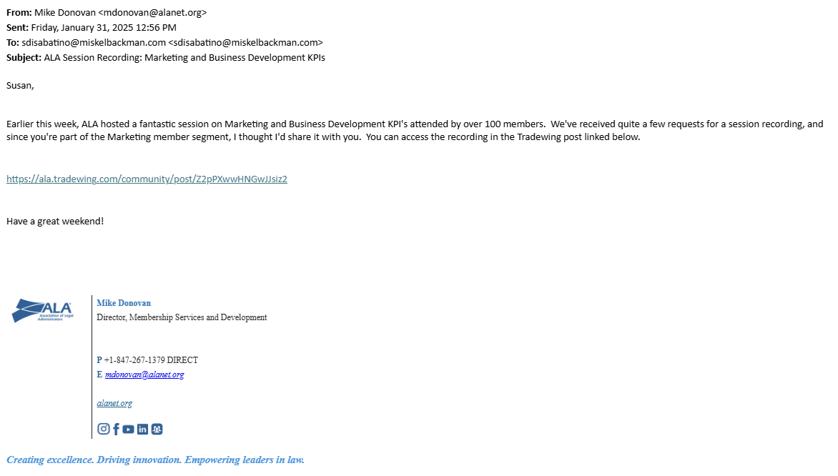

Slide 48
Personalization matters.

Slide 50
Members in Segments vs No Segment
As of February 27, 2,572 ALA members have placed themselves in one or more member segments
Average Engagement Score
Members in Segments: 2.15
Members with no Segment Selected: 1.32
Higher engagement means:
More participation
More participation data
ALA learns more about you as a member
ALA is able to further personalize the member experience

Slide 51
How can I help?
Be sure you and your committee members have selected member segments
Encourage ALA members to select member segments if they haven’t already
Keep member segments and definitions in mind when developing programs, products and events

Slide 52
Fonteva Association Management System
Mike Donovan
ALA Association Leadership Institute
March 8, 2025

Slide 53
ALA has selected Fonteva as its next Association Management System
Enhanced member experience
Data-driven decision making
Improved communication and engagement

Slide 54
How can I help?
Anticipated go-live: early Q2 2026
Log in, become familiar with member portal, profile updates, event registrations and overall layout
Advocate for the system!

