Slide 1
Tools for the Climb:
Charters
Plans of Work
Understanding the Roles of Group Members & Liaisons

Slide 2
Charters
What they are
Where to find them
Setting your goals
https://www.alanet.org/membership/volunteer-at-ala

Slide 3
Plans of Work
PLANNING
An intelligent plan is the first step to success. The man who plans knows where he is going, knows what progress he is making and has a pretty good idea when he will arrive. Planning is the open road to your destination. If you don’t know where you are going, how can you expect to get there?
Basil S. Walsh

Slide 4
What is an ALA Group’s Plan of Work?
It is an “annual statement of initiatives, projects and goals that support budgetary or other resource allocation.”
Groups focus their work on implementing Association strategy policy through their plan of work.

Slide 5
ALA’s Stratgeic Areas of Focus

Slide 6
Why Do Plans of Work?
Help define objectives and set realistic goals
Prioritize tasks
Identify potential issues or challenges
Framework for monitoring and evaluating progress
Foster collaboration and communication

Slide 7
The Fine Print
Plans are due annually for Committees and Advisory Councils.
Projects Teams do not complete Plans of Work.
Plans are submitted to the Board of Directors for review in the first quarter of the calendar year
Plans are presented in the Association’s standard template
Plans are prepared by the group Chair, in collaboration with the group’s Board and HQ liaisons
Plans take effect during the Annual Conference
Progress on the plan is reported to the Board twice a year, in July and December

Slide 8
Components of the Plan of Work
Identification of the group Chair/Vice Chair, Board liaison and HQ liaison
Group description
Details on how the work of the group aligns with the Association’s strategic plan and goals
Listing of the group’s key deliverables & KPI’s for the coming year
Resources needed to accomplish the plan
If applicable, information on collaboration efforts with other groups

Slide 9
Plan of Work Template

Slide 10
Plan of Work Template

Slide 11
Group Chairs, Vice Chairs & Team Members
Qualifications, Expectations & Responsibilities

Slide 12
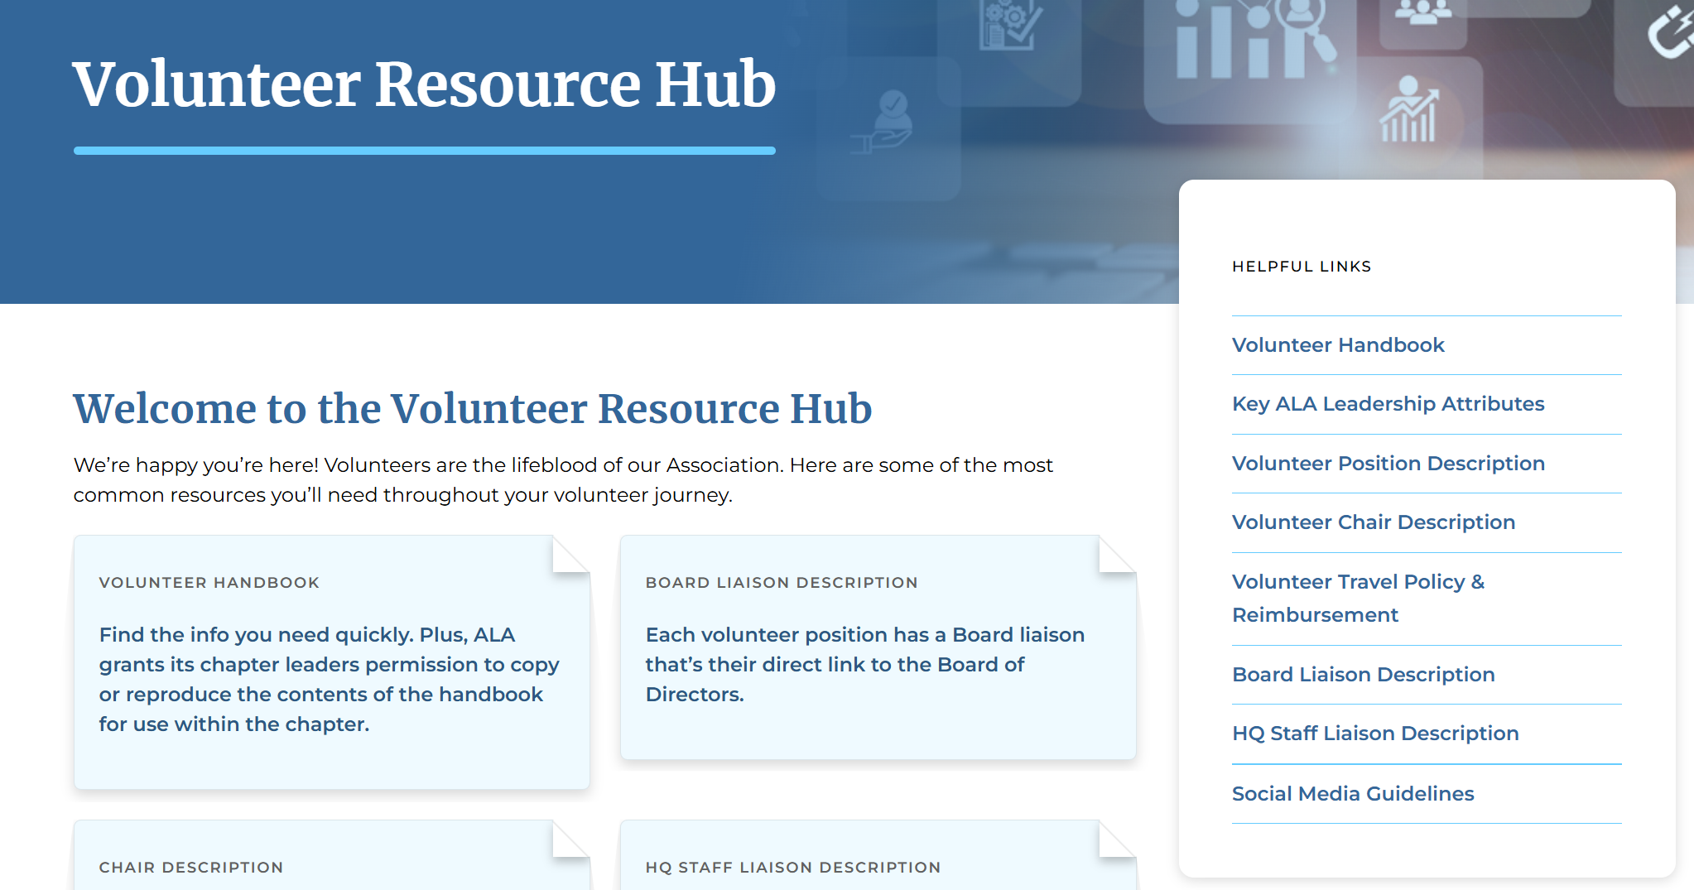

Slide 13
Qualifications & Expectations

Slide 14
Responsibilities
RESPONSIBILITIES – Chair
Develop and implement the Plan of Work, in collaboration with the group members and the liaisons
Report to the Board on progress in execution of the Plan of Work
Run organized, efficient meetings
Monitor group work between meetings
Serve as the conduit for information between the Board and the group
RESPONSIBILITIES – Team Member
Actively participate and contribute
Be prepared
Complete assignments
Represent the group as needed

Slide 15
Board Liaisons https://www.alanet.org/membership/volunteer-at-ala/volunteer-resource-hub/board-liaison-description
Ensure
Ensure that committee/team efforts are and remain aligned with the mission, goals and strategies of ALA and the committee/team’s approved Plan of Work.
Present
Present recommendations and actions to the Board of Directors through Committee Chair and ALA staff for agenda development. Agreement with committee actions is not required.
Serve
Serve as an interpreter to the committee on ALA policies and processes.
Ensure
Ensure fiscal responsibility, working with the Staff Liaison and Committee Chair/Team Lead to ensure the committee/team works within approved budget and fiscal guidelines.
Counsel
Counsel with the Staff Liaison and Committee Chair/Team Lead to meet objectives or should problems occur, consult with the Executive Director and Board, as necessary.
Report
Report to the Staff Liaison and Committee Chair/Team Lead promptly actions of the Board affecting the committee.
Identify
Identify potential future leaders.

Slide 16
HQ Liaisons https://www.alanet.org/membership/volunteer-at-ala/volunteer-resource-hub/hq-staff-liaison-description
Serves as an informed resource person to a Committee Chair or Project Team Lead and members of the committee or project team but is not a member of the committee/team. Assist the Chair/Lead in facilitating committee/team discussions and activities that address the committee’s/team’s charge. Work with the Chair/Lead to ensure that all committee/team work is aligned with the mission, goals and strategies of ALA and the committee’s/team’s approved Plan of Work.
Provide
Provide thorough orientation for each new Chair/Lead and collaborate with the Chair/Lead to provide orientation for new and continuing committee/team members each year.
Work
Work with the Chair/Lead and committee/team members to develop a Plan of Work and budget that will allow the committee/team to effectively and efficiently discharge its responsibilities for the year.
Manage
Manage the committee budget. Ensure that reimbursement requests are processed in accordance with ALA’s Volunteer Travel Policy and in a timely manner.
Work
Work with the Chair/Team to develop agendas and conduct effective meetings.
Provide
Provide administrative support for planning and execution of all committee/team meetings.
Ensure
Ensure minutes of all committee/team meetings are drafted and submitted to the Chair/Team for review and approval. Retain copies of all minutes.
Work
Work with the Chair/Team, other committee/team members and ALA staff to ensure that the work of the committee/team is carried forth between meetings.
Facilitate
Facilitate communication of committee/team activities, including requests for action and/or proposed policies, to the Executive Director and Board of Directors.
Appropriate
Where appropriate, assist the committee/team in proposing products and projects that will further the goals and objectives of the Association.

Slide 17
Questions?

