Slide 1
Climb Higher: The Foundation of ALA’s Journey to the Next Summit
Kira Hansen, CLM – Foundation of ALA Vice President, 2024-2025
Association Leadership Institute, March 8, 2025

Slide 2
The Foundation of the Association of Legal Administrators is the Heart of ALA.
Our mission is to help educate, mentor and inspire current and future legal management professionals in inclusive ways that foster the development and increase awareness of the profession within the legal industry and our communities.

Slide 3
Who Are We?
We’ve got our mission, but who are the people making the journey on the Foundation of ALA this year?
Which way do we hike?
How will we know we’re on the right track?

Slide 4
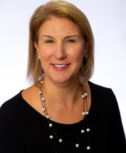
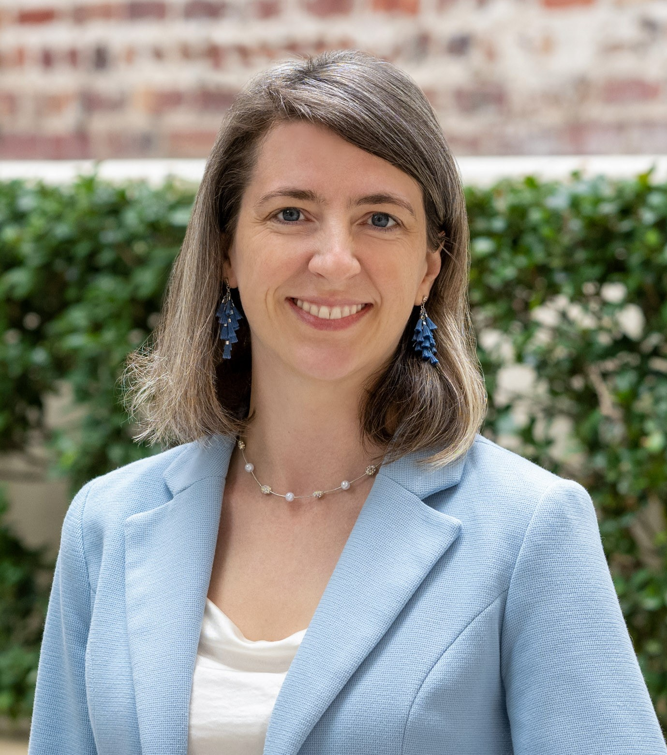
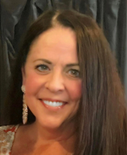
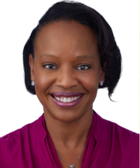
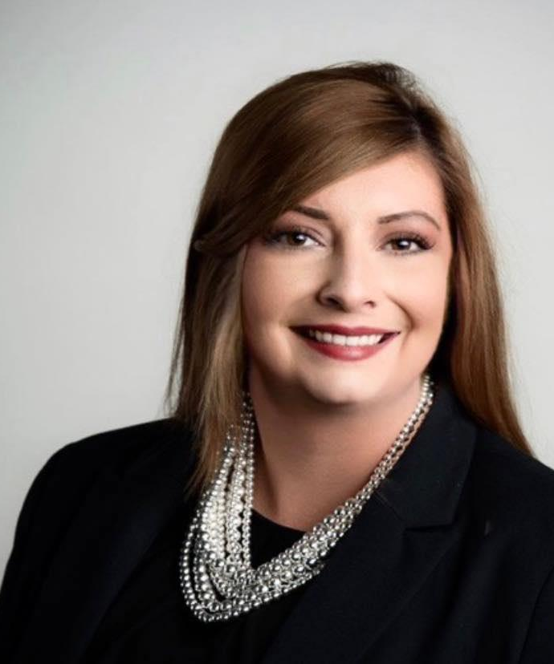
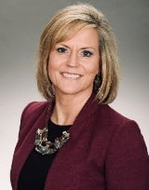
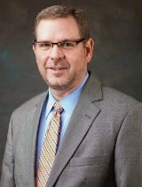
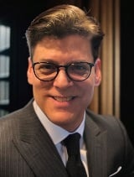
2024-2025 BOARD OF TRUSTEES
Kristie Lynn Manning, CLM, SHRM-CP
President
Kira L. Hansen, CLM
Vice President
Karen Michelle Beasley, PA
Eryn Carter, CAE
Executive Director
Emily C. Spehar
Julie S. Logan,
SPHR, SHRM-SCP
Travis C. Armstrong,
CLM, CPA
ALA President-Elect
Frederick J. Esposito, Jr.
CLM, MBA
Treasurer

Slide 5
Trustee Changes for 2025-2026
Thank you for your incredible service
To the Foundation of ALA, from 2021 to 2025, Kristie Manning!
The Foundation of ALA welcomes
Bill Davis to the Board of Trustees, 2025-2029
Kristie Lynn Manning, CLM, SHRM-CP
President

Slide 6
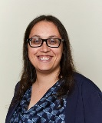
Trustee Changes for 2025-2026
Thank you for your support and advocacy for the Foundation of ALA this past year. We look forward to your leadership as the 2025-2026 ALA President!
We look forward to working together in the coming year, Elyssa Goldstein!
Travis C. Armstrong,
CLM, CPA 2024-2025
ALA President-Elect
Elyssa A. Goldstein, CLM, PHR, SHRM-CP
2025-2026 ALA President-Elect

Slide 7
Strategic Direction
Engagement Draw people into the Foundation to enhance their overall experience within ALA. | Impact Expand the value and scope of all initiative so the ALA community and other key audiences know who we are and what we do. | Endurance Shape and define a legacy that others will recognize and remember by honoring the past and celebrating the future.

Slide 8
Annual Report
In 2024, the Foundation released its first publicly available Annual Report that summarized and celebrated our achievements
This will be a tool of accountability as well as a communication tool for members and stakeholders

Slide 9
We’ve Come a Long Way Already
The last few years have seen incredible growth and maturity for the Foundation.
Let’s take a look at some of the initiatives that keep us motivated, as we move to the next base camp towards the summit.

Slide 10
Our Initiatives
Member Tribute Cards
Members can make a tax-deductible contribution to acknowledge a colleague/friend or to honor a loved one’s memory with a tribute card.
The recipient will receive a personalized card acknowledging the donation.

Slide 11
Our Initiatives
David W. Brezina Memorial Session
At Annual Conference, we sponsor a speaker who personifies the spirit of community, professional ethics, personal fortitude, and high personal standards of human civility that David represented.
This year’s speaker, Allison Massari, is presenting her signature session “Be the One: Cultivating Expansive Thinking and Radical Appreciation.”

Slide 12
Our Initiatives
Student Scholarship and Visibility
We believe that students are the future of our profession.
We offer scholarships for college and post-graduate students that have an interest in pursuing research or a career in legal management, including any role supporting the management functions in a law firm or legal service organization.
A mentor will be assigned to all scholarship recipients.
Awarded a total of $15,000 to two students in 2024; applications for 2025 have just been selected!

Slide 13
Our Initiatives
Susan L. French Emerging Leader Fellowship Program
Two-year fellowship developed to assist up to three ALA members who have a strong desire to enhance their personal and professional leadership skills.
Registration and travel stipend to CLI (1st and 2nd year in the Fellowship)
Leadership and mentorship coaching sessions
Fellows receive an assigned mentor in their first year and become mentors in their second year
2025 applications will open in April!

Slide 14
Our Initiatives
Growing Seeds
Last year we rejuvenated a former initiative originally geared towards chapters building internship programs.
Growing Seeds creates a program accessible and inclusive to all members, whether independent or belonging to a chapter.
Each year up to $1,000 will be awarded to chapters and members proposing new programs needing “seed” money.
In 2024, grants were awarded to the Arizona and Cyber chapters.
We hope to support even more great ideas in 2025!

Slide 15
Entering Uncharted Territory!

Slide 16
Our Initiatives
Corporate Donor Program
Our goal is to attract more corporate donors with a program that clearly outlines the benefits of supporting the Foundation while ensuring financial stability and greater access to unrestricted funds.
Our 2025 levels are:
Visionary ($15,000)
Champion ($10,000)
Advocate ($5,000)
Friend ($2,500)
Over a dozen donors have signed on for our first year of the program!

Slide 17
Our Initiatives
The Foundation Heart of ALA Award
Originally brainstormed at ALI 2023, this award recognizes one member of the ALA community who promotes and/or embodies the Foundation’s mission to educate, mentor and inspire people in inclusive ways.
Will be awarded during the Brezina Memorial Session at the 2025 Annual Conference to a member with outstanding community service in 2024 (service ALA of outside).

Slide 18
What Will Take Us to the Next Summit?

Slide 19
Communication Will Take Us to the Summit!
Communications Committee
We are integrating our communications more than ever, so ALA members can better understand and deepen their relationship with the Foundation of ALA.
Annual In-Person Meeting
It’s not all virtual! We now hold in-person Trustee meetings coinciding with Annual Conference to deepen relationships and foster an environment of collaboration.

Slide 20
Three Giving Campaigns
Fall Campaign
Traditional week-long giving campaign in September focused on uplifting the Foundation’s impact on ALA members
Raised $6,435 in 2024
Giving Tuesday
Participated in the national day of giving
Raised $775 in 2024
February Campaign
Branding awareness campaign where donors can guess the number of candy hearts in a jar for a prize
Raised $840 in 2024 and hope to raise $1,000 in 2025

Slide 21
Silent Auction
Held during Annual Conference, the silent auction is a major fundraiser for the Foundation
Held virtually, and anyone across the country can participate
Donations come primarily from chapters, business partners, and members
We will begin accepting donations mid-March!

