Slide 1
It’s Fun To Have Fun But You Have
To Know How:
Making the volunteer experience a fun and rewarding one!

Slide 2
What we’ll cover today, you simply can’t say nay.
Volunteer motivation
Volunteer environment
Recognition and Appreciation
Skills development and growth
Fun and engaging activities
Empowering volunteers
Overcoming challenges
Success stories

Slide 3

Ice Breaker

Slide 4
Why do we volunteer?
Oh, the reasons why…
  Gain professional experience
  Develop new skills
  Grow leadership skills
  To help people
  Make connections and build a professional network
  Give back to the organization
  Advocate for change
  Be a part of something bigger
  It’s FUN!

Slide 5
Quiz Question #1
Which Dr. Seuss character famously said, "Unless someone like you cares a whole awful lot, nothing is going to get better. It's not?”
  A) The Lorax
  B) Horton the Elephant
  C) The Cat in the Hat
  D) Sam-I-Am

Slide 6
Creating Positive Volunteer Environment
Horton Hears a “WE”
  Establish clear expectations
  Encourage regular communication
  Provide training & support
  Culture of belonging and respect
  Fostering social connections
  Recognize and reward

Slide 7
Quiz Question #2
"The more that you read, the more things you will know. The more that you learn, the more places you’ll go.”
  A) Mr. Brown
  B) Horton the Elephant
  C) The Cat in the Hat
  D) Fox in Socks

Slide 8
Recognition & Appreciation
Oh, the Thanks You’ll Get!
Recognizing volunteer contributions
Celebrating new and innovative ideas
Appreciate all contributions
Creative ways to say Thank you

Slide 9
Skills Development & Growth Opportunities
Oh, the Places You’ll Grow
Leadership development and training
Public speaking development
Flex your creative brain
Personal growth
Practice and develop social skills

Slide 10
Quiz Question #3
Which character proclaimed, "Why fit in when you were born to stand out"?
  A) Cindy Lou Who
  B) The Grinch
  C) Sam-I-Am
  D) The Cat in the Hat

Slide 11
Incorporating Fun & Engaging Activities
Horton’s Quest for Fun
Icebreakers
Gamification
Theme
Change it up
Use of technology to engage

Slide 12


Slide 13
Empowering Volunteers to make a Difference
Oh, the Places You’ll Lead
Highlight impact
Encourage Ownerships and initiative
Empowering volunteers to shine

Slide 14
Quiz Question #4
In which book do we find the phrase, "A person's a person, no matter how small"?
  A) "Oh, the Places You'll Go!"
  B) "Horton Hears a Who!"
  C) "The Sneetches and Other Stories"
  D) "The Lorax"

Slide 15
Overcoming Challenges
Oh, the Places You’ll Bounce Back From!
Addressing volunteer challenges:
  Communication | Role Clarity | Appreciation | Support & Guidance | Flexibility | Conflict Resolution | Feedback | Self-Care | Continuous Improvement |
  Monitor workloads | Empowerment |

Slide 16
Quiz Question #5
Who said, "Don't cry because it's over, smile because it happened"?
  A) Horton the Elephant
  B) The Grinch
  C) Thing One
  D) Dr. Seuss

Slide 17
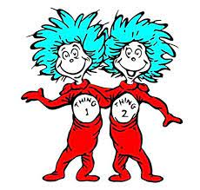
Oh, the Seeds we’ve Planted
Recap of our Whimsical Journey

Slide 18

Oh, the Answers We’ll Share!

Slide 19
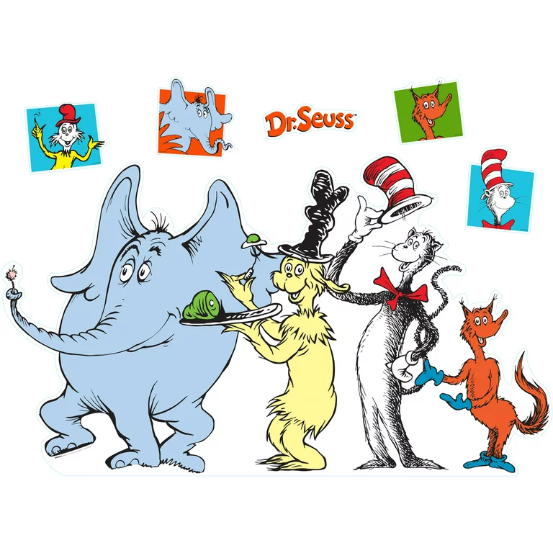
Answers to our Quiz

