Slide 1
ALI - 2024
Plan of Work & Committee Roles

Slide 2
PLANNING
An intelligent plan is the first step to success. The man who plans knows where he is going, knows what progress he is making and has a pretty good idea when he will arrive. Planning is the open road to your destination. If you don’t know where you are going, how can you expect to get there?
Basil S. Walsh

Slide 3
PLAN OF WORK
The ALA Way
What is an ALA Committee’s Plan of Work?
It is an “annual statement of initiatives, projects and goals that support budgetary or other resource allocation.”
Committees focus their work on implementing Association strategy policy through their plan of work.

Slide 5
WHY PLANS OF WORK?
Help define objectives and set realistic goals
Prioritize tasks
Identify potential issues or challenges
Framework for monitoring and evaluating progress
Foster collaboration and communication

Slide 6
THE FINE PRINT
Plans are due annually
They are submitted to the Board of Directors for review in the first quarter of the calendar year
They are presented in the Association’s standard template
They are prepared by the Chair of the committee, in collaboration with the committee’s Board and HQ liaisons
They take effect during the annual meeting of the Association – typically the Annual Conference
Progress on the plan is reported to the Board twice a year, in July and December

Slide 7
COMPONENTS OF THE PLAN OF WORK
Identification of the committee Chair, Board liaison and HQ liaison
Committee description
Details on how the work of the committee aligns with the Association’s strategic plan and goals
Listing of the committee’s key deliverables for the coming year
Resources needed to accomplish the plan
If applicable, information on other committees or project teams that this committee is/will be working with in the coming year
An explanation of the steps being taken by the committee to foster inclusivity

Slide 8
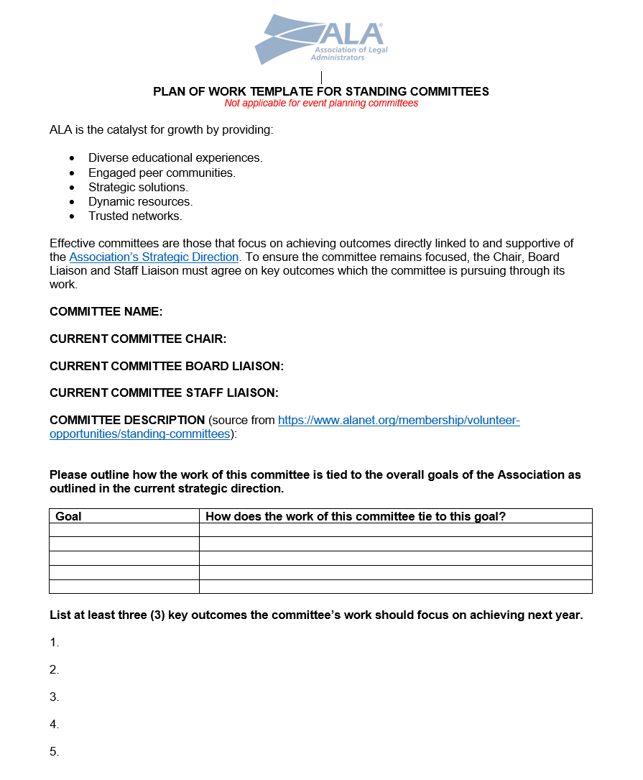

Slide 9
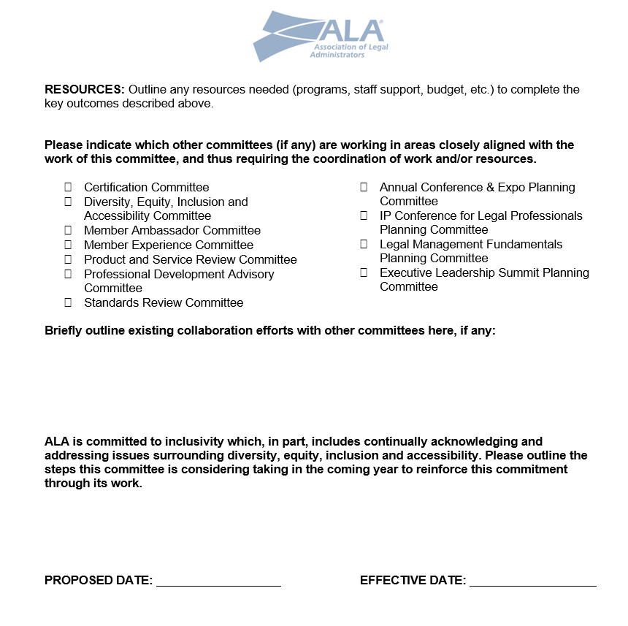

Slide 10
COMMITTEE CHAIRS
COMMITTEE TEAM MEMBERS
Qualifications, Expectations & Responsibilities

Slide 11
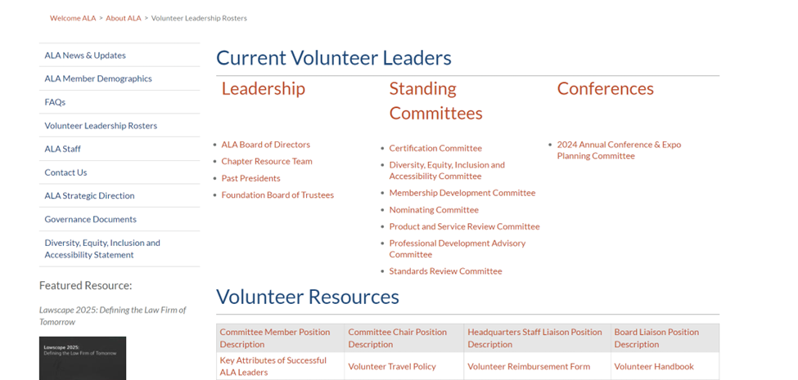

Slide 12
QUALIFICATIONS
Identical for Chairs and Members
Commitment
Communication Skills
Time/Energy
Knowledge
Good Citizen
EXPECTATIONS
Almost identical for Chairs and Members
High standards – decorum, dependability, service
Participation, coupled with firm support
Leadership attributes
Adherence to ALA’s Code of Ethics, Bylaws, Strategic Direction and Plan of Work

Slide 13
RESPONSIBILITIES – Committee Chair
Develop and implement the Plan of Work, in collaboration with the committee members and the liaisons
Report to the Board on progress in execution of the Plan of Work
Run organized, efficient meetings
Monitor committee work between meetings
Serve as the conduit for information between the Board and the committee
RESPONSIBILITIES – Committee Team Member
Actively participate and contribute
Be prepared
Complete assignments
Represent the committee, as needed

Slide 15
ALI - 2024
Committee Liaisons & Charters

Slide 16
COMMITTEE BOARD LIAISON
HEADQUARTERS STAFF LIAISON
Qualifications, Expectations & Responsibilities

Slide 17
WHO IS A BOARD LIAISON?
A Board Liaison is a member of the Board of Directors who is assigned to a committee or project team.
WHY A BOARD LIAISON?
The Board Liaison is the committee/team’s link to the Board of Directors.

Slide 18
THE ROLE OF THE BOARD LISISON
Ensure that committee/team efforts are and remain aligned with the mission, goals and strategies of ALA and the committee/team’s approved Plan of Work.
Present recommendations and actions to the Board of Directors through Committee Chair and ALA staff for agenda development. Agreement with committee actions is not required.
Serve as an interpreter to the committee on ALA policies and processes.
Ensure fiscal responsibility, working with the Staff Liaison and Committee Chair/Team Lead to ensure the committee/team works within approved budget and fiscal guidelines.

Slide 19
THE ROLE OF THE BOARD LIAISON (Continued)
Counsel with the Staff Liaison and Committee Chair/Team Lead to meet objectives or should problems occur, consult with the Executive Director and Board, as necessary.
Report to the Staff Liaison and Committee Chair/Team Lead promptly actions of the Board affecting the committee.
Identify potential future leaders.

Slide 20
WHO IS A STAFF LIAISON?
A member of headquarters staff who serves as an informed resource person to a Committee Chair or Project Team Lead and members of the committee or project team but is not a member of the committee/team..
WHY A STAFF LIAISON?
The Board Liaison assists the Chair/Lead in facilitating committee/team discussions and activities that address the committee’s/team’s charge. Work with the Chair/Lead to ensure that all committee/team’s work is aligned with the mission, goals and strategies of ALA and the committee’s/team’s approved Plan of Work.

Slide 21
THE ROLE OF THE STAFF LIAISON
Provide thorough orientation for each new Chair/Lead and collaborate with the Chair/Lead to provide orientation for new and continuing committee/team members each year.
Work with the Chair/Lead and committee/team members to develop a Plan of Work and budget that will allow the committee/team to effectively and efficiently discharge its responsibilities for the year.
Manage the committee budget. Ensure that reimbursement requests are processed in accordance with ALA’s Volunteer Travel Policy and in a timely manner.
Work with the Chair/Team to develop agendas and conduct effective meetings.
Provide administrative support for planning and execution of all committee/team meetings.

Slide 22
THE ROLE OF THE STAFF LIAISON (Continued)
Ensure minutes of all committee/team meetings are drafted and submitted to the Chair/Team for review and approval. Retain copies of all minutes.
Work with the Chair/Team, other committee/team members and ALA staff to ensure that the work of the committee/team is carried forth between meetings.
Facilitate communication of committee/team activities, including requests for action and/or proposed policies, to the Executive Director and Board of Directors.
Where appropriate, assist the committee/team in proposing products and projects that will further the goals and objectives of the Association.

Slide 23
WHAT IS A CHARTER?
A charter is a formal document describing the rights, aims, or principles of an organization or group of people.
Collins “COBUILD” Dictionary

Slide 24
WHY A COMMITTEE CHARTER?
You can get so confused
that you'll start in to race
down long wiggled rocks at a break-necking pace
and grind on for miles across weirdish wild space,
headed, I fear, toward a most useless place.
Oh, the Places You’ll Go!
Dr. Seuss

Slide 26
PROFESSIONAL DEVELOPMENT ADVISORY COMMITTEE – PDAC
Description: The Professional Development Advisory Committee (PDAC), in alignment with ALA’s Strategic Direction, provides recommendations for a broad range of professional development activities/initiatives, topics and educational content for ALA’s evolving membership, based on current and emerging trends in the legal industry. PDAC collaborates with ALA staff and other Standing Committees, as needed, to ensure that members ’ educational and professional development needs are being met through ALA ’s various resources and publications. Though PDAC guides the educational strategy, it is not directly responsible for developing content or identifying instructors or speakers for courses or conferences.

Slide 28
MEMBER AMBASSADOR COMMITTEE
Purpose:
This committee will recruit, onboard, assign, and evaluate the Ambassador program.
Expectations and Responsibilities:
Quarterly video roundtables to exchange ideas.
Regular video training of new Ambassadors.
Plan in-person gatherings for volunteers in the program.
Follow up on assignments to ensure connections are made.
Conduct annual surveys of Ambassadors and Mentees to continually improve the program.
Assist staff with exploring, defining, and creating a database to manage assignments and commitments.
Train ambassadors and assist ALA-designated staff with pairing experienced members with new members. In addition, ALA staff will be responsible for introducing, connecting, and maintaining the ambassador program.

